Slide 1
Unit 8 Topic 1
We will have a class fashion show.
Section D
WWW.PPT818.COM

Slide 2
Read through Sections A-C carefully and fill in the blanks with the correct words.
Grammar
so... that... …so that... such... that...
I liked it ____ much that my father bought it for me.
My old coats are_____ short that I want to buy some new ones.
I want to buy a windbreaker________ I will look great.
It's_______ a cool windbreaker _______ you should buy it at once.
so
so
so that
such
that

Slide 3
Functions
Shall we meet at the school gate at 8:00 a.m?
All _________.
Excuse me,_________ you tell me where to buy a scarf ?
What size do you take?
_________ M.
right
could
Size

Slide 4
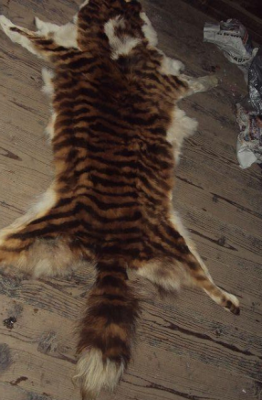
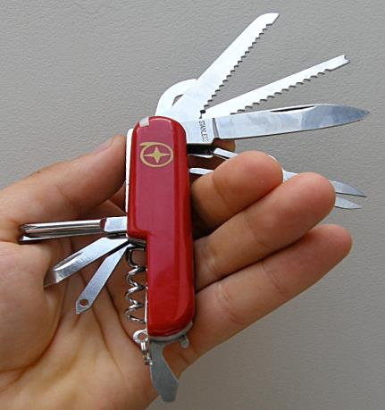
Talk about the pictures and learn some new words.
skin
n.皮，皮肤
function
n.作用，功能，职能
The tool has 16 kinds of functions.

Slide 5
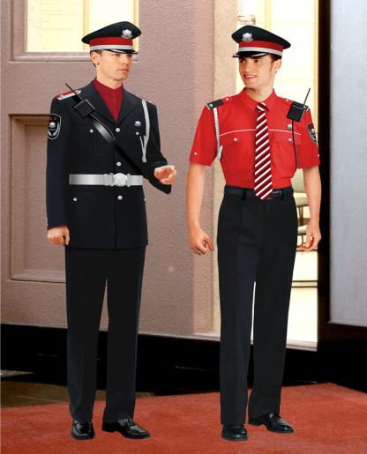
uniform
n.制服
The policemen are wearing uniforms.

Slide 6
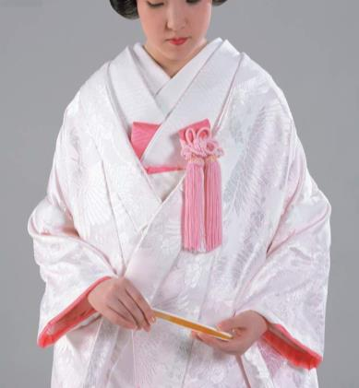
kimono
n.(日本的)和服
She is in a kimono,maybe she is Japanese.

Slide 7
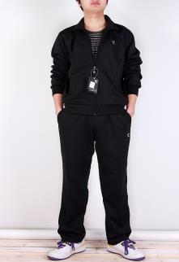
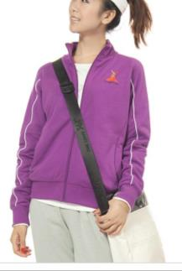
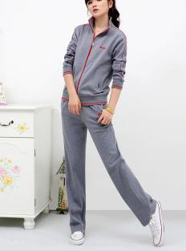
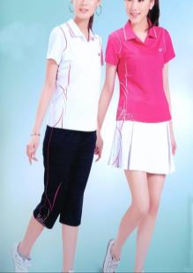
sportswear
n.运动服装
They like wearing sportswear,we may think they are active and like doing exercise.

Slide 8
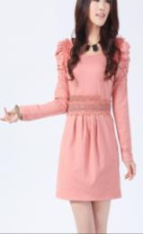
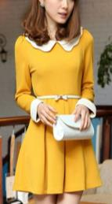
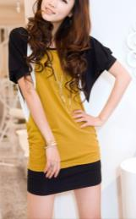
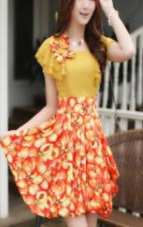
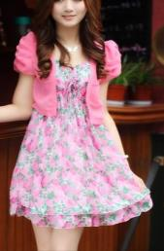
They like wearing yellow or pink clothes,maybe they are lively and easy-going.
adj.随和的

Slide 9
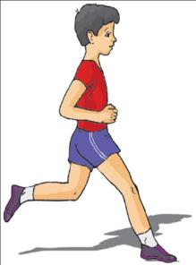
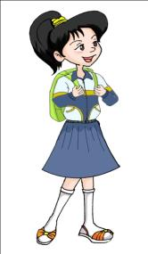
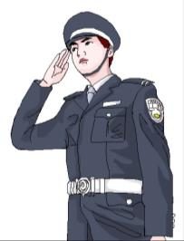
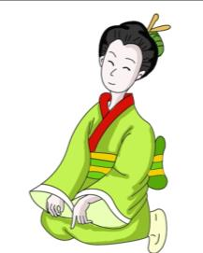
Look at the pictures and guess about the people based on what they wear. Then read and check your ideas.

Slide 10
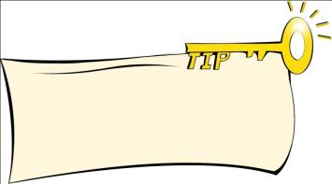
Read again and complete the following tasks.
1b
1.What does the passage mainly talk about?
A.The history of clothes. B.The functions of clothes.
C.The styles of clothes. D.The types of clothes.
2.Which of the following is true?
A.People wore the first types of clothes to show fashion.
B.Nowadays, clothes not only keep us warm.
C.Clothes can tell what your names are.
D.People almost wear the same kind of clothes now.
3.When we see a woman in a kimono,we might think she is ___________.
4.If a man always wears sportswear,we may think he is ________________________.
5.If a person always wears yellow clothes,maybe he or she is ___________________.
6.Work in groups and discuss the meanings of the following sentences.
1)Clothes can also show people our jobs,our culture,our hobbies and even our moods.
2)You are what you wear.
√
Finding key words of the question in the passage can help you to comprehend quickly.
√
Japanese
active and likes doing exercise
lively and easy-going
discuss v.讨论，谈论

Slide 11
The key points of 1a
1. The first types of clothes were made of animal skins.
be made of... 由......制成（从表面可看出原材料）
be made from... 由......制成（从表面看不出原材料）
E.g:这张桌子是由木头制成的。The desk is made of wood.
纸是由木材制成的。Paper is made from wood.
2. People started to wear clothes so that they could protect themselves from the sun, wind, rain and cold. 人们开始穿衣是为了免受日晒、风吹、雨淋和寒冷的侵袭。
(1)protect 意为“保护，防护”，其后可直接跟名词或代词。
E.g:We should learn to protect ourselves.我们应该学会保护自己。
(2)protect .... from ... 保护······不受······的危害
E.g:我会保护你不受周围一切的伤害。
I will protect you from everything around you.
3. But,nowadays, clothes do more than just keep us warm.
但是在当今，服装不仅仅是用来保暖的。
(1)more than 不只是 (2)keep +sb./sth.+adj.保持...
E.g:我们必须保持教室干净整洁。We must keep our classroom clean and tidy.
4. As the saying goes, “You are what you wear”.
正如俗语所讲：“衣如其人”。

Slide 12
Listen and follow.Then try to retell the passage with the help of key words.
The first types of clothes were made of animal skins. People started to wear clothes so that they could protect themselves from the sun, wind, rain and cold.
Today, we use different materials to make different kinds of clothes. But nowadays, clothes do more than just keep us warm. Clothing can also show people our jobs, our culture, our hobbies and even our moods. For example, when we see a man in a uniform, we can guess his job from the uniform. When we see a woman in a kimono, we may think that she is Japanese. If a man always wears sportswear, we may think he is active and likes doing exercise. If a person always wears yellow or pink clothes, maybe he or she is lively and easy-going. We get ideas about people from their clothes. As the saying goes, “You are what you wear.”
material n.材料；原料；素材

Slide 13
Retell the passage with the help of key words.
The first____________ animal skins. People started __________ so that _____protect________from_________________.
Today, we use___________________to make ________________. But,nowadays, ___________________________________. Clothing can also show____________________________________ and even _______. For example, ________________in a uniform, we can ____________________. When____________in a kimono, we may think _______________. If ________________sportswear, we may think _______________________. If _________________yellow or pink clothes, maybe ___________________________. We get ideas about people ___________.As the saying goes, “________________.”

Slide 14
Describe the clothes you are wearing today. The following questions may help you.
What are you wearing today?
What color/size ... are your clothes?
What materials are they made of?
What do you think of them?
Example:
I’m wearing a white T-shirt today. The size is M. It is made of cotton. My jeans are blue. They are made of cotton, too. I like this kind of white sports shoes. They are made of leather and they are size 37. My clothes are very comfortable. They make me active.

Slide 15
Project
Giving Suggestions on Dressing
1.Survey your classmates about their favorite clothes and fill in the table.
Name | Clothing | Color | Size | Material
Li Xing | T-shirt | white | M | cotton
2.Discuss whether your classmates' dressing is suitable or not. Give your suggestions.
3.Write a report and present it to the class.

Slide 16
Exercises in class
根据短文内容填空。
Lisa is fourteen years old.She likes to wear different kinds of _______. One day she went___________with her friends. They went into a new store. The clothes here are all made ______cotton. A pair of pants with two big pockets caught her eye. They looked very cool. But the pants were so expensive_______ she couldn't afford them. She felt very disappointed. When she got home,her mother told her that she ________some new clothes for her. She went into her own room and saw a pair of new ______ on the bed. In fact,the pants were the same style______the ones she saw in the store. She_______ them on and the pants fitted her well. She felt quite satisfied with them and said thanks _____her mom. ________happy she was !
clothes
shopping
of
that
bought
pants
as
tried
to
How

Slide 17
Summary
We learn:
1.Some new words:
skin,uniform,kimono,sportswear,easy-going,saying,material
function,discuss,be made of/from,protect...from...
2.To Review the usages of so...that... ,so that and such...that... .
I liked it so much that my father bought it for me.
My old coats are so short that I want to buy some new ones.
It’s such a cool windbreaker that you should buy it at once.
People started to wear clothes so that they could protect themselves from the sun, wind, rain and cold.
We can:
◆Learn some information from people’s clothes.
Clothes do more than just keep us warm.Clothing can also show people our jobs,our culture,our hobbies and even our moods.

Slide 18
Homework
1. Finish Section D in your workbook.
2. Review Topic 1 of Unit 8 and preview Section A of Topic 2.

Slide 19
Thank you

