Slide 1
Unit 3 A healthy diet
第4课时
WWW.PPT818.COM

Slide 2
Step1 Culture time

Slide 3
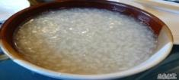
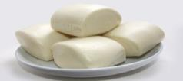
About me
Name | Breakfast | Lunch | Dinner
a little rice
some meat
a lot of
vegetables
a little rice
some fruit
a lot of
vegetables
Miss
Zhou
some porridge
steamed buns
Healthy!

Slide 4
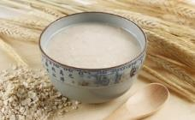
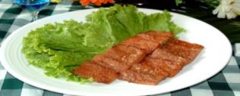
About her
Name | Breakfast | Lunch | Dinner
some milk
some fruit
a lot of
vegetables
some
roast beef,
potato
some cereal,
some bread
Healthy!

Slide 5
Culture time
Chinese people often have some porridge
and steamed buns for breakfast.
Western people often have cereal, bread,
eggs and sausages for breakfast.

Slide 6
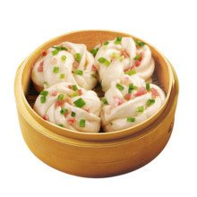
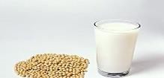
What else do Chinese people eat for breakfast?
steamed stuffed buns
noodles
steamed rolls
sesame seed buns
dumplings
pickles
deep-fried dough
soya bean milk

Slide 7
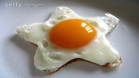
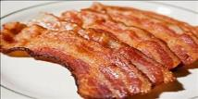
What else do Western people eat for breakfast?
fried egg
bacon
milk
juice
black tea
coffee

Slide 8
Breakfast like a king,
lunch like a prince,
dinner like a pauper.
早饭要吃好，午饭要吃饱，晚饭要吃少。

Slide 9
Step2 Presentation

Slide 10
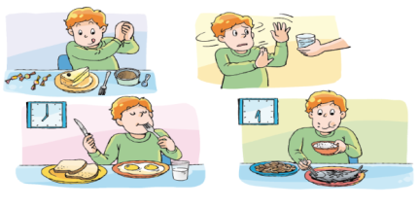
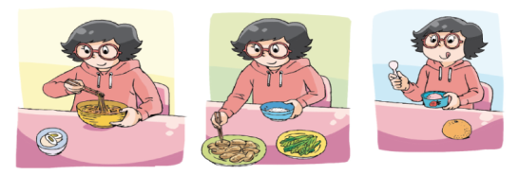
unhealthy
healthy

Slide 11
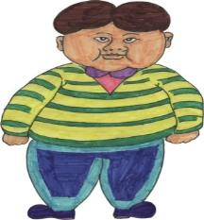
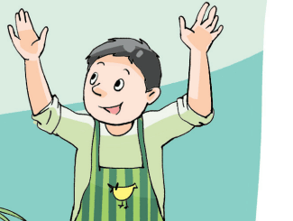
What are their diets?
Bill
Wang Bing

Slide 12
read it freely and discuss in pairs
自由读文章并同桌讨论Bill的 饮食是否健康
Bill is tall and fat.
He doesn’t have breakfast because he often gets up late.
He likes eating fast food. He usually has a hamburger,
some chips（薯条）, an apple pie and a glass of cola for lunch.
For dinner, he usually eats some beef（牛肉） and salad. He
likes sweet food, too. He eats a lot of sweets and ice cream
at a time.

Slide 13
disscuss in pairs
同桌讨论
Can you give some advice（建议） to him?
a lot of…
some…
To keep healthy, you should eat/drink
a few…
a little…
too much…
You shouldn’t eat / drink
too many…

Slide 14
What’s Wang Bing’s diet?
在第四课时中对学生能力的要求
要比前几课时更高，所以设计了
阅读和听力活动，培养学生综合
语言运用能力。
bread
porridge
For breakfast, Wang Bing usually has some_______, some_______
and an _________ .
For lunch, he eats some________, some________ and a lot of
__________ .
For dinner, he has some______, some __________ and some_______ .
egg
rice
meat
vegetables
rice
vegetables
soup
Tips: 在听时可以只记单词的首字母，
只要自己能看懂就行。

Slide 15
Step3
Checkout time
---- Ask and answer

Slide 16
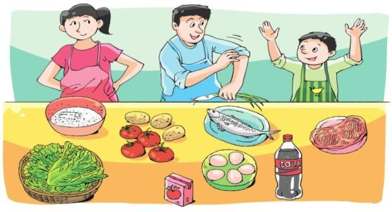
They want to cook a big dinner.
They buy many things in the supermarket.

Slide 17
food
drinks
Guess:
Is/Are there…?
要用上a lot of/ some (any)/ a few/ a little

Slide 18
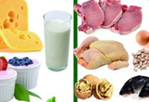
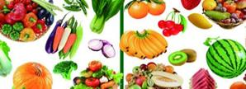
a little/a few
some
a lot of
a lot of

Slide 19
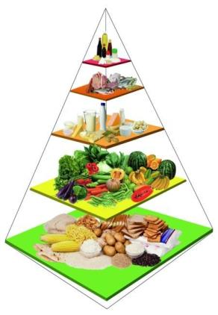
Look and say.
当一回讲解员,两人一组讲解膳食金字塔, 再次向大众普及一下膳食金字塔知识吧！
Don’t eat too much…
That’s bad for….
We can… some… They are
good for… They make us…
Eat a lot of… They keep us…
We should eat a lot of of…

Slide 20
Step3
Checkout time
---- Look and write

Slide 21
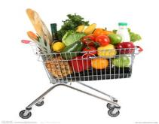
A: Where can you put the…?
B:I put it /them here, because…
a lot of
两人一组问答并贴图
a lot of
some
some
a little/few

Slide 22
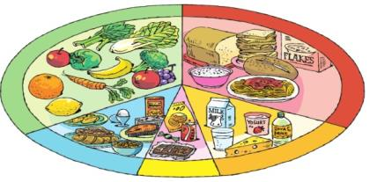
a few
a little
a lot of
some
a lot of
In a healthy diet, there is __________ fruit and vegetables.
There is also __________ rice and bread. You can have
__________ meat and fish in your meals. You can also have
__________ eggs everyweek. Milk is good for your body.
You can have __________ milk everyday. Sweet food is nice,
but it is not good for your teeth. Eat only__________ sweet
food every day.
a lot of
some
a few/some
some
a little

Slide 23
Step4
Design a healthy diet

Slide 24
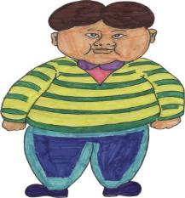
design（设计） a healthy diet for him

Slide 25
My healthy diet
Breakfast | Lunch | Dinner
some bread some milk an egg | some rice a lot of vegetables some fish an apple | a little noodles some meat a lot of fruit a little ice cream

Slide 26
Bill’s diet
Breakfast | Lunch | Dinner
Breakfast like a king,
lunch like a prince,
dinner like a pauper.
Tips:恰当地使用a lot of, some, a little, a few

Slide 27
I know the food and drinks in a
healthy diet.
I can use “a lot of", “some" ,etc.
I can write about something about
a healthy diet.
I’ve got _______ stars.

Slide 28
Homework
1、把你设计的Bill的健康饮食
写成一篇小短文。
2、对照Ticking time的要求自主复习。

