Slide 1
初中英语冀教版七年级
Unit 8 Countries around the World
Lesson 47: The U.K. and Australia
WWW.PPT818.COM

Slide 2
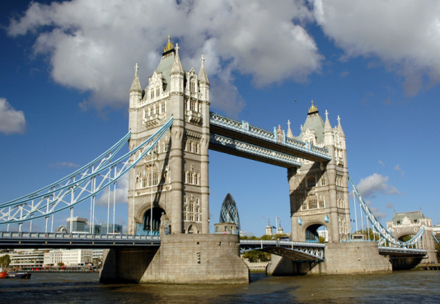
Warm up
Listen and enjoy a song.

Slide 3
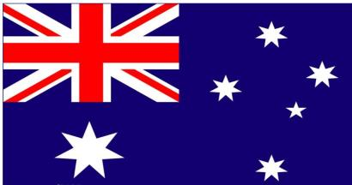
What do you know about the U.K. and Australia?

Slide 4
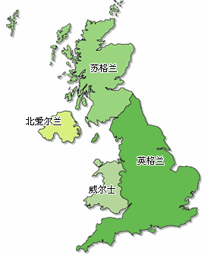
Presentation
What do you know about the U.K.?
1
This is a map of the U.K. People speak English there.
It is _____ of China.
The capital is ________.
west
London

Slide 5
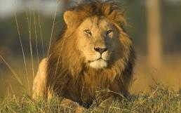
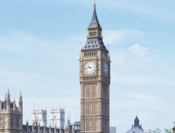
Here's the U.K's flag. It's red, _____
and _____. It has the same colours
as the flag of the U.S.
white
blue
This is a _______.
It's the U.K.'s national animal.
lion
This is Big Ben.
It is a famous clock _____ in London!
tower

Slide 6
Answer the questions:
1.What colour is the U.K.’s flag?
________________________________
2. What is the capital city of the U.K.?
________________________________
3. Is the U.K. south of China?
________________________________
4. What do they speak in the U.K.?
________________________________
It’s red, white and blue.
London.
No, it isn’t.
English.

Slide 7
Check your memory:
 | the U.K.
Capital
Language(s)
Location(位置)
National animal
Famous place(s)
London
English
west of China
lion
Big Ben

Slide 8
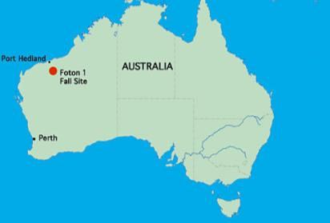
How much do you know about Australia?
2
Look at this map. This is Australia. It's ________ of China. And its capital is Canberra. People speak English in Australia.
southeast

Slide 9
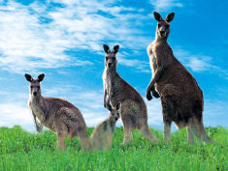
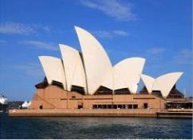
This is Australia's flag. It's blue
and the stars are ______. The little
flag in the corner is the U.K.'s flag.
white
The _________ is one of the national
animals of Australia.
kangaroo
The Sydney Opera House is a
building in Sydney. It's famous.

Slide 10
Check your memory:
 | Australia
Capital
Language(s)
Location(位置)
National animal
Famous place(s)
Canberra
English
southeast of China
kangaroo
Sydney Opera House

Slide 11
Retelling
capital
famous place(s)
Australia
language
national animal
the U.K.
location
flag

Slide 12
Language points
1. It has the same colors as the flag of the U.S.
the same ... as ... 的意思是“与……一样……”，反义词组为be different from (与……不同)。
例：
This shirt is the same price as that one.
这件衬衫和那一件的价格一样。

Slide 13
2. The kangaroo is one of the national animals of Australia.
“one of +可数名词复数”， 意为“……之一”，此结构做主语，谓语动词用单数。
例：
我最喜欢的学生之一是Tom.
One of my favourite ________ is Tom.
students

Slide 14
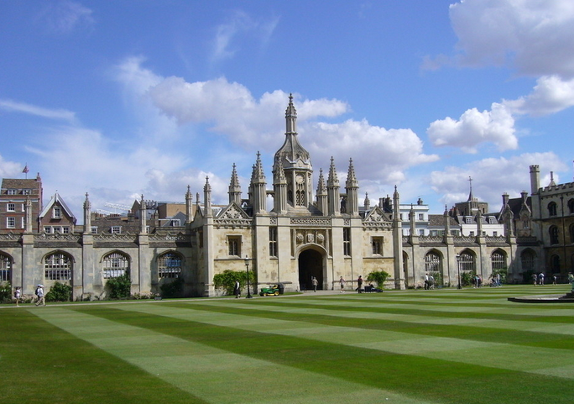
Cultural tips:
This is Oxford. This university is famous around the world.

Slide 15
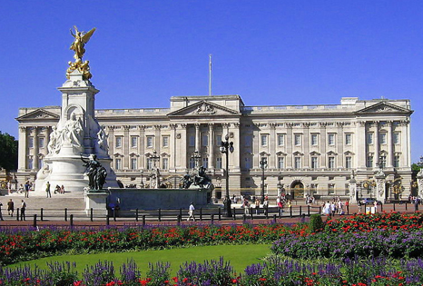
Buckingham Palace is in London. Kings and queens live here. It’s very famous in the world.

Slide 16
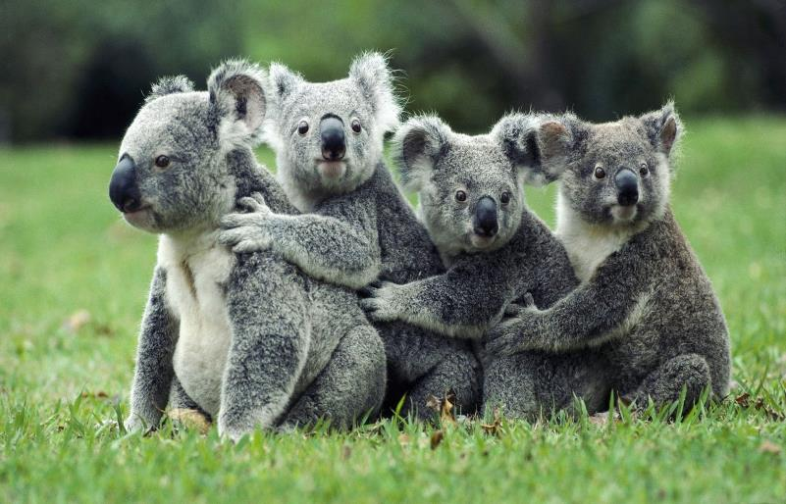
There are many Koalas in Australia.

Slide 17
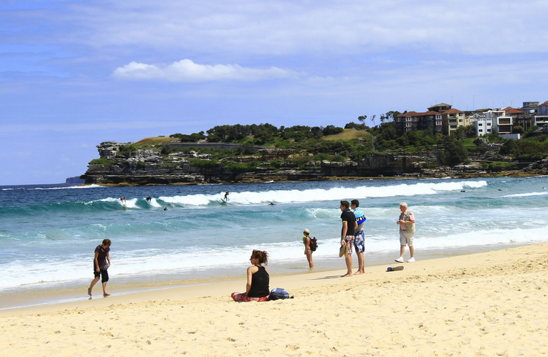
There are many beautiful beaches in Australia. People there enjoy surfing.（冲浪）

Slide 18
Exercise
选择填空。
1. _____ is famous in London. Visitors like to enjoy it.
A. The Great Wall B. The Sydney Opera House
C. Big Ben D. The Statue of Liberty
2. The flag of Australia is ______. The stars are ______.
A. white; blue B. blue; white
C. blue; red D. white; red

Slide 19
3. His pen is ____ mine.
A. same with B. same like C. same as D. the same as
4. Do you like the flag of ____?
A. the U. K.’s B. U. K.’s C. the U. K. D. U. K.
5. The kangaroo is one of ____ of Australia.
A. the national animal B. the national animals
C. a nationals animal D. a nationals animals

Slide 20
Homework
What else do you know about the U.K. and Australia?

