Slide 1
Unit 2
Neighbours
Integrated skills
WWW.PPT818.COM

Slide 2
Play a game.
Here are some riddles(谜语） for you. Tell me the name of the job.

Slide 3
doctor
help sick people
生病的

Slide 4
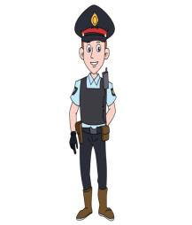
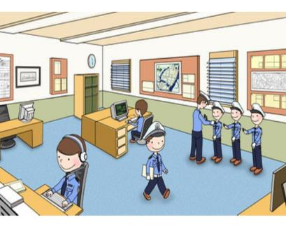
policeman
policemen
policewoman
policewomen
police station

Slide 5
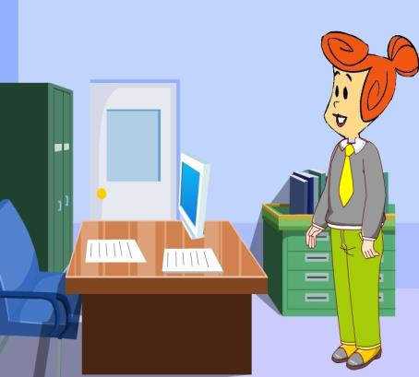
an office worker
company
/'kʌmpəni/
She works for a big company

Slide 6
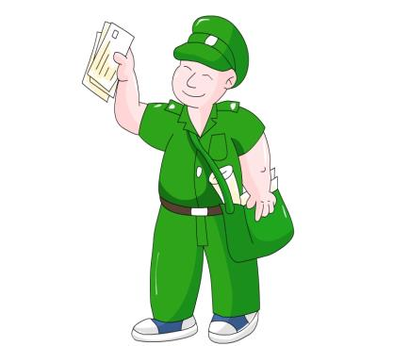
postman
two postmen
post office

Slide 7
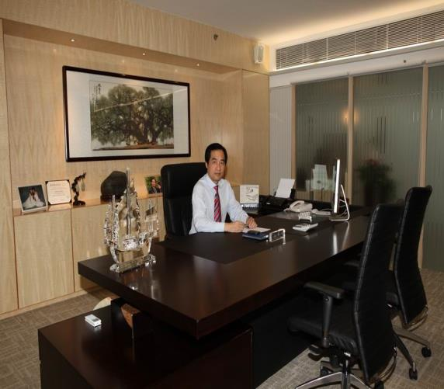
manager
/'mænIdʒə/

Slide 8
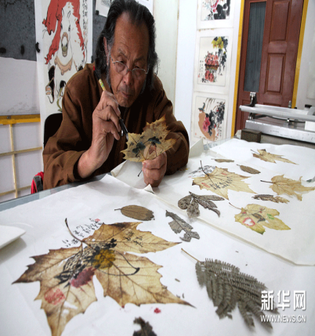
an artist

Slide 9
Listen and complete
Person | Job | Place
Wendy’s dad
Wendy’s mum
Wendy’s elder brother
Wendy’s elder sister
policeman
police station
manager
restaurant
postman
post office
office worker
company

Slide 10
Listen and answer
Where’s her father’s police station?
Where’s her mother’s restaurant?
Is her mother very busy?
How does her elder brother go to work?
5. How does her elder sister go to work?
It’s near her school.
It’s in the town centre.
Yes, she is.
He often goes to work by bike.
She goes to work by train.

Slide 11
Listen and complete
There are five people in Wendy’s family.
Her dad is a __________. He works in a ___________near her school. Sometimes he works ________.
Her mum works in a __________ in the town center. She is a ________, so she is always busy.
Her elder brother works in a __________. He is a _________. He often goes to work __________. He loves his job.
Her elder sister is an ____________. She works for a _____________ far away from her home, so she goes to work by train.
policeman
police station
at night
restaurant
manager
post office
postman
by bike
office worker
big company

Slide 12
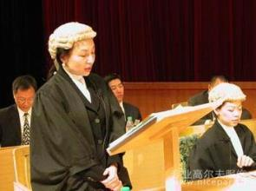
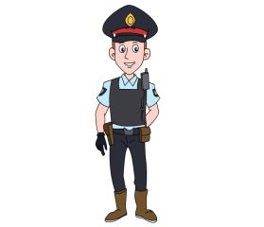
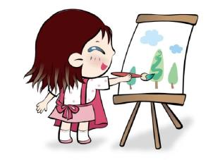
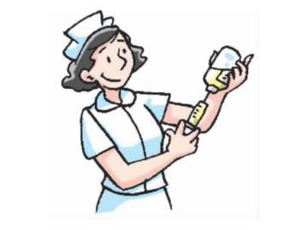
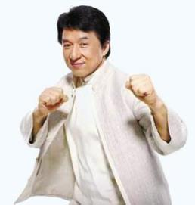
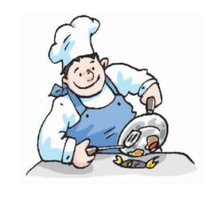

Slide 13
Listen and do the “True or False”
Daniel likes computers.
Millie is going to be a computer engineer.
Amy is going to be a doctor.
Sandy wants to help sick people.
Simon is going to be a basketball player.
T
F
T
F
F

Slide 14
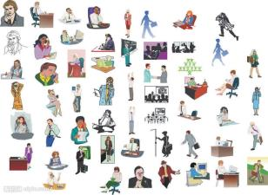
Pair work
The more, the better!
B: I … I’m going to be a … What about you ?
A: Hi,…What are you going to be in the future?
A: …
B: …
A: …
B: …

