Slide 1
Unit 7 How much are these socks?
Self Check
WWW.PPT818.COM

Slide 2
一、单项选择。
1.—______ is the bike?
—Just $50.
A．How much B．How many
C．How long D．How often
2．They always sell school things ______ very good prices in that store.
A．in B．for
C．at D．on

Slide 3
3．Those black ______ are ten dollars.
A．sweater B．a jacket
C．sock D．trousers
4．—Can I help you?
—______．
A．That's good B．OK.I'll take it
C．Yes，I'd like a sweater D．You're welcome
5．—How much ______ the two pairs of shoes?
—______ thirty dollars.
A．is，It's B．are，They're
C．are，It's D．is，They're

Slide 4
6．—What color ______ the shoes?
—______ brown.
A．is，It's B．are，It's
C．is，They're D．are，They're
7．—Do you think the ______ of his skirt suits(适合) me?
—Of course！You always look beautiful in red.
A．size B．color C．price D．design
8．—Is Jim in black shoes?
—Yes，______．
A．it is B．they are
C．he is D．she is

Slide 5
9．______ books are on the desk.
A．We B．They
C．Our D．He
10．There are many shoes ______ sale.
A．in B．at
C．on D．for
11．—Can I help you?
—I want______ for my two daughters.
A．two pair of shoes B．two pairs of shoe
C．two pair of shoe D．two pairs of shoes

Slide 6
12．This hat is too big.I want a ______ one.
A．long B．short
C．small D．nice
13．We have socks ______ white，black and red ______ only ￥2.
A．an，for B．in，for
C．for，in D．in，on

Slide 7
14．—I want to see the movie Iron Man 3(《钢铁3》)．Do you know the ______ of the ticket?
—Yes. Five dollars.
A．number B．price
C．kind D．name
15．—How much is ______ blue bag?
—It's $6.
A．a B．an
C．the D．/

Slide 8
二、词汇运用。
A)根据句意及汉语提示填写单词。
16．Tim's father buys a ________(毛衣) for Tim.
17．The red ______(短袜) are Lucy's cousin's.
18．Can you ______(来) to my home?
19．These _________(裤子) are 80 yuan.
20．What does this store _____(卖)?
sweater
socks
come
trousers
sell

Slide 9
B)看图，根据首字母提示写单词完成短文填空。
Hi，boys and girls！Come and 21.____ your clothes at our great sale. We 22.____ all our clothes at very good 23.______.We have a yellow jacket 24.____ only 22 . dollars Do you like the blue 25. ________？They are on sale for only 26.______ dollars. The shoes are 20 dollars.27.____ girls，we have skirts 28.___ yellow and blue for only 29. ________dollars.We have a red sweater. It's on 30.____ for 14 dollars. Please come to Beauty Clothes Store.
buy
sell
prices
for
trousers
fifteen
For
in
eighteen
sale

Slide 10
三、根据对话内容，从方框中选择恰当的句子补全对话，其中有一项多余。
A：Can I help you?
B：31.____ I want a sweater for my son.
A：We have sweaters in red and yellow.32.____
B：Yellow.
A：Here you are.
B：Oh，this sweater is too small.33.____
A：Yes. What about this one?
B：It's very nice.34.____
A：It's ten dollars.
E
F
D
B

Slide 11
B：OK. I'll take it.35.____
A：You're welcome.
A．Thank you.
B．How much is it?
C．What do you want to buy?
D．Do you have a big one?
E．Yes，please.
F．What color do you want?
A

Slide 12
四、完形填空。
Hi，boys and girls！Come 36. __ have a look at Huaxia Clothes Store！We 37. __ trousers for only $20.Do you like 38. __？We have sweaters 39. __ red，green and other colors.Each one is $15.For 40. __，we have skirts at a very good price—only $22！For boys，you can 41. __ sports shoes for only $12！The long T­shirts are on 42. __ for only $18 and the 43. __ ones are $10.
Come and buy 44. __ at Huaxia Clothes Store！You can 45. __ us at 564­6789 for more information(信息)．
B
A
C
B
B
B
C
B
A
C

Slide 13
36．A.but B．and C．only
37．A.sell B．like C．take
38．A.socks B．shorts C．sweaters
39．A.for B．in C．at
40．A.boys B．girls C．families
41．A.look B．buy C．help
42．A.list B．TV C．sale
43．A.small B．short C．big
44．A.clothes B．fruit C．vegetables
45．A.watch B．found C．call

Slide 14
五、阅读理解。
A
Come and buy clothes，furniture(家具) and things for school at Kelsey's big sale！We have shoes for boys for thirty­five dollars a pair，sweaters for girls for fifteen dollars each and bags for five dollars each!
See our nice dresses，beds and chairs.Get a new bookcase for all your books and notebooks.At Kelsey's big sale，a nice bookcase is only twenty dollars！And we have schoolbag，pencils，pens—everything for school！Come to Kelsey's Store today!

Slide 15
46．Kelsey's Store has shoes for ____．
A．boys B．girls
C．women D．teachers
47．Sweaters for girls are ____ each.
A．$5 B．$15
C．$20 D．$35
48．Bags are ____ each.
A．$35 B．$15
C．$20 D．$5
A
B
D

Slide 16
49．____ is $20.
A．A bookcase B．A book
C．A pen D．A notebook
50．Which of the following things can't you buy in Kelsey's Store？____
A．Clothes. B．School things.
C．Food. D．Furniture.
A
C

Slide 17
B
My name's Tina.Today the clothes at Beauty Clothes Store are on sale.So I want to buy some clothes for my grandparents，my parents and myself.Let me have a look.This yellow sweater is at a very good price—only 15 dollars.And it's OK for my grandfather.For my grandmother，I want to buy these black shoes.They're very comfortable(舒适)．How about this white T­shirt？Oh，my father can wear it for playing basketball.And there are many socks in green，yellow，black，blue，red and white.I know my mother likes red very much，so I will buy these red ones.I need trousers，too，so I will take these blue ones.

Slide 18
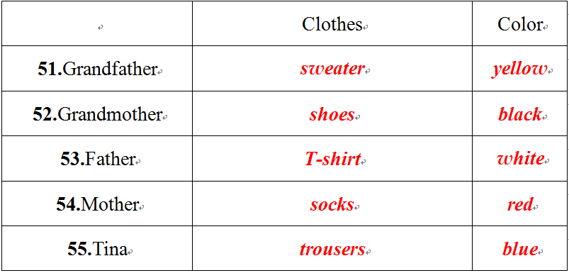
根据短文内容，完成表格。

