Slide 1
Unit 7
Do you want coffee or tea?
WWW.PPT818.COM

Slide 2
words learning
coffee 咖啡

Slide 3
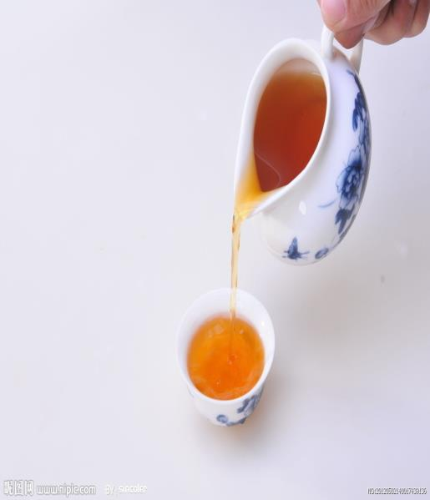
words learning
tea 茶

Slide 4
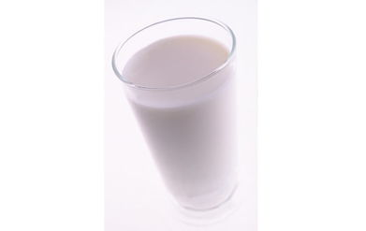
words learning
milk 牛奶

Slide 5
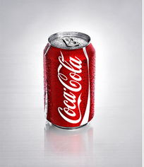
words learning
coke 可乐

Slide 6
words learning
juice 果汁

Slide 7
words learning
drink 喝；饮料
something 某事
cold 冷的
hot 热的
sure 确信

Slide 8
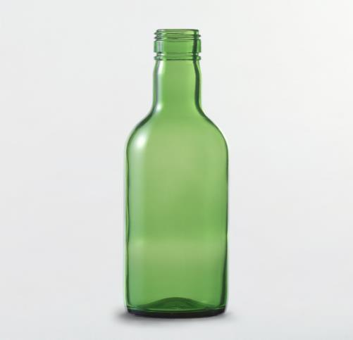
cup 杯
bottle 瓶子

Slide 9
glass 玻璃杯
can 罐

Slide 10
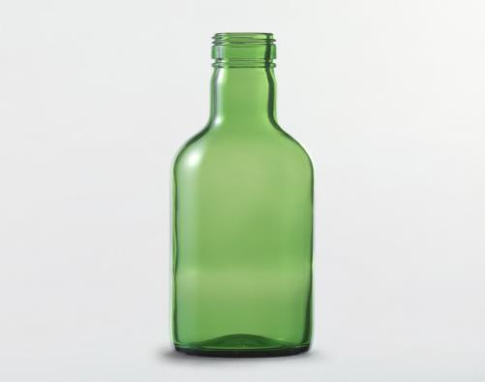
a cup of... 一杯......
a bottle of...
一瓶......

Slide 11
a glass of... 一杯......
a can of... 一罐......

Slide 12
根据图片写短语。
a bottle of juice
a glass of water
a cup of tea

Slide 13
根据图片写短语。
a box of milk
a can of coke

Slide 14
看图，根据句子意思和首字母提示，把句子补充完整。
1.I want to drink a b_____ of j_____ now.
2.Do you want a g_____ of w_____ now?
3.There is a b___ of m____ in the picture.
4.They drink a c___ of t____ every afternoon.
5.It’s hot. The girl wants to drink a c___ of c_____.

Slide 15
重点短语
1. drink ... For lunch 午餐喝......
2. tea with milk 奶茶
3. a bottle of juice 一瓶果汁
4. a glass of water 一杯水
5. a box of milk 一盒牛奶
6. a cup of tea 一杯茶
7. a can of coke 一罐可乐

Slide 16
课文翻译
【原文】Xiaoling: What do you want to drink for lunch?
【译文】Xiaoling: 午餐你想喝什么？
【原文】Ben: Uh... I think I will have a cup of tea with milk, thanks.
【译文】Ben:呃...... 我想我要喝一杯奶茶，多谢。
【原文】Xiaoling: And you, Janet? Do you want coffee or tea?
【译文】Xiaoling: 你呢，Janet？你喝咖啡还是茶？

Slide 17
课文翻译
【原文】Janet: Well. I want something cold. I feel very hot. Can I have a large coke, please?
【译文】Janet: 好吧。我想要一些冷的东西。我觉得很热。我能喝一个大杯的可乐吗？
【原文】Xiaoling: Sure.
【译文】Xiaoling: 当然可以。

Slide 18
课文翻译
【原文】Xiaoling: Can I please have a cup of tea with milk, a cup of coffee and a large coke?
【译文】Xiaoling: 请问，我能喝一杯奶茶、一杯咖啡以及一个大杯的可乐吗？
【原文】Cashier: Here you are. The coffee is ¥2.5, the milk tea and the coke are ¥3 each. That will be ¥8.5, please.
【译文】Cashier: 给你。咖啡是2.5元，奶茶和咖啡3元一杯，一共8.5元。
【原文】Xiaoling: Thanks very much.
【译文】Xiaoling: 多谢了。

Slide 19
课内阅读。
1. It is time for______.
A. breakfast B. dinner C. lunch
2. Ben wants to have a cup of______ for lunch.
A. coffee with milk B. tea with milk C. tea with juice
3. Janet wants to have______.
A. a large hot coke B. a small cold coke C. a large cold coke
4. A cup of coffee is______.
A. two and a half yuan B. three yuan C. eight and half yuan
5. Xiaoling gives the cashier ______.
A. five yuan and half B. eight and a half yuan C. three and a half yuan

Slide 20
课文讲解
区别“招呼客人”和“客人询问”的不同用语。
1.店主招呼客人：What do you want for lunch? Do you want coffee or tea?
客人回答：I want a cup of tea.
2. 客人询问：Can I have a large coke, please?
店主回答：Sure./ Here you are.
英语中价格的读法。（注意小数点的读法）
¥3 读作：three yuan ¥2.50 读作：two point five yuan / two and a half yuan

Slide 21
重点句型
区别“What do you want to drink for breakfast？”和“Do you want to drink coffee？”在意义和用法上的不同。
特殊疑问句：—What do you want to drink for breakfast？
—I want to have some milk.
一般疑问句：Do you want to drink coffee？
肯定回答：Yes，I do. / Please. / Sure.
否定回答：No, I don’t.
口诀：用do问，用do答。用what问，按实际答。

Slide 22
完成课本40页1.2题
完成学评33页第2题。

