Slide 1
Unit 6
Keep our city clean！
第二课时
WWW.PPT818.COM

Slide 2
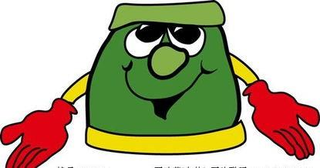
Introduce
What makes the air dirty? ……makes……
What can we do to keep our city clean? We can ……

Slide 3
Expressions
What makes the air dirty？
什么使空气变脏?
“What makes”意思是“什么使···变得” 。
当特殊疑问词做主语成分时，后面的动词要加“s”或“es”。
eg ： Who makes us laugh happily?
谁使我们笑得如此开心？

Slide 4
Expressions
小练习 : There are some _____(sign) of our school.
What ______(make) our house clean?
What can you do _______(help) your friends?
Li Yang can_____(speak) English very quickly.
signs
makes
to help
speak

Slide 5
Expressions
What can we do to keep our school clean?
我们可以做什么让我们的学校更干净？
情态动词 can意思是“可以,能够” ,表示一种能力。
它的用法是后面接动词原形。
否定形式是 cannot,可以缩写为can’t,意思为“不能,不可以”。
eg: We can take taxi to the cinema.
我们可以乘出租车去电影院。

Slide 6
Expressions
小练习 : 1.Is the city clean?
2.Smoke from factory makes the air dirty. (对划线部分进行提问)
3.We can ride a bike to the park.(同义句转换)
We can go to the park _______.
No， it isn’t.
What from factory makes the air dirty？
by bike

Slide 7
Dialogues
Make conversations with your classmates.
Using:
What makes the air dirty? ···makes···
What can we do to keep our city clean? We can ···

Slide 8
Expand
二十四节气 The 24 Solar Terms
立春：spring begins
雨水：the rains
惊蛰：insects awaken
春分：vernal Equinox
清明：clear and bright
谷雨：grain rain
立夏：summer begins
小满：grain buds
芒种：grain in ear
夏至：summer solstice
小暑：slight heat
大暑：great hear

Slide 9
Expand
二十四节气 The 24 Solar Terms
立秋：autumn begins
处暑：stopping the heat
白露：white dews
秋分：autumn equinox
寒露：cold dews
霜降：hoar-frost falls
立冬：winter begins
小雪：light snow
大雪：heavy snow
冬至：winter solstice
小寒：slight cold
大寒：great cold

Slide 10
Summary
What makes···?
What can we do to···?

Slide 11
Exercise
( )1.Rubbish makes the park .
A. beautiful B. dirty C. clean
( )2.We put the rubbish on the floor.
A. can B. should C. can’t
B
C

Slide 12
Exercise
( )3.We can plant more trees the air clean.
A. to keep B. keeps C. keep
( )4.Let’s move the box from the desk.
A. to B. away C. around
A
B

Slide 13
Exercise
5.Can we keep our city clean?（改为陈述句）
______________________________
6.It means “No swimming”.（改为同义句）
________________________________
We can keep our city clean.
It means you shouldn’t swim here.

Slide 14
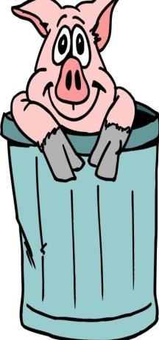
Homework
Make up a conversation.
Using:
What makes the air dirty? ···makes···
What can we do to keep our city clean? We can ···

