Slide 1
Unit 5 Topic 2
He is really the pride of China.
Section D
WWW.PPT818.COM

Slide 2
Report one famous man who has influenced you a lot to the class.
S₁: I think he’s Confucius. Because he was
a thinker who had great influences on
Chinese education. He was also a
famous philosopher whose wise
sayings have influenced many people
in different countries.
S₂: I think he’s Qian Xuesen. Because he
was a scientist who was honored as
“The Father of China’s Missiles”.
S₃: …

Slide 3
Discuss the sayings:
1. He who learns but does not think is lost; he who
thinks but does not learn is in danger.
2. When I walk along with two others, I may be
able to learn from them.
3. What you know, you know; what you don’t know,
you don’t know.
4. Learn the new while reviewing the old.
5. Isn’t it a pleasure that friends come to see you
from far away?
6. Do not do to others what you would not have
them do to you.
7. My career is in China, my success is in China
and my destination is in China.
8. My family name is Qian, but I don’t like qian.

Slide 4
Read through Sections A-C and choose the correct words in Grammar.
Attributive clauses
(Ⅲ)
1. Confucius was a great thinker (which/that/who) had many wise ideas about human nature and behavior.
2. He was a Ming dynasty explorer (which/who/whom) we Chinese people are proud of.
3. Confucius was also a famous philosopher (which/that/who/whose) wise sayings have influenced many people in different countries.

Slide 5
Translate the sentences in Functions into Chinese.
Functions
Could you tell me more about him?
你能告诉我更多关于他的情况吗？
It’s hard to believe!
真是让人难以相信!
What a great explorer!
多么伟大的探险家啊!

Slide 6
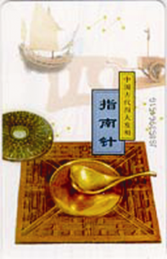
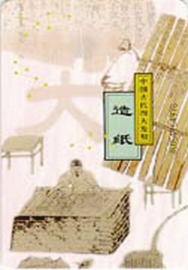
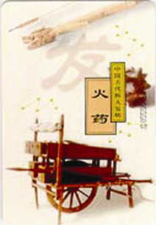
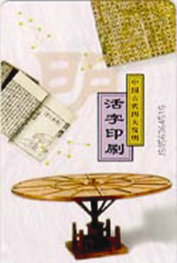
How much do you know about the Four Great Inventions of ancient China?

Slide 7
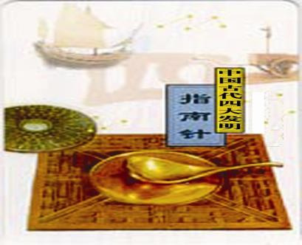
n.水手，海员
n.发现
Sailors made many discoveries with the help of compass.

Slide 8
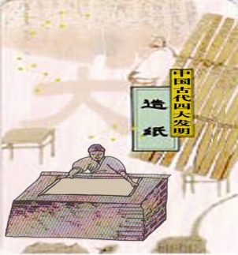
Paper-making was developed in the Eastern Han dynasty by Cai Lun.
adj.东方的

Slide 9
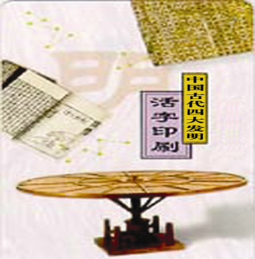
Bi Sheng carved characters on pieces of clay or wood, and then brushed ink on them, and developed printing.
n.粘土
n.墨水

Slide 10
Fireworks are made from gunpowder.
n.烟花
n.火药

Slide 11
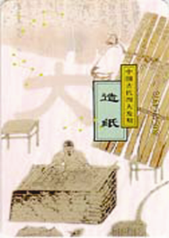
Look at the pictures and match the Four Great Inventions of ancient China with them.
1a
A. gunpowder B. printing
C. paper-making D. compass
D
C
A
B

Slide 12
Fill in the blanks with the names of the Four Great Inventions.
1a
A. gunpowder B. printing
C. paper-making D. compass
___________ It was a great gift to the world from
ancient China. Before it was invented, sailors had to
depend on the star to find the right direction. After
it was invented, the oceans were open to sail. And
many discoveries were made with its help.
compass

Slide 13
Fill in the blanks with the names of the Four Great Inventions.
1a
A. gunpowder B. printing
C. paper-making D. compass
___________ It is one of the greatest inventions. It is
said that in the 3rd century a Chinese man wrote
about how to make it. At first, it was used for making
fireworks. At the end of the Tang dynasty, people
began to use it in wars. The method of making it was
brought to the Arab world and Europe in the 13th and
14th centuries.
gunpowder

Slide 14
Fill in the blanks with the names of the Four Great Inventions.
1a
A. gunpowder B. printing
C. paper-making D. compass
______________ Before it was invented, the ancient
Chinese carved characters on animal bones and
stones. China was the first country in the world to
make it. During the Western Han dynasty, it was
made in some places in China, and was developed in
the Eastern Han dynasty by Cai Lun. He made it with
bark, ropes and rags.
paper-making

Slide 15
Fill in the blanks with the names of the Four Great Inventions.
1a
A. gunpowder B. printing
C. paper-making D. compass
___________ It was developed in the Song dynasty by Bi Sheng. He carved characters on pieces of clay or wood, and then brushed ink on them. After the characters were printed on paper, the pieces of clay or wood could be used again. Later this technology spread to Korea, Japan and Europe. It was the basic method used at that time.
printing

Slide 16
1b Read 1a and answer the following questions.
____________ It was a great gift to the world from ancient
China. Before it was invented, sailors had to depend
on the stars to find the right direction. After it was
invented, the oceans were open to sail. And many
Discoveries were made with its help.
1. How did the sailors find the right direction before the
compass was invented?
Sailors had to depend on the star to find the right
direction.
compass

Slide 17
1b Read 1a and answer the following questions.
_______________ It is one of the greatest inventions. It is
said that in the 3rd century a Chinese man wrote about how
to make it. At first, it was used for making fireworks. At the
end of the Tang dynasty, people began to use it in wars. The
method of making it was brought to the Arab world and
Europe in the 13th and 14th centuries.
2. When was the method of making gunpowder brought to
the Arab world and Europe?
In the 13th and 14th centuries.
gunpowder

Slide 18
1b Read 1a and answer the following questions.
paper-making
____________ Before it was invented, the ancient Chinese
carved characters on animal bones and stones. China was
the first country in the world to make it. During the Western
Han dynasty, it was made in some places in China, and was
developed in the Eastern Han dynasty by Cai Lun. He made
it with bark, ropes and rags.
3. What did Cai Lun use to make paper at that time?
He used bark, ropes and rags.

Slide 19
1b Read 1a and answer the following questions.
___________ It was developed in the Song dynasty by Bi Sheng. He carved characters on pieces of clay or wood, and then brushed ink on them. After the characters were printed on paper, the pieces of clay or wood could be used again. Later this technology spread to Korea, Japan and Europe. It was the basic method used at that time.
4. What was the advantage of Bi Sheng’s printing
technology?
The pieces of clay or wood could be used again.
printing

Slide 20
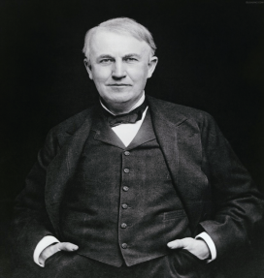
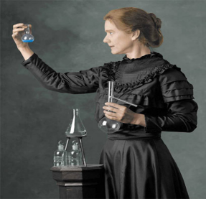
5. Do you want to be an inventor?
How will you realize your dream? Share it with your classmates.
P15-1a

Slide 21
Project
 | famous people | introduction
The Politics Group
The Science Group
The Culture Group

Slide 22
Sum up
Words:
discovery n. 发现
east—eastern
west—western
north—northern
south—southern
Phrases:
depend on 依靠，取决于
at the end of… 在……末

Slide 23
Homework
1. Finish the written work in Project.
2. Search for some information about the places of interest all over the world.

