Slide 1
Lesson 46
My Dream
WWW.PPT818.COM

Slide 2
Think about it!
Do you have any dreams or interests?
What are they?
2.What would you like to do but feel afraid to try?

Slide 3
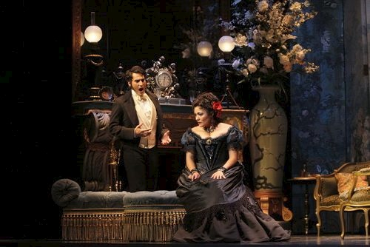
Presentation
They are playing opera.
opera

Slide 4
microphone

Slide 5
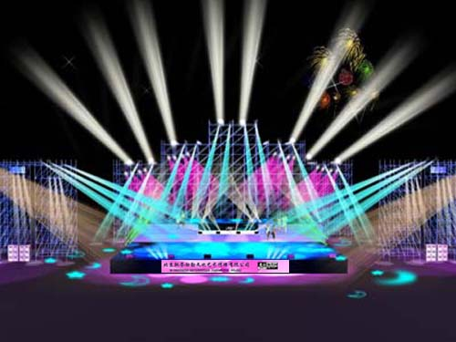
stage
The stage is so beautiful.

Slide 6
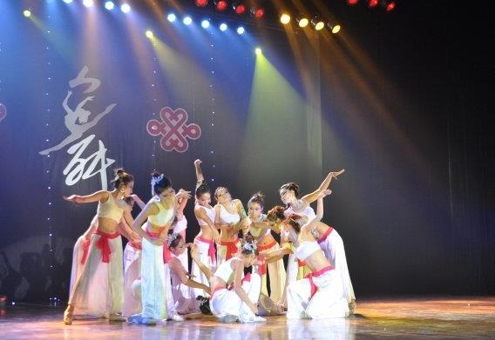
dance
They are dancing.

Slide 7
Read the text and answer.
What did Cathy dream of?
2. What did she want to show in the talent show?
3. Did she feel nervous on the talent show?
4. What did her friends say when she finished singing?
5.How did the teacher encourage Cathy?
She dreamed of being an opera singer.
She wanted to sing.
Yes, she felt a little nervous at first.
They said :"well done,Cathy!You will be a real opera singer someday!
She said:"Your voice sounds beautiful.Believe in yourself!

Slide 8
Language Points
But I taught myself by listening to the radio and watching Tv programs.
teach oneself=learn by oneself 自学。
I teach myself English in my spare time.
2. Maybe I ’m not a good enough to be a singer.也许当一名歌手，我不是很优秀。
enough修饰形容词或副词要放在其后面。enough+形容词/副词+ to do 表示有足够的……去做某事。
e.g. He is old enough to look after himself.

Slide 9
3. Finally, it was my turn. 最后，轮到我了。
这里turn是名词，表示次序。
It’s one’s turn to do sth. 轮到某人做某事。
e.g. It’s our turn to clean the classroom.
4. Your voice sounds beautiful .voice “嗓音，说话声”，指人，还表示悦耳之声，如鸟鸣声、乐器；sound“声音”，泛指任何声音；noise“噪音，吵闹声”。
Please speak in a louder voice.
Light travels faster than sound.
There is a lot of noise.

Slide 10
6.I feel my heart beating so faster! Then I saw my teacher smiling and my friends waving at me
感官动词：一感feel 二听hear listen (to )，三让make let have 四看see look (at) notice watch
后接宾语，再接省略to的动词不定式或ing形式。前者表全过程，后者表正在进行。句中有频率词时，以上的词也常跟动词原形.
see sb doing sth看见某人正在做某事 （强调动作正在进行）see sb do sth看见某人做某事（强调动作发生的过程）
I saw him cleaning the room.
I often saw him playing basketball.

Slide 11
Practice
完成句子
这个男孩足够大，可以去上学。
The boy ___ ___ ___ go to school.
2. 他们的话让我伤心。
What they said _____ me ______.
3. 这个主意听起来不错。
The idea _______ very good.
慢慢地我变得放松了。
_______, I began to relax.
5. start 和 begin有相同的意思。
Start and begin have ____ _____ ________.
6.轮到你值日了。It’s your turn ____ _____ on duty.
old enough to
made sad
sounds
Slowly
the same meaning
to be

Slide 12
宾语补足语:
某些及物动词的宾语后面还需要有一个补足语，意思才完整，宾语和它的补足语构成复合宾语。而复合宾语的第一部分通常由名词或代词充当，第二部分表示第一部分的名词或代词发出的动作或身份、特征等，称为宾语补足语。
宾语补足语有以下几类。
1.由动词不定式充当。They encouraged me to try again．
2.由-ing形式或过去分词充当。He could hear his heart beating fast．
3.由名词充当。 He made her secretary．他挑选她当秘书。
4.由形容词充当。You must keep the classroom clean．你应保持教室清洁。

Slide 13
Homework
Remember some important sentences.
Write a passage about your dream.

