Slide 1
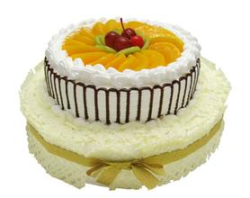
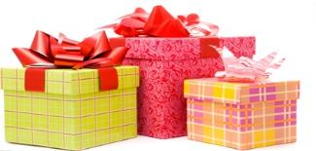
Unit 3 Birthday When is your birthday?
WWW.PPT818.COM

Slide 2
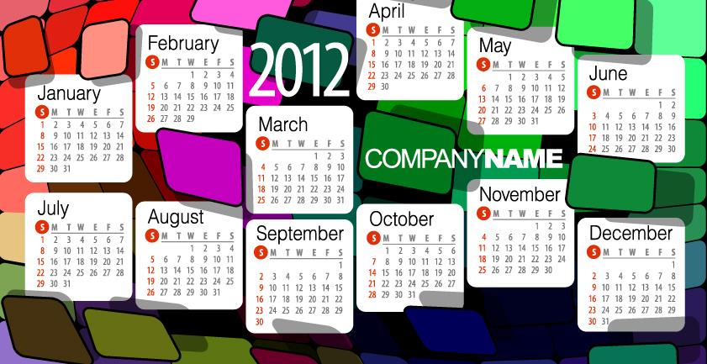
twelve months

Slide 3
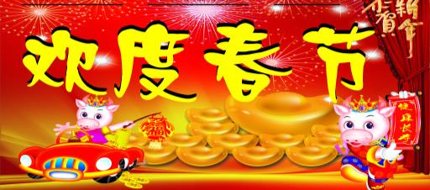
January
February

Slide 4
March
April

Slide 5
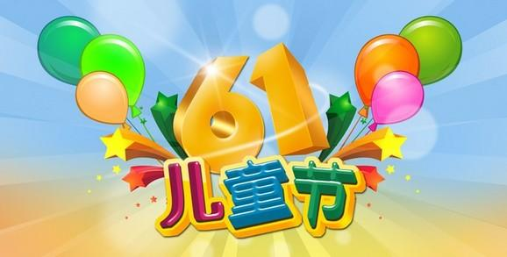
May
June

Slide 6
July
August

Slide 7
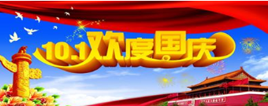
September
October

Slide 8
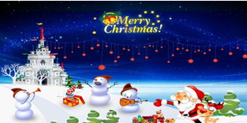
November
December

Slide 9
I can say .( 我会说！）
一月一月 January 二月二月 Februay
三月三月 March
四月四月 April
五月五月 May
六月六月 June
七月七月 July
八月八月 August
九月九月 September
十月十月 October
十一月十一月 November
十二月十二月 December

Slide 10
When is your birthday ?
when 什么时候

Slide 11
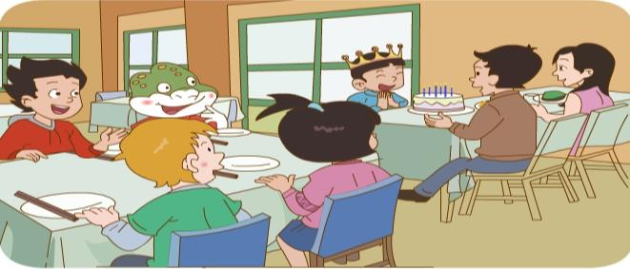
How happy they are !
What are they doing ?
They’re having a birthday party ?

Slide 12
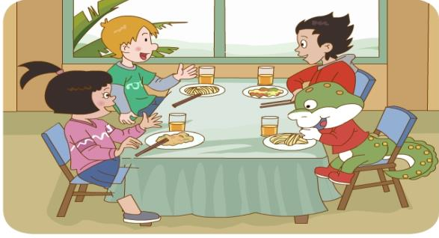
When is Li Ming’s birthday ?
When is Peter’s birthday ?
When is Wang Hong’s birthday ?

Slide 13
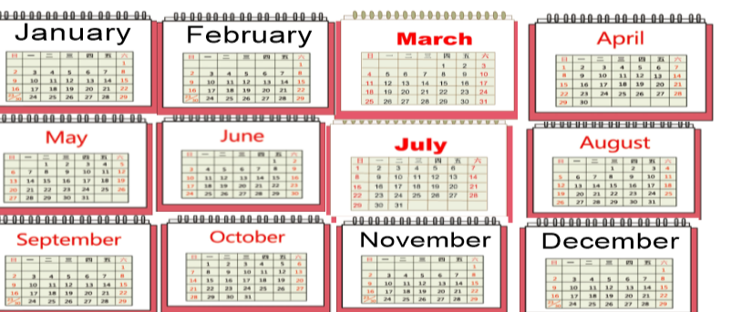
P29 Let’s talk
A: When is your birthday ?
B : It’s in May . When is your birthday ?

Slide 14
本节课你学到了什么？

