Slide 1
Unit7 Sports and Good Health
Move your body
WWW.PPT818.COM

Slide 2
Learning aims
1 To master(掌握) some new words and key sentences in the passage.
2 Students can express(表达) the good habits and the bad habits in English.
3 To make friends and understand,help each other.

Slide 3
New words
1.重量 [weit]
2.空气 [eə(r)]
3.幸运的 ['lʌkɪ]
4.边；侧边 [saɪd]
5.睡椅 [kaʊtʃ]
6.在户外 [ˌaʊtˈdɔ:z]
weight
air
lucky
side
couch
outdoors

Slide 4
Key phrases
短语互译
1. 过去常常 做… __________
2. 体重增加 __________
3. not. . . any more __________
4. get out __________
5. on one’s side _________
used to do
put on weight
不再……
出去
站在某人一边；支持某人

Slide 5
Ben sends Tim a poem:
You can be a couch potato and watch TV all day.
But don’t do that.There is another way.
Move your body, get out and have fun.
Fresh air, a bike ride, playing in the sun.
Tim writes a poem back to Ben
Your poem is funny ,
But I feel really lucky.
With a true friend on my side,
My world will be open wide,
Let’s meet tomorrow at six o’clock,
And we can go for a good walk.
bad habit
What are your bad habits?

Slide 6
Activity
小组对话，把以上诗以对话的方式表现出来，体现出朋友间的真诚，互帮互助。

Slide 7
Key and difficult points
1. used to do 过去常常…..
They used to be very active together.
他们过去非常活跃。
2. I used to like tea very much, but now I’m used to drinking milk.
我过去非常喜欢茶，但是现在我习惯喝牛奶了。

Slide 8
【探究总结】used to do与be used to doing的区别
used to do: 过去常常做，后跟动词原形
be used to doing sth:习惯于做某事,后跟动名词

Slide 9
【学以致用】
My grandfather _______ us stories when I was young．
A. used to tell B. is used to telling
C. are used to tell D. was used to telling

Slide 10
【学以致用】
Many old people ________in the countryside(乡下)，because the air is fresh.
A used to live B are used to living
C are used to live

Slide 11
3. lucky adj. 幸运的；侥幸的
But I feel really lucky. 但是我觉得确实幸运。
Good luck to you! 祝你好运！
Luckily, he was not hurt badly. 幸运的是，他伤得不重。

Slide 12
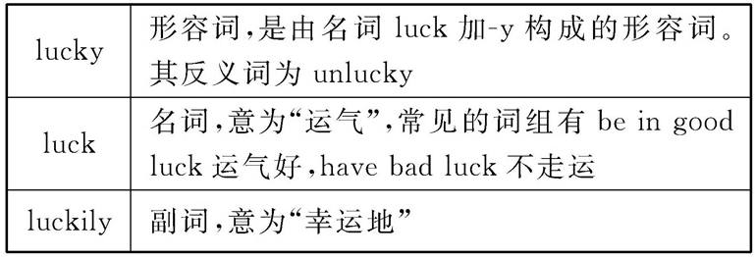
【探究总结】lucky, luck及luckily的辨析

Slide 13
【学以致用】
1 It’s _______ to pass the exam.
luck B. lucky
C. luckily D. unlucky
2 ______ (lucky), got third place in the dance.
Luckily

Slide 14
4 not…..any more 不再……, 用于否定句中
He does not live here any more.
The boy is not lazy any more.
他不再住在这儿了。
这个男孩不再偷懒了。

Slide 15
To scan（浏览）the passage again and do you still have any questions?

Slide 16
课文检测
1. 他们过去常常很活跃。
They ______ ______ ______ very active together.
2. 蒂姆的体重正在增加。
Tim is ______ ______ ______.
3. 我感觉非常幸运。
I feel really ______
4 .We’re _____ busy ________（不再）.
used to be
putting on weight
lucky
not
any more

Slide 17
当堂检测
Ⅰ. 用所给词的适当形式填空
1. Bill used to ______ (be) shy, but now he is outgoing.
2.Don’t __________ （担心）my health.
3. ______ (lucky), he caught the last bus yesterday.
4. He eats _______ (许多， 很多)meat, so he is fat.
5. Let’s ______ (meet) tomorrow at six.
be
worry about
Luckily
too much
meet

Slide 18
Activity
Friends are really important for us. The best mirror is a friend.(最好的镜子是朋友) So, write down something that you want to say and show us.

Slide 19
Homework
1 Let’s do it Part 3.
2 Please write a passage about your friend .

