Slide 1
Unit 8
Apples are good for us
WWW.PPT818.COM

Slide 2
Review words
can 能，能够 pear 梨
peach 桃子 fruit 水果
watermelon 西瓜 grape 葡萄
banana 香蕉 apple 苹果
orange 橙子

Slide 3
Let’s play games!
What’s missing in the following picture？

Slide 4
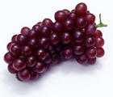
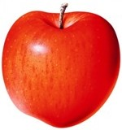
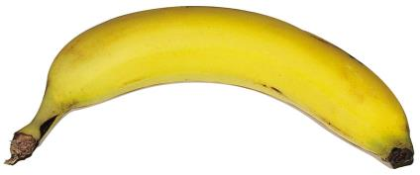

Slide 5
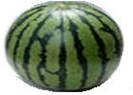

Slide 11
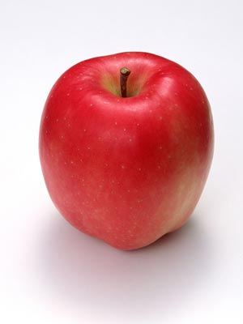
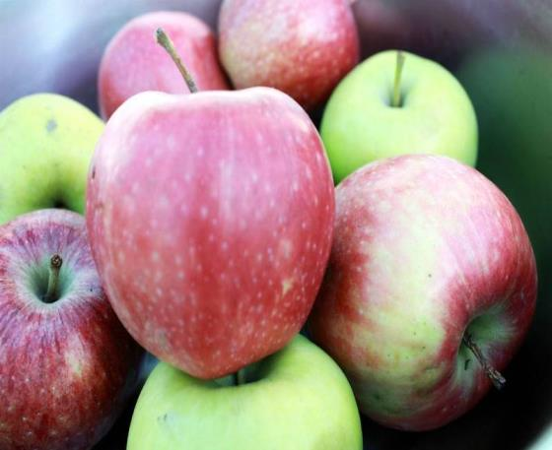
apple
some
apples

Slide 12
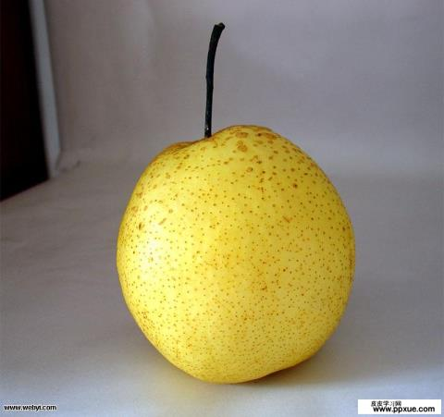
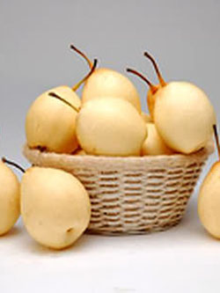
pear
some
pears

Slide 13
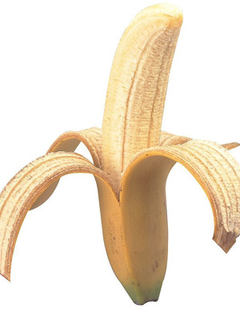
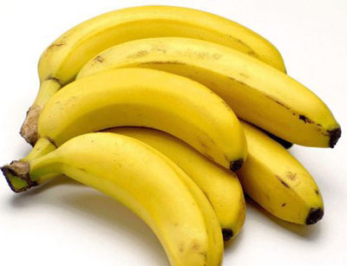
banana
some
bananas

Slide 14
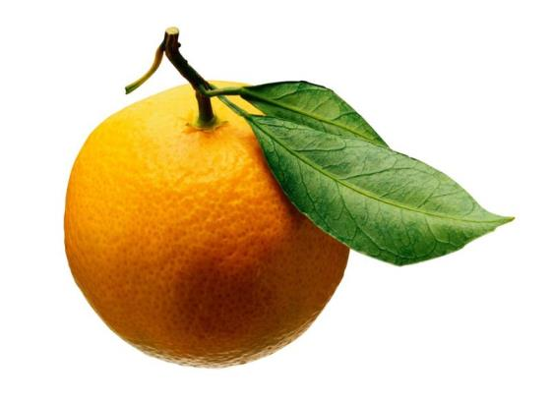
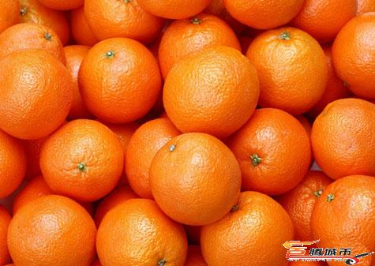
orange
some
oranges

Slide 15
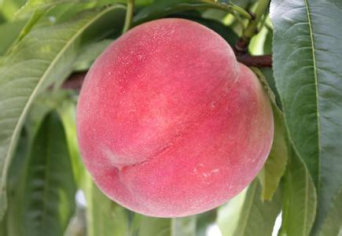
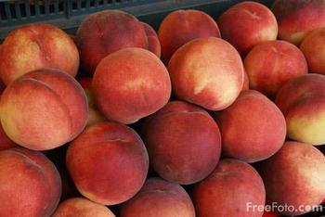
peach
some peaches

Slide 16
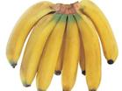
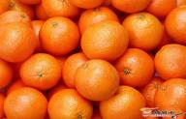
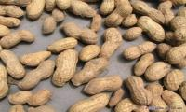
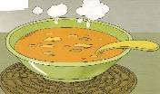
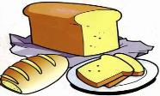
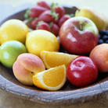
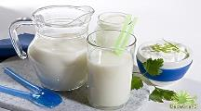
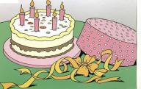
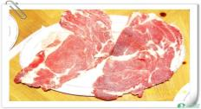
apples
bananas
vegetables
chocolates
biscuits
可数名词（两个或两个以上可加S)
dumplings
pears
sweets
oranges
peanuts
noodles
rice
fish
a或an+名词，一个···（不加S）
soup
bread
fruit
milk
cake
meat

Slide 17
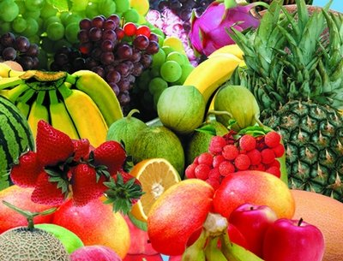
We are fruits!!!

Slide 18
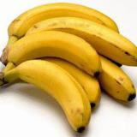
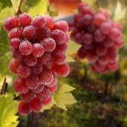
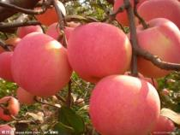
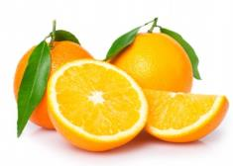
I like...

Slide 19
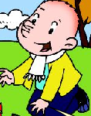
问： What fruit do you like?
答：I like ···.

Slide 20
I like
bananas.
You like
bananas ，too.
We like
bananas！

Slide 21
为什么？
But, why?

Slide 22
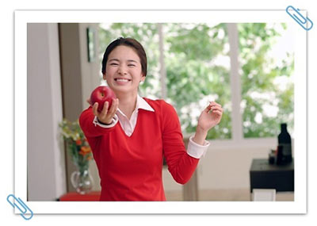
Apples are good for us.
Good！

Slide 23
Bananas are good for us.
Good！

Slide 24
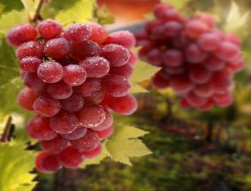
What fruit do you like?
I like grapes.
grapes
Grapes are good for us.

Slide 25
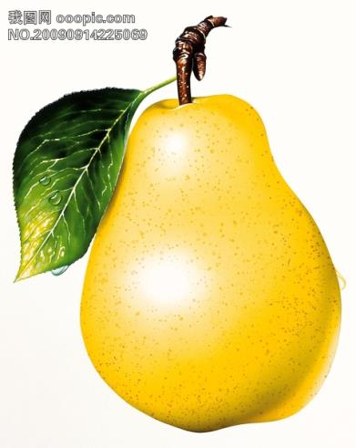
pears
Pears are good for us.

Slide 26
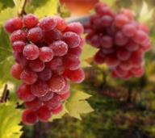
apples
bananas
pears
Can I have some…?
oranges
Yes, you can.
Sorry, you can’t.
grapes

Slide 27
Chant:
Can I have some apples?
Can I have some apples?
Yes, you can. Yes, you can.
Of course，You can！
Can I have some grapes?
Can I have some grapes?
Sorry, you can't. Sorry, you can't.
You can't have some grapes.

Slide 28
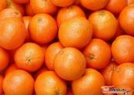
What is for lunch?
Let’s get 1/2/3/4···

Slide 29
Listen time
Today we are going to learn Ben and his mother are going market. And what happen with them. Let’s look at the VCD.

Slide 30
Answer questions
1. Who are they?
They are Ben and his mother.
2. What fruit does ben like?
He likes grapes and apples.
3. How many apples do they have?
Six apples.

Slide 31
Read time
1. Read the dialogue after teacher.
2. Try to read the dialogue by yourself. You have two munities to read.
3. Read the dialogue together.
4. Act the dialogue with your partners.

Slide 32
Homework:
1. Read the dialogue five times and try to recite the dialogue.
2. Write down the new words on your homework book.

Slide 33
See you!

