Slide 1
Unit 2
A country life is a healthy life
WWW.PPT818.COM

Slide 2
Look and say
count country a country life
like life ride ill still red fresh
make take air hair clean air head healthy
grand grandparent fresh food
a.m. =morning p.m. = evening
milk the cows ride my bike
help my parents with other housework
still much work to do a healthy life
plenty of exercise plenty of fresh milk

Slide 3
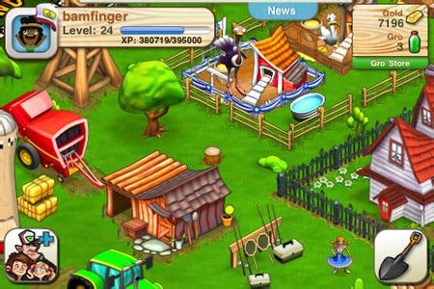
Where does Li Wei live?
He lives on the farm.
He loves living in the country.
Is he usually busy ?
Yes . He is usually very busy.

Slide 4
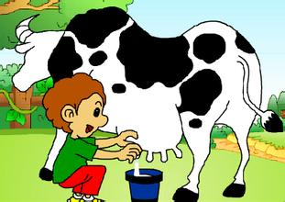
When does Li Wei wake up every moring?
He wakes up at 5 a.m.
What does Li Wei do every morning?
He helps his father milks the cows.
milk the cow

Slide 5
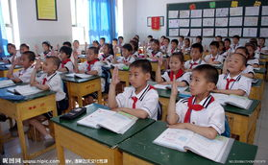
How many pupils are there in Li Wei’s school?
There are 48 pupils .

Slide 6
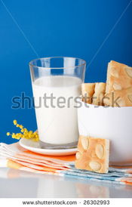
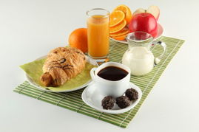
What does he have for breakfast?
He has plenty of fresh milk for breakfast.

Slide 7
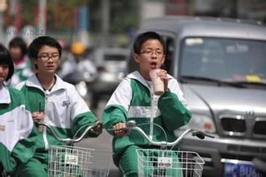
How does Li Wei go to school every day?
He goes to school by bike.
He rides his bike to school.
Li Wei

Slide 8
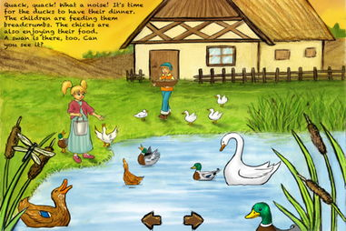
What does Li Wei do after school?
He gets home and does still much work to do after school.

Slide 9
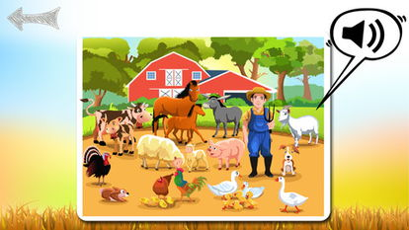
Why doesn’t Li Wei feel tired?
Because he has plenty of exercise, clean air and fresh food every day.

Slide 10
My name is Li Wei . I am eleven years old and I live on a small farm with my mum, dad and grandparents. I love living in the country,but I’m usually very busy.

Slide 11
Every day I wake up at 5 a.m. and help my father milk the cows. We have more than 50 cows. So I always have plenty of fresh milk for breakfast.

Slide 12
After breakfast I ride my bike to school. It takes about 40 minutes. My school is very small. There are 48 pupils and only one classroom. We must all learn together.

Slide 13
When I get home after school there is much work to do. After I finish my homework. I feed our chickens and help my parents with other housework.

Slide 14
I am always very busy but I never feel tired, because I have plenty of exercise, clean air and fresh food every day. So I think a country life is a healthy life.

