Slide 1
Unit11
Would you like to go with us?
WWW.PPT818.COM

Slide 2
What would you like ?
║
What would you like to eat/drink?
Would you like to ...? 是邀请用语，语气委婉客气.
接受：Yes, I’d love / like to. / Yes , of course.
不接受：I’d like to ,but… / Sorry, I can’t. I …
Do you want to …? 也是邀请用语，语气比较随意，

Slide 3
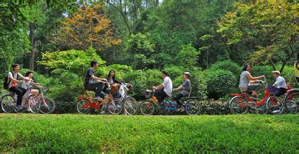
Would you like to ride the bike on Dafu Hill?
接受：Yes, I’d love / like to. / Yes , of course.
不接受：I’d like to ,but… / Sorry, I can’t. I …

Slide 4
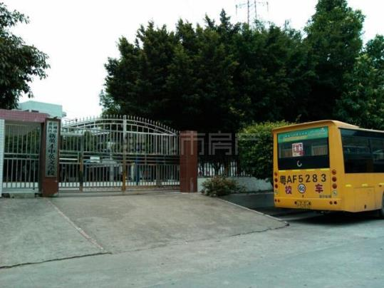
a
make
gate
大门
What would you like to wait for me at the school gate ?
接受：Yes, I’d love / like to. / Yes , of course.
不接受：I’d like to ,but… / Sorry, I can’t. I …

Slide 5
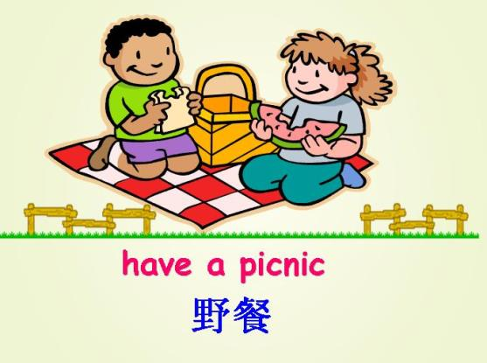
Would you like to have a picnic?
接受：Yes, I’d love / like to. / Yes , of course.
不接受：I’d like to ,but… / Sorry, I can’t. I …

Slide 6
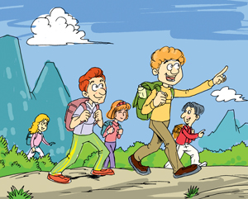
go on a picnic
去野餐
Would you like to go on a picnic?
不接受：I’d like to ,but… / Sorry, I can’t. I …
watch a football match
看足球赛

Slide 7
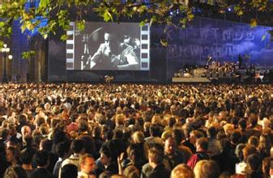
see a film
看电影
Would you like to see a film in the cinema?
接受：Yes, I’d love / like to. / Yes , of course.
不接受：I’d like to ,but… / Sorry, I can’t. I …

Slide 8
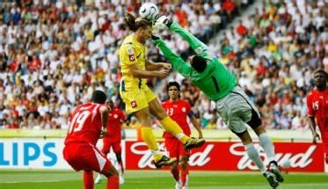
a
bag
match
比赛
e
bed
centre
中心
Would you like to watch a football match in Sports Centre?
接受：Yes, I’d love / like to. / Yes , of course.
不接受：I’d like to ,but… / Sorry, I can’t. I …
watch a football match
看足球赛

Slide 9
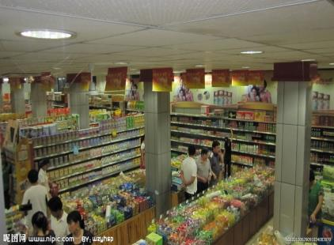
super
supermarket
market
超市
Would you like to go shopping in the supermartet?
接受：Yes, I’d love / like to. / Yes , of course.
不接受：I’d like to ,but… / Sorry, I can’t. I …

Slide 10
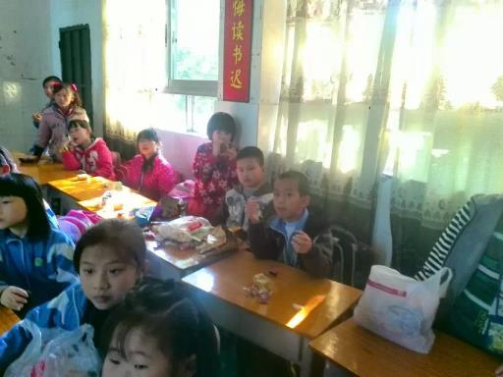
have a party
开派对
sound great
听起来很棒
next time
下次
Would you like to have a party?
That sounds great!
No problem!
没问题
We will have a party next time.

Slide 11
words:
invitation
hey
邀请________ 嗨________ 小伙子________
没有东西，没有事情_______为什么______
计划______ 将会；愿意_________ 听起_________
大门_______ 太妙了，酷_______ 问题________
电影_______比赛_____ 中心______
超市____________ 你愿意……吗？____________
guy
nothing
why
plan
would
sound
gate
cool
problem
match
centre
film
supermarket
would you like...?

Slide 12
phrases:
plan to do
go on a picnic
计划去做________________去野餐__________________
在学校门口___________________下次_______________
开派对___________________ 没问题________________
观看一场足球赛______________________
听起来很棒__________________
at the school gate
next time
no problem
have a party
watch a football match
sound great

Slide 13
单项选择。
( ) 1. --What would you like to __________? --I’d like some water.
A. eat B. have C. drink D. drinks
( ) 2. ---Would you like to visit the museum? ---________
A. Yes, please. B. Sure, I'd love to. C. Sorry, I wouldn't. D. Yes, I would.
( ) 3. Thanks a lot for ________me ________your party.
A. invite; for B. invite; to C. inviting; for D. inviting; to
( ) 4. ---Would you like to come to dinner this Sunday, Xiao Ming? ---______
A. I'd love to, but I have lots of things to do.
B. Oh, no. That'll be too tired.
C. I'll stay at home.
D. Yes, please. http://w w w. xkb1. com
( ) 5. --- Eliza, would you like to go shopping with us?
--- _____, but I have to wash the dishes first.
A. No, I can’t B. I don’t want to C. Yes, please D. I’d love to
c
B
C
A
D

Slide 14
Decide true (T) or false (F).
1. ( ) Ben has nothing to do this Saturday.
2. ( ) Janet plans to have a picnic this Sunday.
3. ( ) Jiamin will have a picnic with Janet.
4. ( ) The three children plan to meet at the school gate.
5. ( ) August 14th is Jiamin’s grandpa’s birthday.
F
a picnic with Janet
T
F
go to grandma's birthday party.
T
F
grandma's

Slide 15
Homework：
1、熟记本课单词,词组和重点句型。
2、向同学、老师或家人发出邀请，建议用微视频拍录下来邀请更多的好友。

