Slide 1
Unit 5
A party
WWW.PPT818.COM

Slide 2
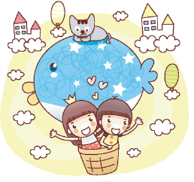
Let's enjoy
What is the song about?
Where are they going?

Slide 3
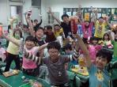
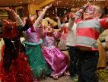
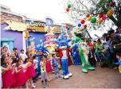
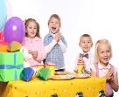
Brain storming
Tips：
1、说出看到party想到物品、活动……
2、音乐停止，游戏结束！
party

Slide 4
Before the party
We should prepare things for the party. 为派对准备物品
drinks
fruit
snacks
toys

Slide 5
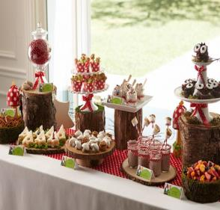
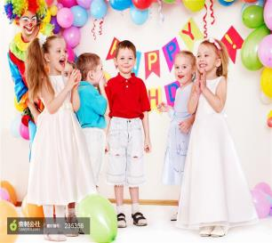
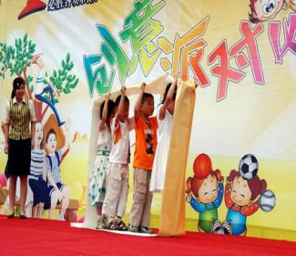
At the party
dance
eat
drink
sing
play

Slide 6
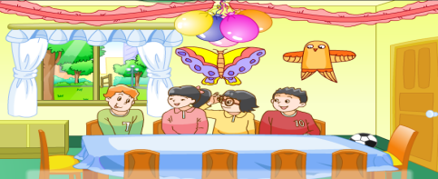
预习反馈：
It is Children's Day this Sunday. The children are going to have a party at Mike's house.
When are the children going to have the party?
2. Where are they going to have the party?

Slide 7
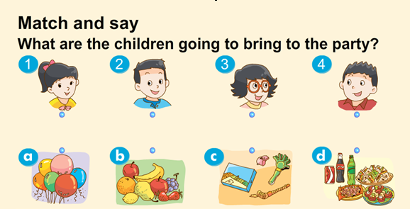
Listen and match
?
Try to say like this:
Su Hai is going to bring…to the party.
Wang Bing is going to bring…
…

Slide 8
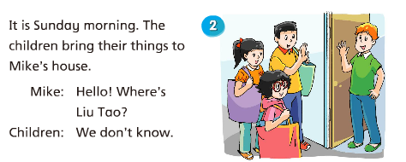
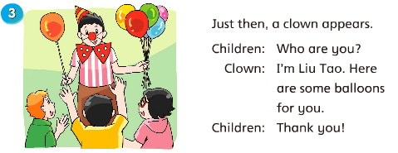
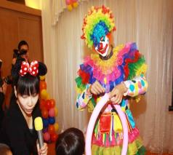
Read in groups
Tip:
If you find some new words, you can circle them. Then you can understand according to the story time. (圈出生词，结合上下文理解其意)
about
near
appear
[ə'pɪə]
出现
flower
how
clown
[klaʊn]
小丑

Slide 9
Listen and match
?
balloons
/u:/

Slide 10
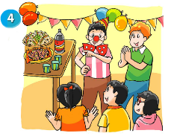
Liu Tao: Are we going to
eat or play with
the toys first?
Mike: Let's have some
fun first!
Children: Hooray!
Read and choose
选择疑问句：是指提出两个或两个以上可能的答案供对方选择。让对方根据实际情况进行选择回答 的句式。
Now the party begins.
a
The children are going to _____ first.
play with the toys
b. eat the food
c. sing a song

Slide 11
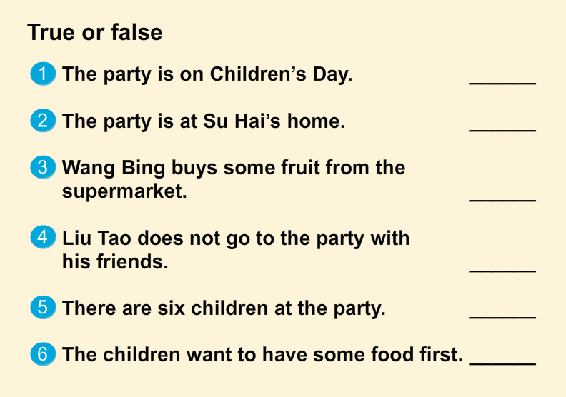
Let's judge!
T
F
Tip:
Remember, if the sentence is wrong, please say out the right answer.
at Mike’s house
F
brings some fruit from home
F
Liu Tao goes to the party
F
five
F
have some fun

Slide 12
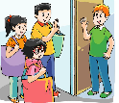
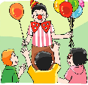
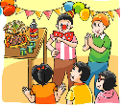
Let’s act
四人一组分角色表演课文，其中一人当旁白，其余三人扮演课文中的人物。要语言正确、流利、生动哦！
Sunday morning
The Children bring their things to Mike’s house…
Just then
A clown appears…
The party begins…
Now

Slide 13
Fill in blanks：
hildren’s
C_______ Day is coming. Mike and his f______ are going
to have a p____ at Mike’s house. Su Hai is going to bring
some s______ and d_____. Wang Bing is going to bring
some f___. Yang Ling is going to bring some t___. Liu Tao is going to bring something too.
It is S______ morning. Su Hai, Wang Bing and Yang Ling
bring their things to Mike’s house. Liu Tao does not come.
Then, a c_____ a______ with some colourful b_______. That is Liu Tao! The party b_____. The children have great f___ at the party.
riends
arty
nacks
rinks
ruit
oys
unday
lown
ppears
alloons
egins
un

Slide 14
Parties in the world

Slide 15
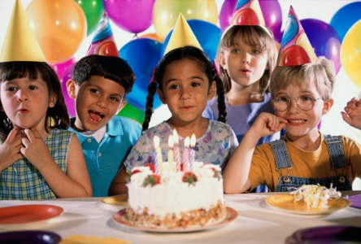
Birthday party
she is having a birthday party.
They are going to have a great time.

Slide 16
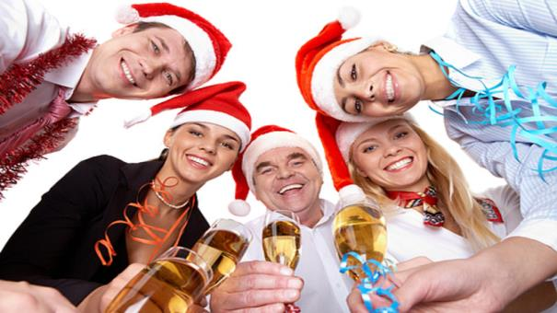
Christmas party
Christmas is a big day. So people in western
countries often have a Christmas party.

Slide 17
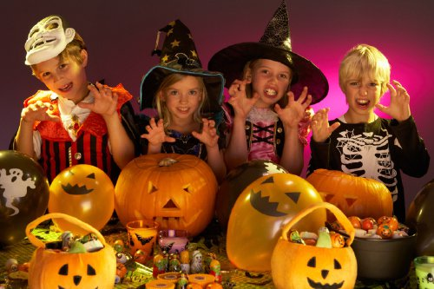
Halloween party
Children like Halloween party.
Because Halloween party is interesting.

Slide 18
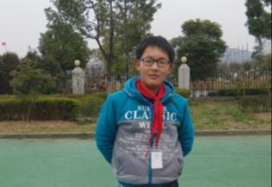
homework
Birthday: 8th April
Invitation(邀请卡)
Date:_________
Time:__________
Place:_________
With__________
Come and have fun !
Welcome to the party
Tip: Introduce(介绍) your invitation. Use the following sentences:
We are going to…

