Slide 1
陕旅版小学英语三年级下册
Unit8 The Ruler Is Long
第2课时
WWW.PPT818.COM

Slide 2
学习目标
1. 学生能熟练听说三对反义词以及单词：
long – short, tall – short, big – small, tree, grass, see。
2. 听说句子：
The ruler is long. The pencil is short.
The tree is tall. The grass is short.
The cars are big. The bikes are small.
3. 锻炼学生的观察、记忆、思维和想象力。

Slide 3
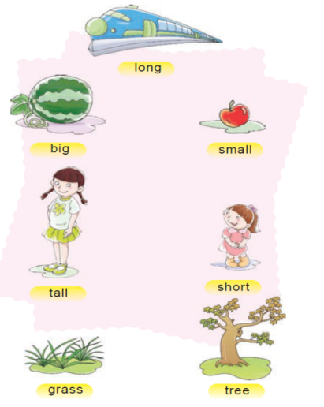
Let’s do a quick response.
快速反应说单词

Slide 4
Part A Let’s say
The ruler is long. The pencil is short.
尺子长，铅笔短。

Slide 5
The tree is tall. The grass is short.
树高，草低。

Slide 6
The cars are big. The bikes are small.
车大，自行车小。

Slide 7
Part B Read and tick or cross.

Slide 8
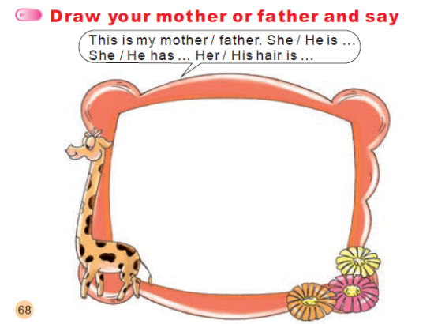
Introduce us your mother or father. 介绍自己的爸爸妈妈

