Slide 1
Unit 4 Topic 1
Which do you like better, plants or animals?
Section C
WWW.PPT818.COM

Slide 2
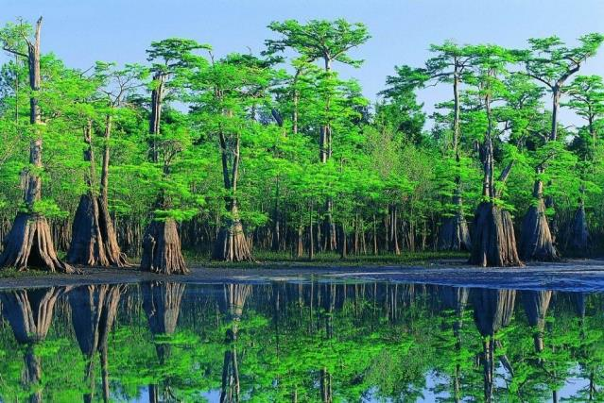
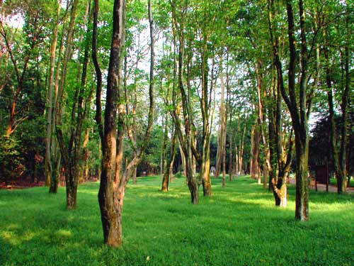
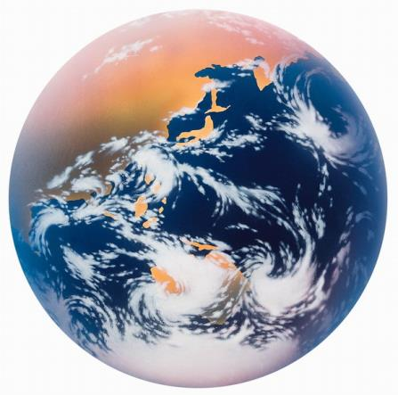
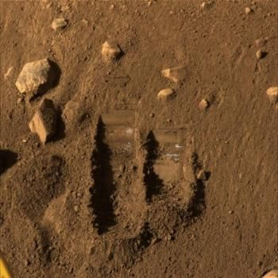
earth n. 地球；土，泥；大地
Look and learn
forest n. 森林
rainforest n. (热带)雨林

Slide 3
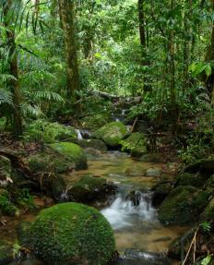
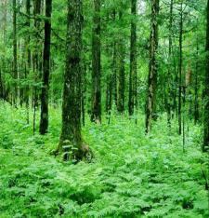
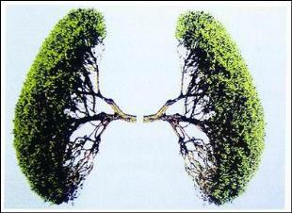
Look and guess !
Look at the pictures and check which questions the passage can answer.

Slide 4
What are rainforests?
How many animals are living in rainforests?
Where do animals live in rainforests?
What can we get from rainforests?
Why are rainforests important to us?

Slide 5

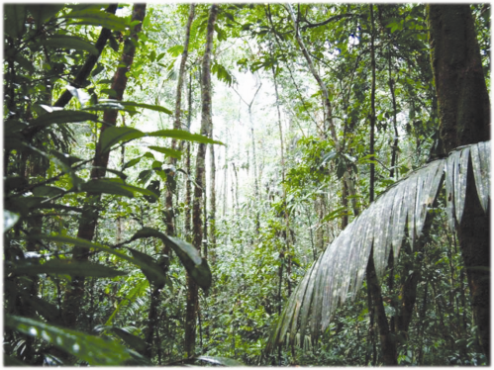
Watch the flash of 1a, and find out the answers.
1a
What can rainforests give us ?

Slide 6
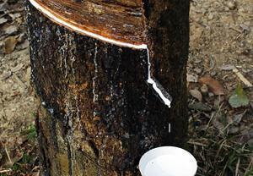
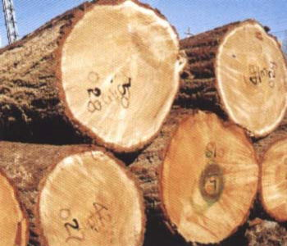

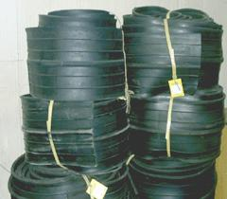
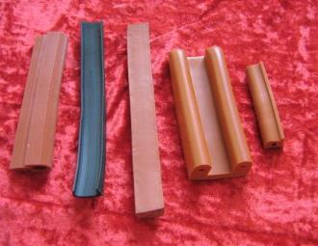
wood n. 木头，木材；woods 树木，森林
Rainforests give us …
rubber n.橡胶

Slide 7
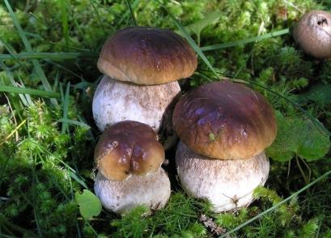
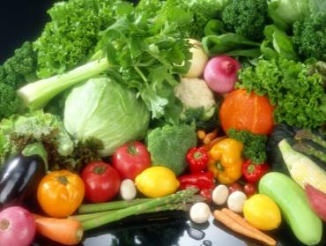
Rainforests give us …
food

Slide 8
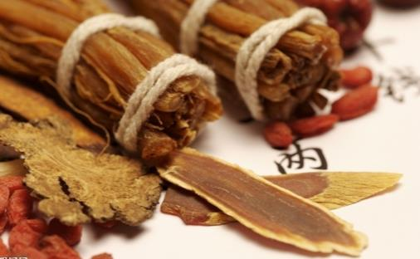
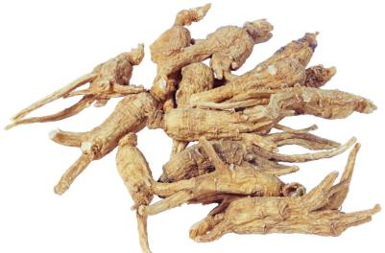
Rainforests give us …
medicine

Slide 9
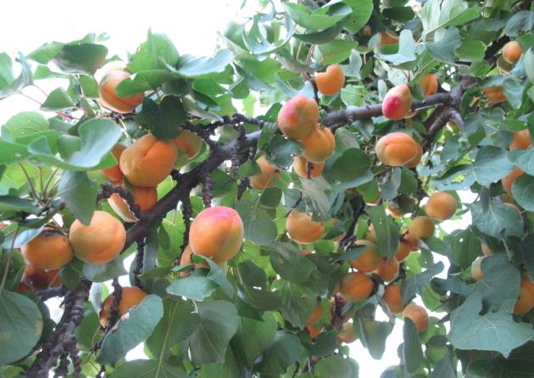
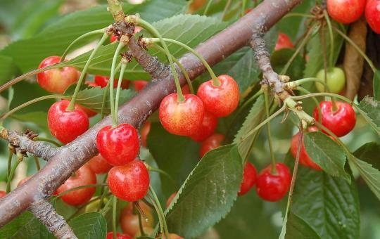
Rainforests give us …
fruits

Slide 10

1b
Listen to 1a and complete the table. Then check with your partner.
Feature of rainforests | in the ______ parts of the world _______ ground and always ____ and ____ in them cover ____ of the earth’s _______ give a home to many beautiful ______ and ________
Importance of rainforests | make the air _______ and ________ _____ the water and keep the water______ control the ________ keep the beauty of ________ give us ______, ______, fruit, ________ and so on
hot
wet
dark
hot
6%
surface
plants
animals
fresher
cleaner
hold
cycling
climate
nature
wood
food
medicine

Slide 11
1c
Read again and answer the questions.
What does the word “cover” mean in Paragraph 1 ?
Why are rainforests the lungs of the earth ?
It means “覆盖”.
Because the plants in the forests help to make the air fresher and cleaner.

Slide 12
1c
Read again and answer the questions.
3. Why should we protect rainforests well ?
4. Can you guess what the next part of the passage will talk about ?
Because they help to hold the water and keep the water cycling. They play an important part in controlling the climate.
Yes. The next part may talk about what we should do to protect rainforests.

Slide 13
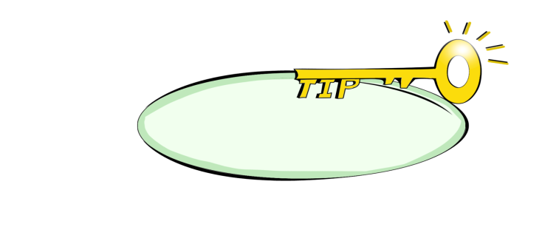
1c
Read again and answer the questions.
5. What should we do to protect rainforests ?
We should save paper and mustn’t use the chopsticks for only once.
The last sentence in a paragraph may tell you what comes next.

Slide 14
Key points
Rainforests cover 6% of the earth’s
surface.
six percent
可数名词复数
数词 % +
可数名词单数 / 不可数名词
Eg: 50% of the students in our class are boys.
70% of the earth is water.

Slide 15
成千上万的
Thousands and thousands of
animals live in rainforests.
成百上千的
成百万上千万的，数以百万计的
hundreds of
millions of

Slide 16
3. Many of them live in the trees over 30 meters
from the ground.
over = more than 多于， 超过
eg: Our class has _________________ 50 students.
4. They play an important part in controlling the
climate.
play an important part ( in sth.)
在某事中起重要作用； 参与（某事）
Eg: 他积极参加班级活动。
He _________________________ class activities.
over/more than
plays an active part in

Slide 17
5. But now rainforests are becoming smaller and
smaller.
“形容词比较级 + and + 形容词比较级” 越来越……
Eg. 天气变得越来越暖和了。
The weather gets warmer and warmer.
中国变得越来越强大。
China becomes stronger and stronger.
越来越小

Slide 18
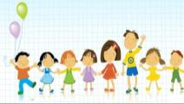
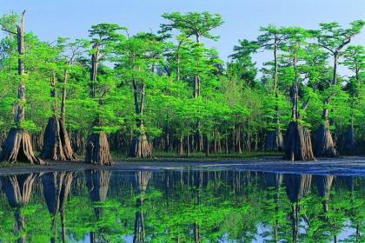
Group work
Discuss the pictures in groups about how to protect rainforests. Then write a short passage.

Slide 19
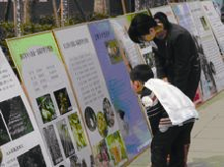
show and tell people about …

Slide 20
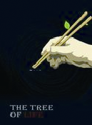
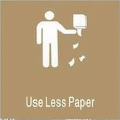
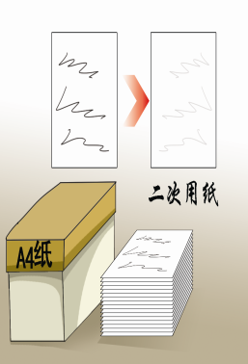
do anything we can，such as …

Slide 21
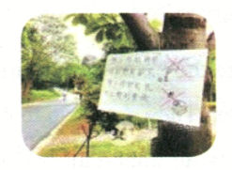
ask people not to …

Slide 22


ask people not to cut …

Slide 23
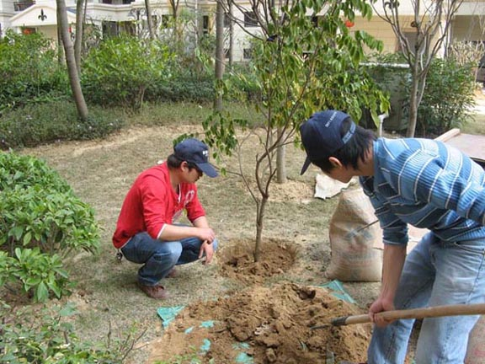
Let’s plant …

Slide 24
You can write like this :
Example :
Rainforests are very important to us. It is necessary for us to protect them very well. First, we should make people know about the importance of protecting them. Then ask people not to cut down the trees without plans. For us, we should do something as possible as we can. When we have meals, we mustn’t use chopsticks for only once. In the life, use less paper and be sure not to waste it.

Slide 25
summary
1. Learn to describe the situation of
rainforests and the importance to the earth.
2. Talk about how to protect rainforests.
3. useful phrases:
thousands of
control the climate
over = more than
play an important part ( in sth.)
smaller and smaller

Slide 26
Homework
Make a survey among your classmates about how to save water in their family. Then report it to the class tomorrow.
Name | Way

