Slide 1
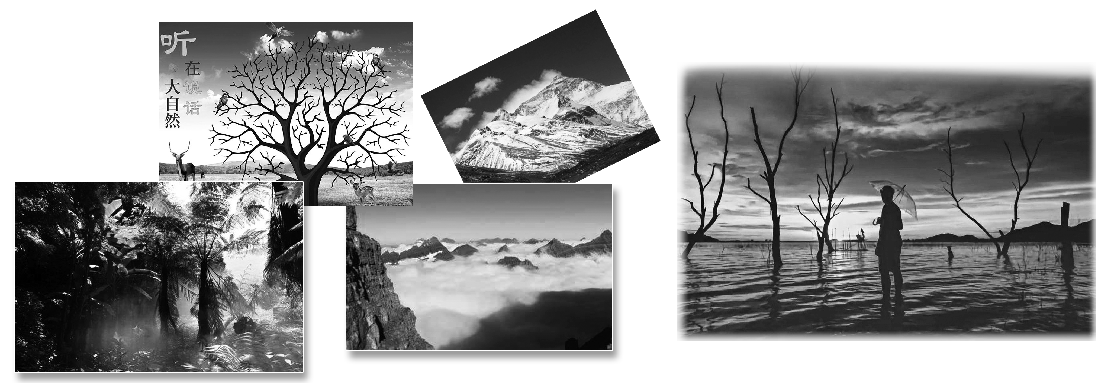
Section Ⅲ Developing ideas
WWW.PPT818.COM

Slide 6
教材原句
These words come from the author of the book The Secret Garden, first published in 1911.
这些话来自1911年首次出版的《秘密花园》这本书的作者。
句式解构
first published in 1911为过去分词短语作后置定语，修饰the book。
佳句背诵
Hangzhou, known to the nation for its West Lake, has changed a lot.
以西湖闻名全国的杭州已发生了很大变化。

Slide 7
教材原句
Expert gardeners know just the right corner for roses, and others spend hours trying to grow perfect vegetables to enter into competitions.
园艺师知道种植玫瑰的合适角落，其他人花数个小时尽力种植完美的蔬菜来参加竞赛。
句式解构
spend ... doing ...“花费时间做某事”。
佳句背诵
I spent a long time reflecting on what he'd said.
我花了很长时间思考他说的话。

Slide 8
教材原句
And while many Brits like nothing better than spending their Sunday cutting the grass, some are happy just to sit under the branches of the trees and enjoy the beauty of the world around them.
许多英国人喜欢在花园除草来度过周末，还有一些人仅仅满足于坐在树荫下欣赏他们的周围世界的美。
句式解构
nothing better than是否定词与比较级连用，表示最高级，意为“没有什么比……更好的”。
佳句背诵
There is nothing better than staying at home.
没有什么比宅在家里更好的了。

Slide 9
教材原句
As well as being good for the environment, gardening is also good for the soul.
园艺除了对环境有好处，对人的心灵也有益。
句式解构
as well as 连接并列成分。
佳句背诵
Electric energy can be changed into light energy as well as into sound energy.电能既可以被转变成声能，又可以被转变成光能。

Slide 11
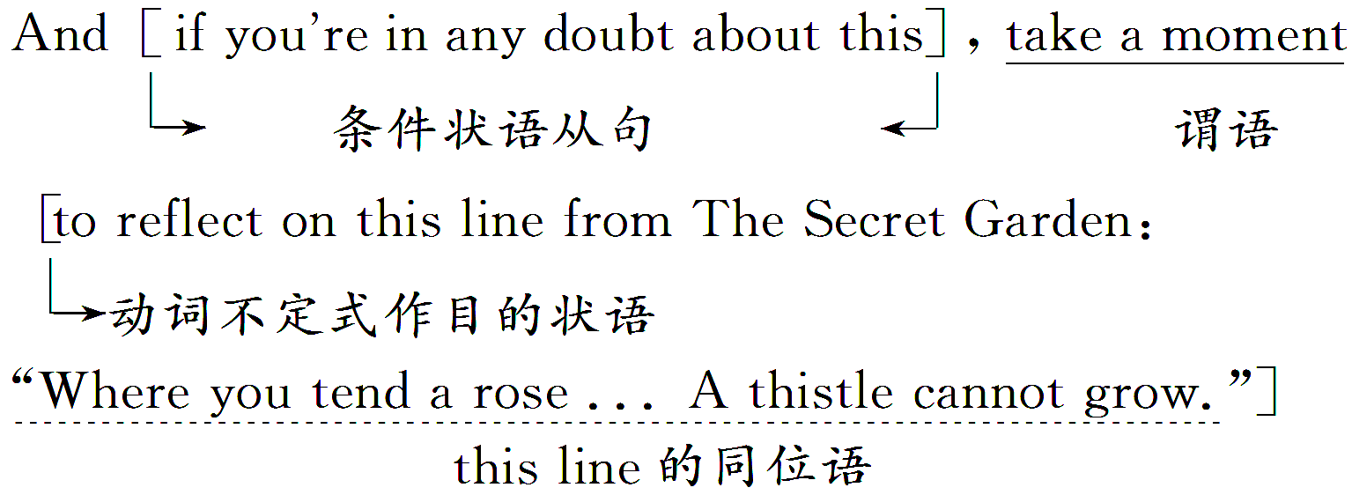

Slide 17
The beginning of gardening | •In 1911, only 1.___________ in Britain had gardens. •Very soon after this, 2.______ with gardens started to be built. •Today, 3.______________ spend their free time gardening.
Gardening activities | •Children plant sunflowers. •4.______ gardeners know the right corner for roses. •Others grow perfect vegetables to enter into 5.___________. •Many Brits spend their Sunday 6._________ _____. •Many just sit under the branches of the trees and 7._______________ of the world around them.
the very rich
homes
millions of Brits
Expert
competitions
cutting the
grass
enjoy the beauty

Slide 18
The present situation | •Those without outside space can 8.____ small pieces of land. •Over 4,000 people are 9._______ for pieces of land.
The benefits | Gardening is good for the 10.___________ as well as the soul.
rent
waiting
environment

Slide 43
谢 谢 观 看

