Slide 1
初中英语冀教版九年级
Unit8 Culture Shapes Us
What Could Be Wrong?
WWW.PPT818.COM

Slide 2
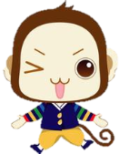
学习目标
To learn words and expressions about giving suggestions.
To learn about how to solve the problems between friends.
To realize the importance of friendship and the ways of solving the problems between friends.

Slide 3
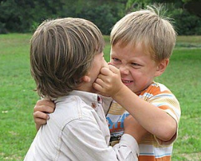
Warming up
Do you have any problems between you and
your friends?

Slide 4
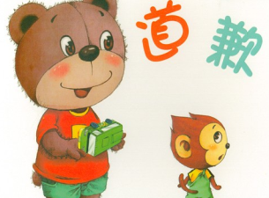
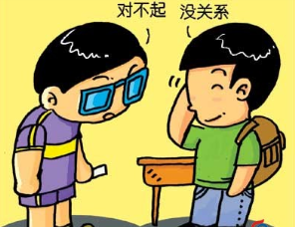
Warming up
If you have a problem with a friend, what
do you usually do?

Slide 5
Fast-reading
Find out tips for good interpersonal communication.
(1). What has happened to the Lost Girl?
(2). What are Sue’s suggestions if a friend wants to end the friendship?
Her good friend hasn’t spoke to her for a few days, and she can’t figure out what the problem is.
There is nothing you can do, but still say hi to her when you pass her at school.

Slide 6
Fast-reading

Slide 7
Scanning
Read the lesson again and tick the advice Sue
gave to the Lost Girl.
√
(1) Say sorry if you hurt your friend.
(2) Give your friend some time to cool down.
(3) Clearly express how you feel.
(4) Write to your friend and ask what’s wrong.
(5) Talk to your friend directly as soon as possible.
(6) You can still be friendly even if you are not friends.
(7) Be aware of your body language.
√
√
√

Slide 8
Language points
1. We used to study and play together all the time, but ever since last Friday. 我们过去曾经一起学习过、玩过，但从上个星期五就不一样了。
used to “过去经常”，后加动词原形。
否定句式有两种变化形式：
used not to + 动词原形
didn’t use to + 动词原形

Slide 9
Language points
2. Say hi to her when you pass her in the hallway at school. 当你在学校的走廊里从她面前走过时，要和她打声招呼。
say hi to…意为“和……打招呼”，其中hi可用hello替换。
类似句式还有：say goodbye to… 向……告别；say sorry to… 向……表示道歉

Slide 10
Discussion
If you were Sue, what are your suggestions to
the lost girl?
Possible answers:
(1)Say sorry if you hurt your friend.
(2)Give your friend some time to cool down.
(3)Write to your friend and ask what’s wrong.
(4)Talk to your friend directly as soon as possible.
……

Slide 11
Guessing
After receiving Sue’s e-mail, what would the lost
girl do?

Slide 12
Listening
Listen to the reply from the Lost Girl and fill in
the blanks.
Dear Sue,
Thanks for your advice. I wrote her a letter and told her I wouldn’t want to lose her as a friend. I asked her what was wrong. She wrote back to me after she _____________.
cooled down

Slide 13
Discussion
misunderstanding
There was a ________________. She was hurt because I didn’t go back home with her on Wednesday as we had planned. She ________ me, but I didn’t answer her. I had forgotten that! After I ___________ it was all my fault, I went to her and said sorry. We are now friends again. I’m very happy.
called
figured out

Slide 14
Project
Work in groups. Write about a problem between two friends on a piece of paper.
Collect all the papers in the class.
Shuffle the papers.
Each group draws a piece of paper.
Read the problem in your group and write some advice to that person.

Slide 15
Homework
Write an e-mail to the person who has something wrong with his/her friend to give him/her some good suggestions.

