Slide 1
Module2 What can you do?
Unit2 I can run really fast.
WWW.PPT818.COM

Slide 2
内容结构
Warm-up
1
Presentation
2
Language Points
3
Exercise
4

Slide 3
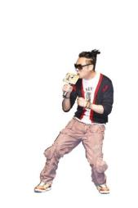
Show yourself:
根据提示的图片用上节课学的句型造句。
Warm-up
A: I can…
B: I can …
dance
swim
sing
paint
play the guitar

Slide 4
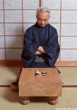
Can you… ?
Yes, I can.
/ No, I can’t.
swim
speak English
play the
guitar
paint
dance
play chess
sing

Slide 5
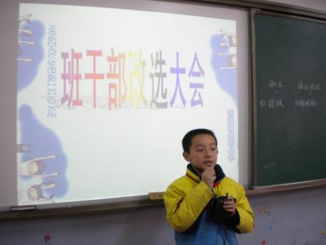
Presentation
Learn some new words.
monitor 班长，监督员
I’d like to be the class monitor.

Slide 6
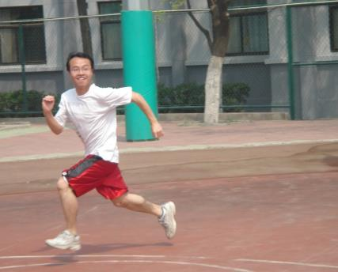
the PE monitor
I want to be the PE monitor. I enjoy sport, and I can run really fast.

Slide 7
start 开始；开端
It’s the start of the new term and we’re choosing our new monitors.

Slide 8
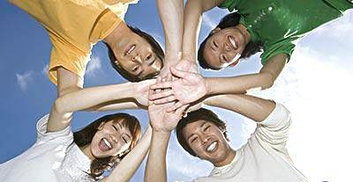
get on well with sb. 与某人相处融洽
I get on well with my classmates.

Slide 9
ready 乐意的
ready to do sth.
乐意做某事
I’m kind and I’m always ready to help others.

Slide 10
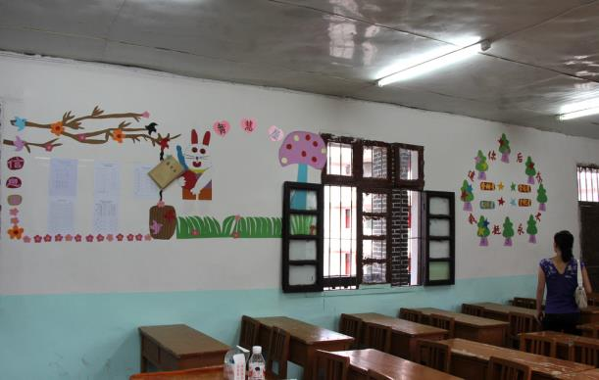
beautiful 美的；美丽的
We can make our classroom beautiful.

Slide 11
1
Ask and answer the questions.
1. Which monitor would you like to be for your class?
class monitor
PE monitor
cleaning monitor
2. What do these monitors do?

Slide 12
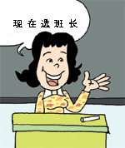
2
Listen and read
It’s the start of the new term and we’re choosing our new monitors.

Slide 13
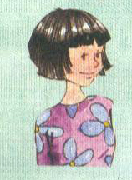
I’d like to be the class monitor. I get on well with everyone, classmates and teachers. I work very hard, and I do well at school. I’m kind and I’m always ready to help others. I can even help teachers too. Choose me as
your class monitor and promise
to help you!

Slide 14
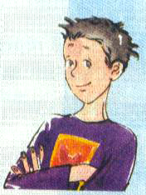
I want to be the PE monitor. I enjoy sport, and I can run really fast. I’m really fit and healthy. Just watch me in the playground between lessons! I play most ball games well. But I’m really good at football, and I play basketball in the school team. I usually get the best score in every match. Choose me for the PE monitor and you can
get the best score too!

Slide 15
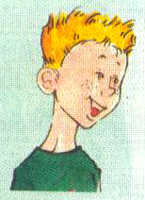
I’d like to be the cleaning monitor. I often help my mother do cleaning at home and I like a clean and tidy house. I’m sure everybody would like a clean classroom, just like home. Choose me and we can make our
classroom beautiful.

Slide 16
Read the passage and check (√) the true sentences.
×
1. Lingling doesn’t get on well with
others.
2. Lingling is kind to everyone.
3. Daming is good at sport so he wants
to be the PE monitor.
4. Daming plays football for the school.
5. Tony doesn’t like cleaning.
6. Tony’s home is tidy.
√
√
×
×
√

Slide 17
2
Underline the correct words.
How to choose your monitors
A good class monitor gets on well with (1)classmates / everybody and (2)promises / likes to help you.

Slide 18
A good PE monitor enjoys sport and is usually (3) fit / tidy. They often play (4)basketball / the piano or other sports in the school (5) team / class. They always try to get the best (6)score / help in a match.
A good cleaning monitor is (7)bad / good at cleaning. They make the classroom (8)just / best like home.

Slide 19
4
Complete the sentences with the correct form of the expressions from the box.
get on well with good at ready to
1. Lingling is a kind girl and she is always ___________ help others.
2. Everybody likes her because she
________________ others.
3. Daming plays football and is _________ sports.
ready to
gets on well with
good at

Slide 20
5
Work in pairs
Choose the best people in your class to be the monitors in Activity 1.
Say:
who they are and what job they can do
why they can do it

Slide 21
Language points
1. I get on well with everyone…
get on well with... 与......相处融洽；进展顺利
1) Do you get on well with your parents?
你跟你父母相处得怎样？
2) I get on very well with them.
我和他们相处的非常好。

Slide 22
3) He is not easy to get on well with.
他不是一个容易相处的人
如果要表达“与某人相处得不好”，可以用get on badly with sb. 如果想询问“与某人相处得怎样”，要用how来提问，例如：
—How do you get on well with your
classmates? 你跟同学相处得怎样？
—Just so so. 一般般。

Slide 23
2. Choose me as your class monitor and I promise to help YOU!
as的意思是“作为，当作”，例如：
As a student, she has to finish her homework.
作为一个学生，她必须完成作业。
promise “允诺；许诺”
promise sb. to do sth.
答应某人做某事

Slide 24
make a promise 许下诺言
keep one’s promise 保守诺言
break one’s promise 打破诺言, 说话不算数
do some cleaning 打扫卫生
do some shopping 买东西
do some reading 看书
do some washing 洗衣服
3. I often help my mother do cleaning at home.

Slide 25
4. I’m always ready to help others.
be ready to do sth. “准备好做某事”
get ready to do sth. 和be ready to do sth.的意思是“准备做某事”。前者强调行为；后者强调状态。两者后面可接介词for，for后面接名词。如：
We are ready for the English test.

Slide 26
5. I’m sure everybody would like a clean classroom, just like home.
sure “确信的；有把握的”
1) be sure +不定式用于祈使句，作“务必、一定”讲。
Be sure to come to my house.
Be sure to finish your homework as soon as possible.

Slide 27
2) be sure+从句，表“确信、对……有把握”
I am sure that he is coming.
= He is sure to come.
3) make sure +从句 = make sure of
弄清、查清楚
Make sure that he has handed his workbook.
Make sure of it before you start out.

Slide 28
just like “正如，正像”
The night of the celebration was just like Christmas for them.
当晚的庆祝活动对他们来说就像圣诞节一般。

Slide 29
6. We can make our classroom beautiful.
此句子中的make是“使、使得”意思，一般用于“make + 宾语 + 宾补”这种结构，常用的句型是：make + sb. / sth. + adj. 意为“使某人或某物处于某种状态”。
例如：The news made him happy.
这个消息使他很高兴。

Slide 30
Exercise
一、翻译下列短语。
1. 新学期开始 ____________________
2. 愿意成为…… ___________________
3. 与……相处得好 __________________
4. 努力工作 ______________________
5. 乐意去做某事 _________________
6. 帮助别人 _____________________
the start of the new term
would like to be
get on well with
work hard
be ready to do sth.
help others

Slide 31
choose sb. as
promise to do
want to be
run fast
in the playground
play ball games
be good at
get the best score
7. 选择某人作为…… _______________
8. 承诺做…… _________________
9. 想成为…… _________________
10. 跑得快 _________________
11. 在球赛上 _________________
12. 打球赛 _________________
13. 擅长于…… _________________
14．得分最高 _________________

Slide 32
15. 在校队打篮球
_________________________________
16. 帮助某人搞清洁
_________________________________
17. 干净整洁的房子
_________________________________
18. 确信 __________________
19. 就好像 __________________
20.使……漂亮 __________________
play basketball in the school team
help sb. do cleaning
a clean and tidy house
be sure
just like
make … beautiful

Slide 33
二、完成句子。
1. 我与全班同学都相处得很好。
I ______________ all the classmates in our class.
2. 我想成为班长，请选我。
I _________________________ the class monitor, please choose me.
get on well with
would like to be / want to be

Slide 34
3. Tom总是乐意帮助别人。
Tom ______always_____________ help ___________.
4. Sam在家经常帮助妈妈做家务。
Sam often __________ his mother ______________ at home.
is ready to
others
helps
do cleaning

Slide 35
is good at playing
Choose for
make healthy
5. 我兄弟擅长于踢足球。
My brother ___________________ football.
6. 选我做体育委员，我会使大家都健康。
_________me ________the PE monitor, I can ________ everyone _________.

Slide 36
Homework:
以“Choose me as the PE monitor ” 为题，写一篇作文。
1、介绍自己在体育方面的强项。
2、承诺对同学们的服务。
3、希望同学们选自己。

