Slide 1
Unit 6 Topic 1
I would rather watch sports shows than those ones.
Section B
WWW.PPT818.COM

Slide 2
Review
1.我更喜欢苹果。
2.康康更喜欢踢足球。
3.Lily喜欢电视剧胜过新闻报道。
4.汤姆和迈克喜欢下象棋胜过看电视。
=汤姆和迈克宁愿下象棋也不愿看电视。
I prefer apples.
Kangkang prefers to play soccer.
Kangkang prefers playing soccer.
Lily prefers TV plays to news reports.
Tom and Mike prefer playing chess to watching TV.
Tom and Mike would rather play chess than watch TV.

Slide 3
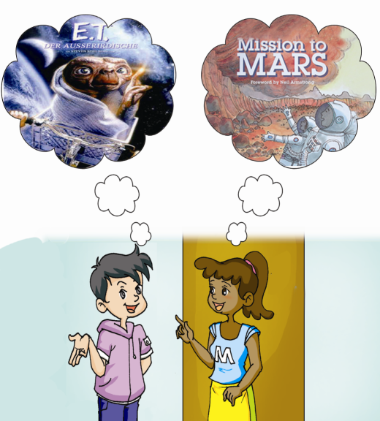
被提到
What movies were mentioned?

Slide 4
1b. Listen to 1a and choose the correct answers.
录音P29-1a
( ) 1. What program did Maria watch last night?
A. The Time Machine and Mission to Mars.
B. A science fiction movie.
C. A program about science fiction movies.
( ) 2. Who are interested in the science fiction movies?
A. Kangkang. B. Maria. C. Both of them.
C
C

Slide 5
1c. Read 1a and mark T (True) or F ( False).
1. Kangkang looks very tired today. ( )
2. There were three movies mentioned in the conversation. ( )
3. Maria saw all of the movies mentioned in the conversation. ( )
4. Kangkang saw E.T. last night. ( )
5. Jane, Maria and Kangkang will go to the cinema tomorrow. ( )
F
T
F
F
T

Slide 6
1a Look, listen and say. 视频 P29-1a

Slide 7
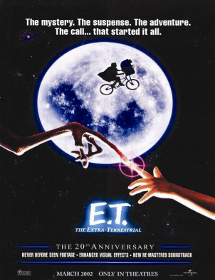
If you want to watch movies ,the following posters may help you .From them ,you can get more information about movies.

Slide 8
2b. Read 2a and fill in the blanks.
1. If you want to see The Time Machine and E.T. on the same day, you should go on .
2. In the movie, The Time Machine, the scientist and inventor decides to prove that .
3. If you are interested in aliens, you can watch .
Aug. 26th to 29th
time travel is possible
E. T.

Slide 9
2c. Read 2a again and mark T (True) or F (False).
1. The three movies are not all about aliens. ( )
2. In the movie, The Time Machine, people can travel to the future. ( )
3. E. T. refers to Elliot. ( )
4. In the movie, Mission to Mars, a mysterious storm kills all the crew members. ( )
T
T
F
F

Slide 10
Summary
1. 用疲惫的声音
2. 惊奇地
3. 以……为基础
4. 在……的帮助下
5. 上演，上映，穿上
6. 你看起来有点累。
in a tired voice
in surprise
be based on
with the help of …
put on=be on
You look a little tired.

Slide 11
Write down the key words of the conversation to introduce their favorite movies.
Search for more information about some famous movies.

