Slide 1
Section B Using language
外研版高中英语必修二
Unit 5 On the road
WWW.PPT818.COM

Slide 2
Ⅰ
Ⅱ
Ⅲ
Ⅰ.知识体系图解
route
aboard
landscape
dramatic
hike
volcano
budget
chain
credit
cash
flight
remote
engage
cafe

Slide 3
Ⅰ
Ⅱ
Ⅲ
夜以继日地工作
从……跳出来
在……尽头;在……末尾
看一看
申请
登记
提前
(有)现金
参加;从事
第一次

Slide 4
Ⅰ
Ⅱ
Ⅲ
Ⅱ.释义匹配
1.route A.on or onto a ship,plane,or train
2.aboard B.everything you can see when you look across a large area of land,especially in the country
3.landscape C.a long walk in the mountains or countryside
4.hike D.a journey in a plane or space vehicle
5.flight E.a way from one place to another
答案:1.E 2.A 3.B 4.C 5.D

Slide 5
Ⅰ
Ⅱ
Ⅲ
Ⅲ.单句填空
1.Do you know the girl (dance) on the stage?
2.The students need to adapt to the rapidly (change) world.
3.They gave a (convince) demonstration of the car’s safety features.
4.The building (build) at present is our library.
5.They built a highway (lead) into the mountains.
dancing
changing
convincing
being built
leading

Slide 6
重点词汇
重点句式
重点语法
随堂练习
1.aboard adv.在船(飞机、火车)上
【课文原句】People who travel aboard the Bernina Express have the chance to see incredible views.
乘坐伯尔尼纳快车旅行的人有机会看到令人难以置信的景色。
【词汇精讲】aboard是副词,意为“在船(飞机、火车)上”。
We walked her to the wharf and put her aboard the ship.
我们陪她走到码头,将她安顿到船上。
We must not take combustible goods aboard.
我们切不可带易燃物上车。

Slide 7
重点词汇
重点句式
重点语法
随堂练习
【词汇拓展】
The man says that we have to go aboard half an hour before the ship sails.
那人说我们必须在开船前半小时上船。

Slide 8
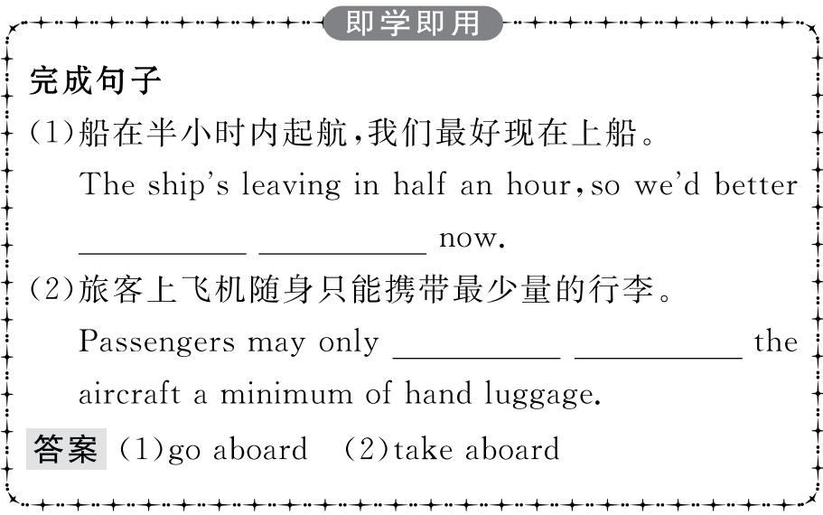
重点词汇
重点句式
重点语法
随堂练习

Slide 9
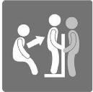
重点词汇
重点句式
重点语法
随堂练习
2.transfer n.转乘
【课文原句】 I’ve bought the plane tickets and arranged transfer from the airport to the hotel.
我买了机票并做好了从机场到酒店的安排。
【词汇精讲】transfer可作动词或名词,意为“转乘,转移”。
He has asked for a transfer to the company’s Paris branch.
他要求调到公司的巴黎分部。
My friend tells me that he will transfer to another school.
我的朋友告诉我,他要转到另一所学校。
Passengers are transferred from the airport to the hotel by taxi.
旅客自机场乘出租车到旅馆。

Slide 10
重点词汇
重点句式
重点语法
随堂练习
【词汇拓展】
It is reported that the injured have been transferred to the local hospital for treatment.
据报道,目前伤者已被转移至当地医院进行治疗。
She was able to transfer her new wisdom to other parts of her life as well.
她能够把她的新智慧也传递到她生活中的其他部分。

Slide 11
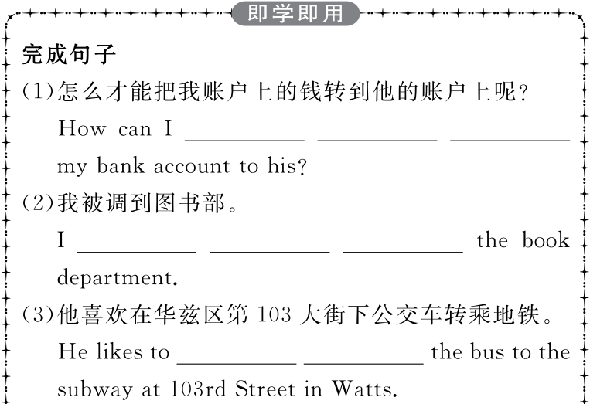
重点词汇
重点句式
重点语法
随堂练习

Slide 12
重点词汇
重点句式
重点语法
随堂练习

Slide 13
重点词汇
重点句式
重点语法
随堂练习
3.exchange v.交换,兑换
【课文原句】Have you exchanged foreign currency?
你兑换外币了吗?
【词汇精讲】句中的exchange是动词,意为“调换;交换”,exchange还可以作名词,意为“交换;交流”。
Now cross-cultural exchanges are becoming more common in the world.
现在跨文化交流在世界上正变得越来越普遍了。
You can have photos taken with your friends,or dine out together and exchange gifts.
你可以和朋友一起照相,或出去吃饭并交换礼物。

Slide 14
重点词汇
重点句式
重点语法
随堂练习
I was lucky to have been chosen to the International Students’ Exchange Program.
我非常幸运地被挑选参加国际学生交流项目。
【温馨提示】exchange和change作动词时,前者强调双方交换,而后者则强调事物的属性或位置的改变。

Slide 15
重点词汇
重点句式
重点语法
随堂练习
【词汇拓展】
They exchange ideas and feelings with each other,through which they probably acquire more knowledge.
他们互相交流想法和感受,通过这种方式他们很可能获得更多的知识。
He’s giving her French lessons in exchange for her teaching him English.
他教她法语,她教他英语,互教互学(作为交换条件)。

Slide 16
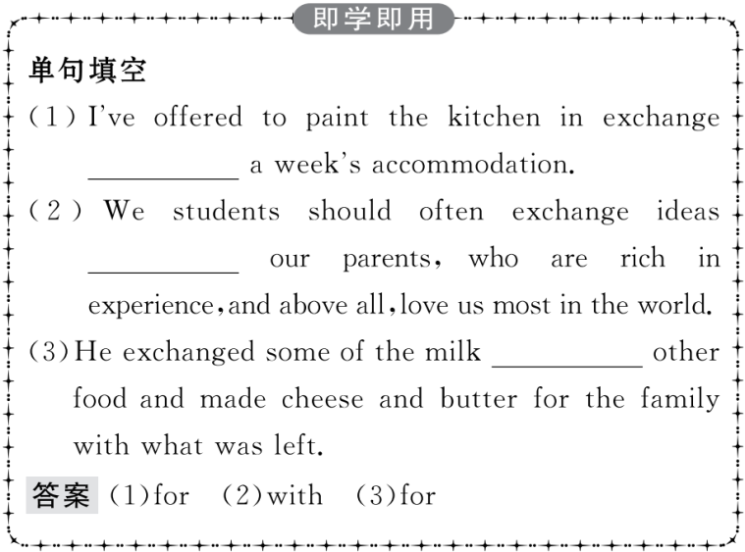
重点词汇
重点句式
重点语法
随堂练习

Slide 17
重点词汇
重点句式
重点语法
随堂练习
4.engage v. 参与,参加
【课文原句】...travellers explore unusual or remote destinations,often engaging in risky activities.
……探险不寻常或偏远目的地的游客,经常参与危险的活动。
【词汇精讲】句中的engage是动词,意为“参与,参加”。
I never engage in such kind of activities.
我从不参与这种活动。
Would you often engage in activities you love?
你经常参与你喜欢的活动吗?

Slide 18
重点词汇
重点句式
重点语法
随堂练习
【词汇拓展】
They tried to engage him in conversation.
他们试图跟他交谈。
As we travel,let us engage with other cultures and celebrate human diversity.
让我们在旅游时接触其他文化,庆祝人类的多样性。

Slide 19
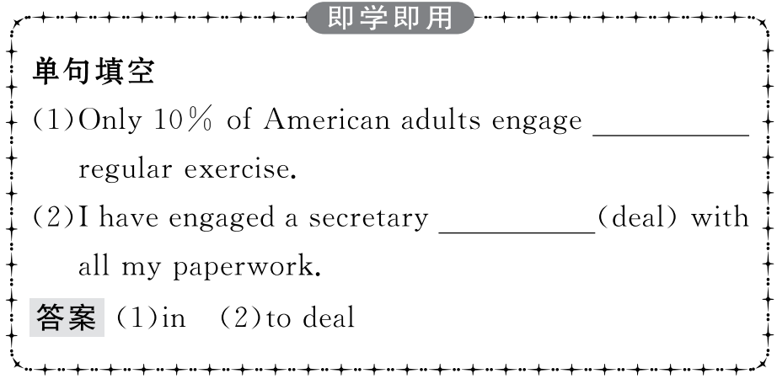
重点词汇
重点句式
重点语法
随堂练习

Slide 20
重点词汇
重点句式
重点语法
随堂练习
There is no doubt that the Bernina Express is a journey for travellers who want to get back to nature...
毫无疑问,伯尔尼纳快车是(属于)想回归自然的旅行者的旅程……
【句式剖析】
there is no doubt that...意为“毫无疑问……”,that引导同位语从句。
There is no doubt that John’s first aid skills he learned at school saved Ms Slade’s life.
毫无疑问,是约翰在学校学到的急救技能,挽救了斯莱德女士的生命。

Slide 21
重点词汇
重点句式
重点语法
随堂练习
There is no doubt that I have little difficulty communicating with foreigners.
毫无疑问,我与外国人交流几乎没有什么困难。
There is no doubt that a small child has to learn to keep his balance before he can walk far.
毫无疑问小孩子必须学会保持平衡才能走得更远。

Slide 22
重点词汇
重点句式
重点语法
随堂练习
【句式拓展】
I don’t doubt that he is telling the truth.
我毫不怀疑他在讲真话。
Do you doubt that he will win the match?
你怀疑他会赢这场比赛吗?

Slide 23
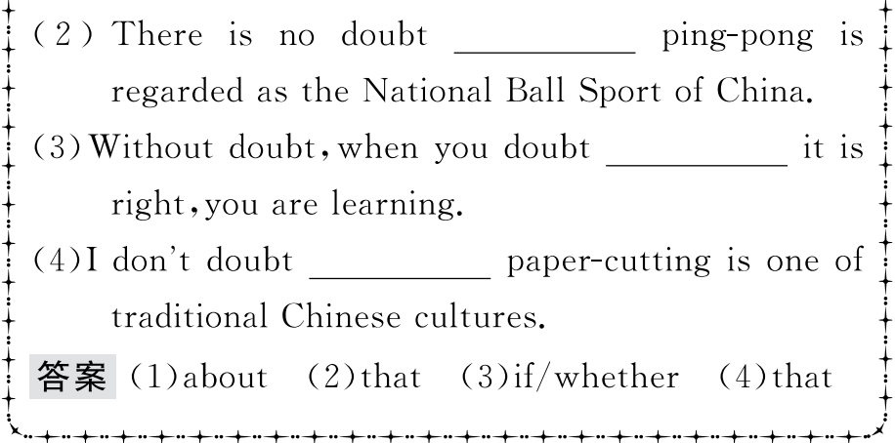
重点词汇
重点句式
重点语法
随堂练习

Slide 24
重点词汇
重点句式
重点语法
随堂练习
现在分词作定语
1.位置
一般来讲,单个现在分词作定语通常放在被修饰名词的前面,而现在分词短语作定语则放在被修饰名词的后面。
China is a developing country.
中国是个发展中国家。
Make less noise.There’s a sleeping child.
不要出太大声音,有个孩子在睡觉。
Who is the student standing by the door?
站在门口的那个学生是谁?

Slide 25
重点词汇
重点句式
重点语法
随堂练习
The young man sitting between John and Mary is the editor of the campus newspaper.
坐在约翰和玛丽之间的那个年轻小伙子是校园报的编辑。
有些作定语的现在分词已经转化为形容词,可被very修饰。
That is a very interesting story.
这是个非常有趣的故事。
类似这样的词还有: inviting,charming,promising,pleasing,encouraging,disappointing,exciting,surprising,amazing,astonishing,shocking,striking等。

Slide 26
重点词汇
重点句式
重点语法
随堂练习
2.逻辑主语
现在分词作定语时,其逻辑主语就是被修饰的名词。换句话说,被修饰的名词是现在分词动作的执行者。
We visited the village lying in the south of our county.
我们参观了位于我们县南部的村庄。
The man driving the car is our English teacher.
开车的那个人是我们的英语老师。
Give the book to the man carrying a blue umbrella.
把书给拿蓝色伞的那个人。

Slide 27
重点词汇
重点句式
重点语法
随堂练习
3.时间
现在分词作定语时,它所表示的动作一般与谓语动词所表示的动作同时发生,但有时也可表示经常性的动作或状态。
Do you know the woman talking to our head teacher?(表示正在进行的动作)
你认识和班主任谈话的那位女士吗?
The factory making colour TVs is located east of the city.(表示经常性的动作)
制造彩电的工厂在城市的东部。
The boy coming to dinner this evening is a classmate of mine.
今晚来吃饭的男孩是我的同学。

Slide 28
重点词汇
重点句式
重点语法
随堂练习
有些不及物动词的现在分词与其过去分词所表达的时间形成鲜明的对比——现在分词表示动作正在进行,而过去分词则表示动作已经完成。
falling leaves—fallen leaves
boiling water—boiled water
a developing country—a developed country
a sinking ship—a sunken ship
a drowning person—a drowned body
the rising sun—the risen sun
the changing world—the changed world

Slide 29
重点词汇
重点句式
重点语法
随堂练习
4.语态
如果作定语的现在分词和它修饰的名词有逻辑上的动宾关系,则要用现在分词的被动式。
The question being discussed is of great importance.
正在讨论的问题非常重要。
The room being painted belongs to Li Ming.
正在粉刷的房间是李明的。

Slide 30
重点词汇
重点句式
重点语法
随堂练习
5.现在分词、过去分词和动词不定式的被动式作定语的区别
动词不定式的被动式作定语表示一个未来的动作;现在分词的被动式作定语表示的动作正在发生或是与谓语动词所表示的动作同时发生;过去分词作定语表示的动作或是在谓语所表示的动作之前发生,或是没有一定的时间性。
Will you attend the meeting to be held next week?
你参加下周召开的会议吗?
The building being put up will be our library.
正在建的大楼是我们的图书馆。
This is the car bought last year.
这就是去年买的那辆车。

Slide 31
重点词汇
重点句式
重点语法
随堂练习
Ⅰ.介(副)词填空
1.Mr Brown is one of the people who work the clock.
答案:around
2. the end of the road,you will find the bus stop.
答案:At
3.I want to see the view of the sun that is setting the sea.
答案:on
4.Are you going to apply a visa tomorrow morning?
答案:for
5.When he went on a trip,he took 500 yuan cash.
答案:in

Slide 32
重点词汇
重点句式
重点语法
随堂练习
Ⅱ.句型转换
1.Do you know the man who is shaking hands with Mr Brown?
Do you know the man Mr Brown?
答案:shaking hands with
2.There is a small river that runs through our village.
There is a small river our village.
答案:running through
3.There are many students who are reading in the library.
There are many students the library.
答案:reading in

Slide 33
重点词汇
重点句式
重点语法
随堂练习
4.The bus didn’t come and the people who were waiting for it became anxious.
The bus didn’t come and the people it became anxious.
答案:waiting for
5.The professor who is giving us the lecture comes from Shandong University.
The professor the lecture comes from Shandong University.
答案:giving us

