Slide 1
Module
Rules and suggestions
4
Unit 1 You must be careful of falling stones.
WWW.PPT818.COM

Slide 2
Language goals
To understand conversations of talking about
rules and giving suggestions.
To use modal verbs to give instruction.

Slide 3
Warm up
How much do you know about traffic signs? What should you do when you see the following traffic signs?

Slide 4
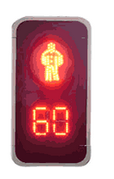
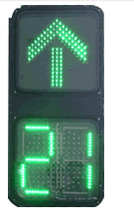
When I see this sign, I should stop walking and wait.
When I see this sign, I can pass the street.

Slide 5
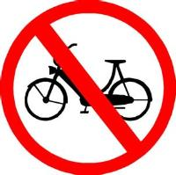
It means we can not ride bicycles here.
We mustn’t walk through when we see this sign.

Slide 6
We should pay more attention because accidents are easily to happen here.
We should be careful because there might be rocks falling.

Slide 7
The driver should be very careful because the road is becoming narrower.
It tells us there is a school nearby, the driver should slow down and be careful.

Slide 8
Words and expressions
动身；出发
set off
sock
whenever
proper
edge
yourself
go off
starve
/sɔk/
n. 短袜
/wen'evə/
conj.每当；无论什么时候
/'prɔpə/
adj.合适的；恰当的
/edʒ/
n. 边，边缘
/jə'self/
pron.你自己
(pl. yourselves)
离开
/sta:v/
v.挨饿，饿死

Slide 9
Words and expressions
n.尝试；努力
go
in one go
rock
rock climbing
stone
fairly
smooth
straight
/gəu/
一口气；一下子
/rɔk/
n. 岩；岩石
攀岩
/stəun/
n.石头
/'feəli/
adv.相当；还算
/smu:ð/
adi. 无困难的；顺利的；
平坦的
/streit/
adj. 直的；笔直的

Slide 10
Focus on
Words:
sock whenever proper edge yourself starve fairly smooth straight
Phrases:
set off go off in one go
rock climbing
Patterns:
You should always wear proper clothes.
You mustn’t go off on your own.
It should be a fairly smooth walk to begin with.

Slide 11
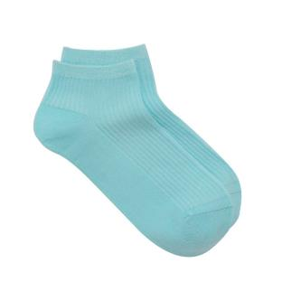
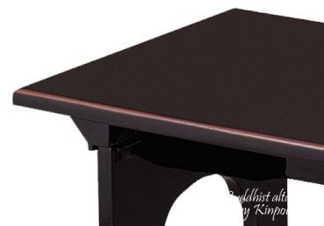
socks
n. 短袜
edge
n. 边，边缘

Slide 12
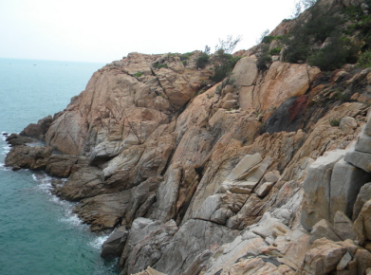
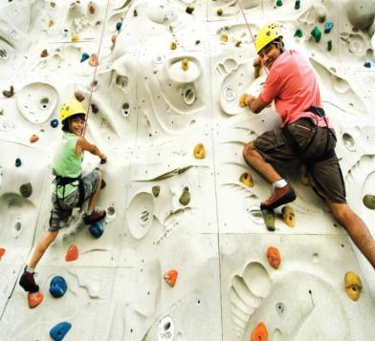
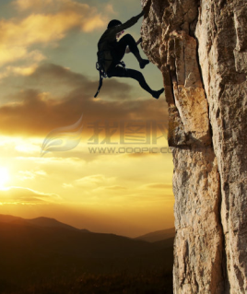
rock
n. 岩；岩石
rock climbing
攀岩

Slide 13
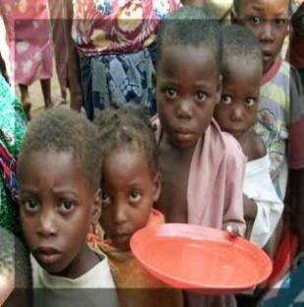
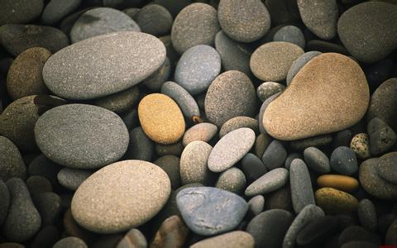
starve
v.挨饿，饿死
stone
n.石头

Slide 14
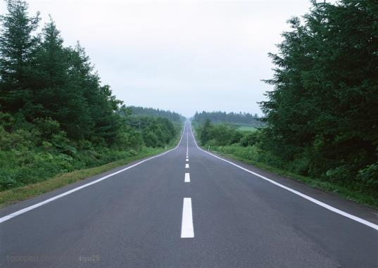
smooth
adi. 无困难的；
顺利的；平坦的
straight
adj. 直的；笔直的

Slide 15
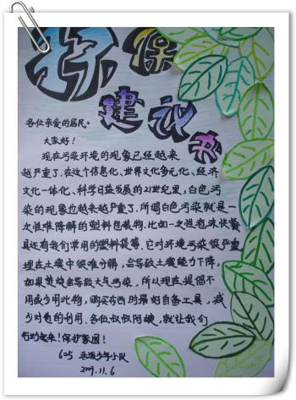
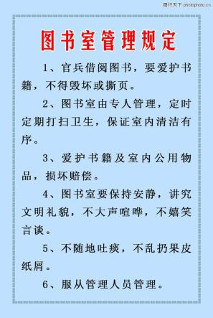
suggestion
n. 建议；提议
rule
n. 规定；规则

Slide 16
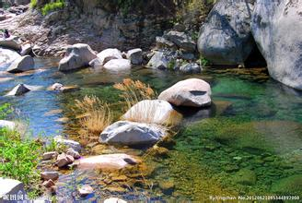
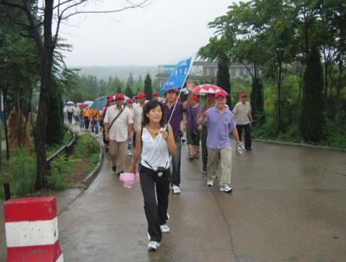
stream
n. 小溪；溪流
lead the way
带路

Slide 17
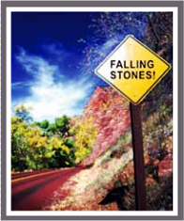
Listening and vocabulary
1
Look at the photo. Then say what suggestions you can give to people who go walking in the mountains.

Slide 18
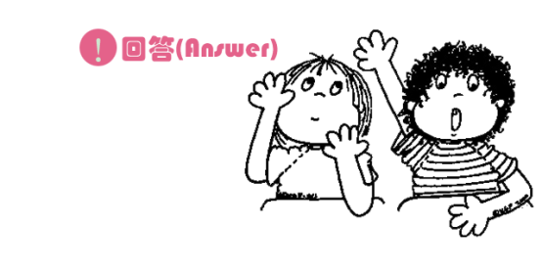
I suggest that they should be careful of the falling stones and shouldn’t stay there for a long time.

Slide 19
go walking with your friends
No selfies
(自拍).
take some food and water
wear comfortable shoes
inspect your emergency and first aid kits before the hike
have a haircut before the hike if possible

Slide 20
2
Listen and answer the questions.
1 When is Betty leaving for the trip?
2 What is Mr Jackson going to tell the
students?

Slide 21
3 What does Betty’s mum suggest Betty should not do?
4 Does Betty think the trip will be dangerous?

Slide 22
Watch and read

Slide 23
3
Listen and read.
Mr Jackson: OK, please pay attention for a moment!
Before we set off, there are a few rules and
suggestions for you.
All: Yes, Mr Jackson.
Mr Jackson: First, is everyone wearing strong shoes
and thick socks?
All: Yes, Mr Jackson.
Mr Jackson: OK, whenever you go walking in the hills,
you should always wear proper clothes.
Now, you mustn’t walk too close to the
edge of the hill path because you might
fall and hurt yourselves. Is that clear?

Slide 24
All: Yes.
Mr Jackson: And you have to keep together so you
don’t get lost. You mustn’t go off on your
own.
All: No, we won’t, Mr Jackson.
Daming: Can we have something to eat now? I’m
starving!
Mr Jackson: No, you can’t, Daming! You just had
breakfast an hour ago. Let’s start
walking, and we’ll stop at noon for our
picnic. Don’t drink all your water in one
go. You may need some later.
Betty: Can we go rock climbing?

Slide 25
Mr Jackson: No, you can’t. And you must be careful
of falling stones. OK, off we go, down this
path, and across the stream, and then
we’ll…
Daming: … have lunch?
Mr Jackson: … have lunch when we get up to the top.
Come on! I’ll lead the way. It should be
a fairly smooth walk
to begin with because
it’s a straight path,
but it’ll start to get
difficult soon!
Everyday English
Please pay attention
for a moment!
I’m starving!

Slide 26
Now choose the correct answer.
1 Mr Jackson gives a lot of rules and
suggestions, so he probably ________.
a) is happy about walking in the hills
b) has never been to the hills
c) has a lot of experience of walking in the hills
2 The children might hurt themselves if they
________.
a) walk along the edge of the hill path
b) wear proper clothes
c) drink all their water before lunch
c
a

Slide 27
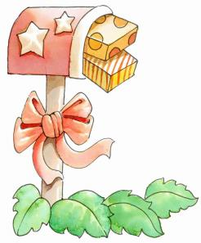
3 Before they have lunch, they ________.
a) have to get up to the top
b) can have something to eat
c) can go rock climbing
a
Learning to learn
When you give
suggestions, you may use
can, must, have to, should,
mustn’t and shouldn’t,
depending on the strength
of your advice.

Slide 28
Language points
When is Betty leaving for the trip? 贝蒂什么时候出发去旅行？
leave for 意为“出发去某地”，后接的是目
的地。如：
I will leave for Xi’an from Shanghai this afternoon.
今天下午我将要离开上海去往西安。

Slide 29
2. Before we set off, there are a few rules
and suggestions for you.
在我们出发前，我要先讲几条纪律和建议。
set off最常用的意思有：出发，动身，启程。如：
If you want to catch that train we’d better set off for the station immediately.
你要是想赶上那班火车，咱们最好马上动身去火车站。

Slide 30
3. Can we have something to eat now?
我们现在能吃点东西吗？
修饰不定代词something, nothing, anything, somebody, nobody等的形容词和动词不定式要放在代词后面。如：
Hello! I have something important to tell you.
你好！我有重要的事情要告诉你。

Slide 31
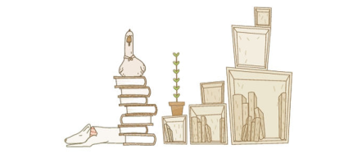
4. I’m starving! 我都快饿死了！
口语中，人们常用starving表示“非常饿”。
如：What’s for lunch? I’m starving!
午饭吃什么？我快饿死了！

Slide 32
5. OK, off we go, down this path, and across the
stream, and then we’ll… 好，我们出发，沿着
这条路，穿过小溪，然后我们就要……
此句中的off we go 为完全倒装，当句首为副词或表示地点的介词短语时采用完全倒装，句型结构为：状语( 时间、地点……)+谓语+主语(必须是名词而不是代词)。如：
In came the doctor. 医生进来了。
Under the tree are some children. 树下有些孩子。

Slide 33
6. Come on! I’ll lead the way. 走吧！我来带路。
come on 在不同的情境中有不同的意思，可
表示“快一点”或者表示不相信。如：
Come on ! We are going to be late.
快点！我们要迟到了！
Oh, come on! I could do it in ten minutes.
得了吧，我十分钟就能干完。
(2) lead 在这里表示“带(路)；领(路)。如：
I don’t know the way. You’d better lead.
我不认识路，所以最好你带路。

Slide 34
4
Make notes about Mr Jackson’s rules
and suggestions.
You should _____________________________.
You can’t _____________________________.
You mustn't ____________________________
________.
Don’t ___________________________________.
You have to ______________________________.
You can’t ______________________________.
You mustn’ t _____________________________.
You must ______________________________.
always wear proper clothes
go rock climbing
walk too close to the edge of the
hill path
drink all your water in one go
keep together so you don’t get lost
have something to eat now
go off on your own
be careful of falling stones

Slide 35
Role-play
Role play the conversation
in groups;
2. Role play the conversation in front of the class
Let’s see which group does the best.

Slide 36
5
Complete the passage with the correct
form of the words in the box.
smooth stone straight thick whenever
(1) _________ you walk in the hills, you
must wear strong shoes and (2) _______
socks. The walk may be fairly (3) _______
at the start because the path is (4) _______,
but later it may get difficult. You should
also be careful of (5) _____ falling from above.
Whenever
thick
smooth
straight
stones

Slide 37
Pronunciation and speaking
英语连读的规则：
1. “辅音+元音”型（即相邻两词中的前一
个词是以辅音结尾，后一个词以元音 开头）
2. “辅音+半元音”型（即前一个词以元音开头，后一个词以/j/,/w/开头）
3. “元音+元音”型（即前一个词以元音结尾，后一个词以元音开头，这两个词往往要自然而不间断地连读）
注意：若前一个词的结尾和后一个词的开头相同，这两个词要连读。

Slide 38
6
Read and predict how the speaker is
likely to link the words.
Whenever you go walking in the hills, you should always wear proper clothes. Now, you mustn’t walk too close to the edge of the hill path because you might fall and hurt yourselves.
Now listen and check.

Slide 39
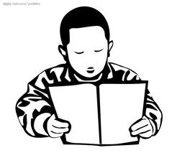
7
Read the paragraph in Activity 6 aloud.
Whenever you go walking in the hills, you should always wear proper clothes. Now, you mustn’t walk too close to the edge of the hill path because you might fall and hurt yourselves.

Slide 40
8
Work in pairs. Talk about a trip to:
● the beach ● the mountains
● the countryside ● the theatre
Now give rules and suggestions.

Slide 41
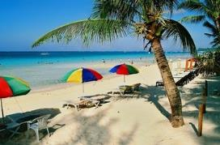
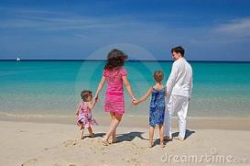
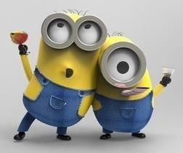
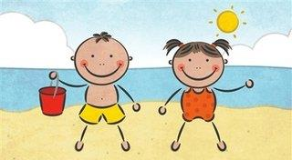
For example:
Yes! You must bring good sun cream to protect your skin.
Yes, that’s very important. It’s easy for us to get sunburnt.
You also should keep your camera away from the water.
Well, thanks for your suggestions! I’ll prepare for my trip.
Where are you going for your trip?
We are going to go to the beach.
Oh, what a wonderful idea!
Yeah! Do you have any suggestions?
Have a good time!

Slide 42
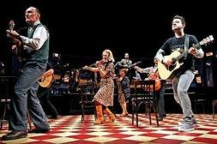
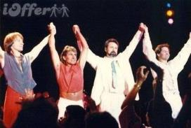
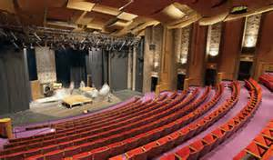
For example:
Right! You should try to keep the theatre clean.
Yes, and we mustn’t drop litter in the theatre.
A great choice! You should keep quiet all the time there.
Where are you going for your trip?
Yes! Thanks for your suggestions.
I’d like to go to the theatre.

Slide 43
Exercises

Slide 44
一、单项选择
John ___ come to see us tonight, but he isn't
very sure yet.
A. may B. can C. has to D. must
2. They ___ do well in the exam.
A. can be able to B. be able to
C. can able to D. are able to
A
D

Slide 45
3. -May I take this book out?
-No, you___.
A. can't B. may not
C. needn't D. aren't
You___ go and see a doctor at once because
you’ve got a fever.
A. can B. must
C. dare D. would
A
B

Slide 46
5. -- Can you speak Japanese?
-- No, I____.
A. mustn't B. can't
C. needn't D. may not
6. --He___ be in the classroom, I think.
--No, he ___ be in the classroom. I saw him
go home a minute ago.
A. can; may not B. must; may not
C. may; can't D. may; mustn't
B
C

Slide 47
7. -Shall I get one more cake for you, Dad?
-Thanks, but you___, I've had enough.
A. may not B. must not
C. can't D. needn't
Even the top students in our class can't work
out this problem, so it___ be very difficult.
A. may B. must
C. can D. need
D
B

Slide 48
9. You___ worry about your son. He will get
well soon.
A. needn't B. can't
C. mustn't D. have to
10. The poor man needs our help, ___ he?
A. need B. needn't
C. does D. doesn't
A
D

Slide 49
二、 用方框中合适词的正确的形式填空。
straight edge rock climbing themselves in one go
themselves
Children may hurt _________ when they
play with fire.
2. I have a friend who often goes __________ at the weekend.
3. The horse had enough power to run these 50 miles _________.
4. Terry was so tired he couldn’t walk _________.
5. She was standing at the water’s _________.
rock climbing
in one go
straight
edge

Slide 50
三、 根据提示翻译句子。
我对这里也不熟悉，找个向导领路吧。
(lead the way)
_____________________________________
__________________________________
2. 作为学生，独立完成作业对你来说很重要。(on your own)
______________________________________
___________________________________
3. 你能给我从冰箱里拿点饮料吗？
(something to drink)
______________________________________
____________________________________
I’m also a stranger here. Find a guide to lead the way.
As a student, it’s important for you to finish your homework on your own.
Can you get me something to drink from the fridge?

Slide 51
Homework
Preview the new words and
expressions in Unit 2.
2. Search for information about basic survival skills in the wild.

