Slide 1
Lesson 35
Future Transportation
WWW.PPT818.COM

Slide 2
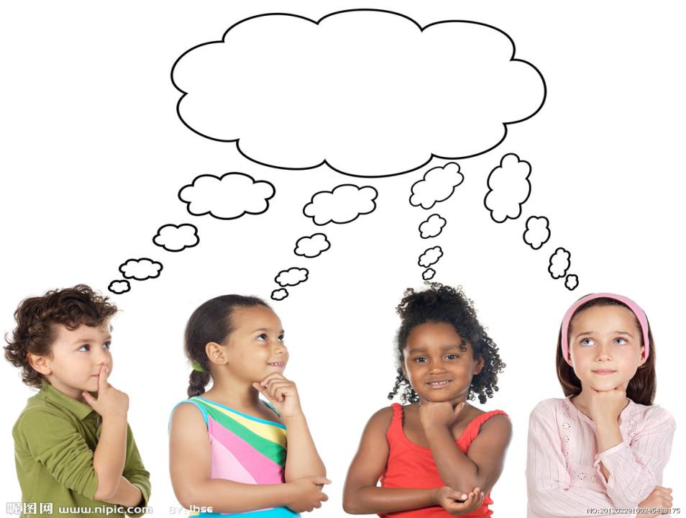
THINK ABOUT IT

Slide 3
Have you ever used a skateboard?
What type of transportation do you think is
amazing?

Slide 4
Hello everyone! My name is Sam.
What type of transportation would I like to see
in the future? I would like to see hoverboards. A
hoverboard would be like a skateboard, but it
wouldn’t have any wheels. It would go really fast,
and the ride would be very smooth. How would a
hoverboard float? I have no idea. But it would be
great! I hope someone will invent one in the future.

Slide 5
Maybe someone will invent a transporter, too.
A transporter would send you from one place to
another very, very quickly. Today, it takes eleven
hours to fly from Canada to China. But with a
transporter, it would take just a few seconds. A
transporter would allow you to travel at the speed
of light.

Slide 6
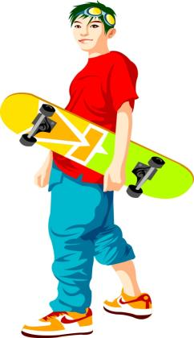
I like to watch TV shows about space and
spaceships. The shows are about the future, not
about today! In these shows, people use new forms
of transportation all the time.

Slide 7
Read the lesson and write true (T) or false (F).
A hoverboard would be like a skateboard with
wheels. （ ）
2. A hoverboard would float in the air. （ ）
3. Riding the train from Canada to China takes
eleven hours. （ ）
4. TV shows about space and spaceships are about
the future. （ ）
F
T
F
T

Slide 8
1.
It would go really fast, and the ride would be
very smooth.
它跑得快且平稳。
形容词 平稳
的，无颠簸的，
无摇晃的
在这里作名
词，表示“骑
马旅行或坐车
旅行”
He went for a ride in his car.
他坐汽车转了一圈。
a smooth ride in a good car
坐着性能好的汽车平稳的行驶。
a smooth landing in a plane
乘飞机平稳地着陆

Slide 9
2.
invent 动词
发明
名词形式：inventor 发明家
名词形式：invention 发明
Who invented the stream engine?
谁发明了蒸汽机？
Alexander Bell was a great inventor, and he invented
many things. Of all the inventions, the telephone is the
most famous one.
亚历山大·贝尔是一个伟大的发明家，他发明了很多东
西。 其中，电话是他所有发明中最有名的一个。

Slide 10
3. But with a transporter, it would take just a
few seconds.
但有了这种交通工具，将只用几秒钟。
此句中表示“假想，猜测，推断”
I know you wouldn’t get lost.
我知道你不会迷路的。

Slide 11
4.
allow 动词
允许
常用结构：allow doing sth. 允许做某事
allow sb. to do sth.
允许某人做某事
We don’t allow smoking here.
在这里不允许抽烟。
My mother doesn’t allow me to go out alone in
the evening. 妈妈不允许我晚上单独出门。
at the speed of light 以光的（传播）速度。

Slide 12
5. all the time.
总是，一直
Follow that man and keep him in sight all the time.
跟着那个人，要一直盯着他。
I’ve kept on thinking about that all the time.
我一直想着那件事。
I have a dog and a cat, but they fight all the time.
我养了一只猫和一只狗，但它们总是打架。

Slide 13
常见的关于time的词组还有：
at that time（在那时） at the same time （同时）
at times （时常） in time （及时）
on time （准时） in no time （立刻）……

Slide 14
Match the words with the correct descriptions.
wheel
It would send you from one place to
another very quickly.
space
It is how fast or slow something moves.
transporter
It has no air to breathe.
speed
It is the part of a car that allows it to
move smoothly.

Slide 15
Complete the dialogue with the correct forms of
the words in the box.
smooth form float send
Paul: Hi Jack! My Canadian pen pal, Frank,
wrote me an e-mail about a new __________
of transportation.
Jack: Oh, really! What’s it like?
Paul: It’s a bit like a ship.
form

Slide 16
float
Jack: Can it___________on the sea?
Paul: Of course. It gets energy from water. It
____________people to different places
very fast.
Jack: Sounds cool! Does it move___________?
Paul: I have no idea. I’ll ask Frank more about it.
sends
smoothly

Slide 17
Work in groups. Talk about some inventions you
know. Then fill in the table.
Invention | Who invented it? | When was it invented? | How does it work?

