Slide 1

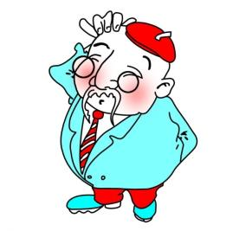
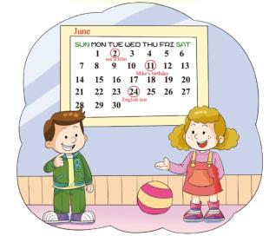
Unit 3
We are going to have an English test.
WWW.PPT818.COM

Slide 2
教学目标：
1、能听说以下词汇和词组并知道它们的意义：
词汇：date , forget, farm, meeting , test, important,
month, third.
词组：visit a farm, have a test, have a party.
2、能用What’s the date？询问日期并尝试用两种方式回答，能初步尝试用be going to 表达计划。
教学建议：把日期的表达及问答达渗透到日常教学中。

Slide 3
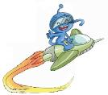

Let’s talk
Can you say something about him with the key words（关键词）?
1.引导学生发挥想象，根据关键词谈论图片人物，句子意思接近即可。学习third.并引导学生思考：Why he likes writing? T：Because he often forgets something important.让学生更好地理解forget。
2. T： So he usually writes down something important. Let’s look at the picture and tell me what you can get from the picture.
Mr.Forget
a car
Feb. 3rd
60
writing
animals
He is Mr. Forget.
He is 60 years old.
His birthday is on February 3rd.
He is learning to drive a car.
He love animals very much.
His hobby is writing.

Slide 4

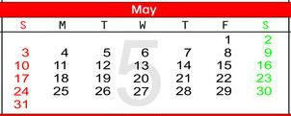

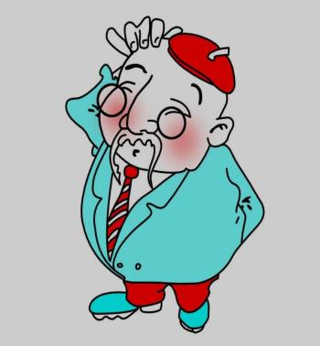
Let’s look and talk.
visit a farm
1.学生认真看图并说出获取到的信息。（引导学生说出人物、地点、星期、日期、月份）
2.回答Mr. Forget的问题。也可以呈现the first of May.
have a driving test
1
Fri.
have a meeting
What day is it today ?
It’s Friday.
2. What’s the date today ?
It’s May 1st.
Mr. Forget

Slide 5
1.引导学生关注日历上的日期及对应的备忘记录，并学习farm, test, meeting.
Let’s look.
visit a farm
have a driving test
1
Fri.
have a meeting
Mr. Forget

Slide 6

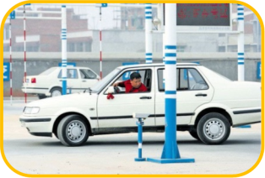

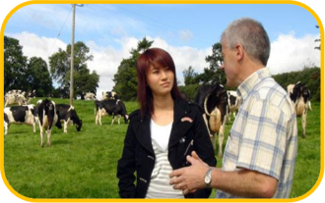
Let’s match.
visit a farm
1.引导学生观察图片，根据短语的构成尝试进行信息匹配。
have a driving test
have a meeting
2023-01-17

Slide 7

Let’s help.
Let’s remind（提醒）him of the important things to do.
visit a farm
引导学生帮助Mr. Forget， 提醒他将要做的事情。学习并体验be going to 的用法。
have a driving test
1
Fri.
have a meeting
W: What’s the date today ?
F: It’s May 1st.
visit a
farm
W: You are going to _______
_____ tomorrow. Don’t
forget.
Mr. Forget

Slide 8
Let’s help.
Let’s remind（提醒）him to do something important.
visit a farm
引导学生帮助Mr. Forget， 提醒他将要做的事情。体验be going to 的句型。关注时间表达的变化。
have a driving test
1
Fri.
have a meeting
W: What’s the date today ?
F: It’s May 1st.
W: You are going to visit a
farm on May ____.
Don’t forget.
2nd
Mr. Forget

Slide 9
Let’s help.
Let’s remind（提醒）him to do something important.
visit a farm
引导学生帮助Mr. Forget， 提醒他将要做的事情。学习important。
have a driving test
1
Fri.
have a meeting
F: Is there anything important
this week?
have a driving test
W: Yes. You are going to ____
___________ this_______.
Don’t forget.
Sunday
Mr. Forget

Slide 10
Let’s remind（提醒）him to do something important.
Let’s help.
visit a farm
引导学生帮助Mr. Forget， 提醒他将要做的事情。并进行句型转换。关注时间表达的变化。
have a driving test
1
Fri.
have a meeting
F: Is there anything important
this week?
W: Yes. You are going to have
a driving test on ________.
Don’t forget.
May 3rd
Mr. Forget
2023-01-17

Slide 11
Let’s remind（提醒）him to do something important.
Let’s help.
visit a farm
1.引导学生帮助Mr. Forget， 提醒他将要做的事情。
2. He is going to have a test in April. Ben and Janet are going to have a test , too. Are they going to have a driving test? Let’s look at the picture.
have a driving test
1
Fri.
have a meeting
F: Is there anything else important
this month?
are going to have a meeting
W: Yes. You _______________
___________ on May 21st.
Don’t forget.
Mr. Forget
2023-01-17

Slide 12

Let’s talk.
引导学生看图并用自己的话描述Ben和Janet的计划。
They are going to ________ on ________.

Slide 13

Let’s learn.
Janet: What’s the date, Ben?
Ben: The first of June. Why?
Janet: We are going to see a film tomorrow evening. Don’t forget.
Ben: Isn’t that Mike’s birthday? We are all going to his home for
a party tomorrow.
Janet: No. Mike’s birthday party is on June 11th.
Ben: Is there anything else important
this month?
Janet: Yes. We are going to have an
English test on June 24th.
Don’t forget.
学生自己先尝试读课文对话，再模仿录音朗读对话，并进行分角色朗读、分组朗读等。

Slide 14
Let’s do.
T or F
( )1. It’s July 1st today.
( )2. Ben and Janet are going to
see a film on June 2nd.
( )3. It isn’t Mike’s birthday
tomorrow.
( )4. There is nothing important
this month.
( )5. The English test is on June
11th.
根据课文内容判断正误。
F
T
T
F
F
Mr. Forget
2023-01-17

Slide 15







Let’s say.
Janet: What’s the date, Ben?
Ben: The first of June. Why?
Janet: We are going to see a film tomorrow evening. Don’t forget.
Ben: Isn’t that Mike’s birthday? We are all going to his home for
a party tomorrow.
Janet: No. Mike’s birthday party is on June 11th.
Ben: Is there anything else important
this month?
Janet: Yes. We are going to have an
English test on June 24th.
Don’t forget.
抽空训练。

Slide 16



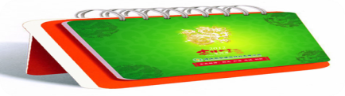

Let’s say.
Janet: What’s the date, Ben?
Ben: The first of June. Why?
Janet: We are going to see a film tomorrow evening. Don’t forget.
Ben: Isn’t that Mike’s birthday? We are all going to his home for
a party tomorrow.
Janet: No. Mike’s birthday party is on June 11th.
Ben: Is there anything else important
this month?
Janet: Yes. We are going to have an
English test on June 24th.
Don’t forget.

Slide 17
Let’s practise.
Fill in the form.
Activities | dates
see a film
 | June 11th
 | June 24th
根据课文内容填空并尝试复述课文。
June 2nd
Mike’s birthday party
have an English test
Today is ____________. Janet and Ben are talking about their plans. They are going to _______________. Mike’s birthday is on _____________. They are going to his home for a party. And they are going to _________.
2023-01-17

Slide 18
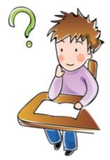
Let’s conclude
基数词 序数词
表示个数的词 表示顺序的词
让学生观察并归纳。
1.one
2.two
3.three
4.four
5.five
6.six
7.seven
8.eight
9.nine
10.ten
11. eleven
12. twelve
first
second
third
fourth
fifth
sixth
seventh
eighth
ninth
tenth
eleventh
twelfth
基变序，有规律，
第一二三，特殊记，
th 从四起，
第八去t, 第九去e,
词尾ve用 f 代替。

Slide 19




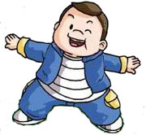
读、记新单词。
2. 读U3课文，并尝试复述课文。
Homework:
广
州
市
小
英
教
研
会
广
州
市
小
英
中
心
组

