Slide 1
Western festivals
第二课时
WWW.PPT818.COM

Slide 2
Warm up
P73歌曲

Slide 3
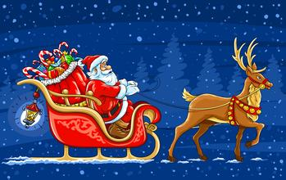
Warm up

Slide 4
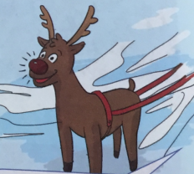
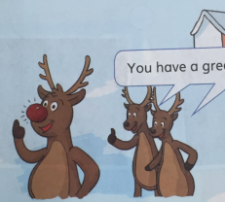
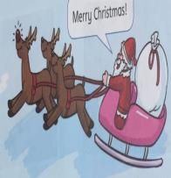
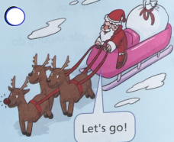
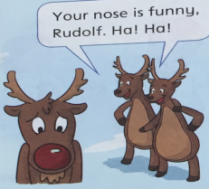
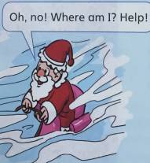
Listen and number
④
⑥
⑤
②
③
①

Slide 5
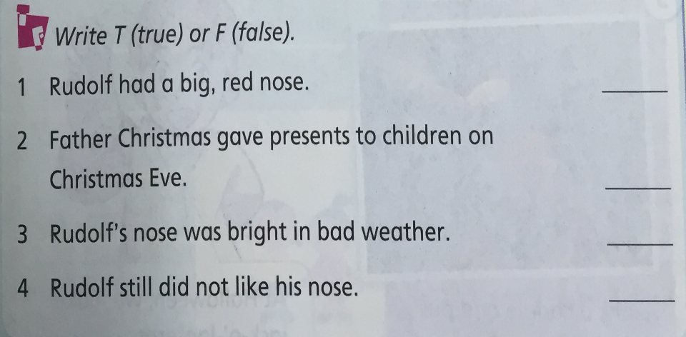
Read and judge
T
T
T
F

Slide 6
Think and retell
Rudolf / did not like / laughed at

Slide 7
Think and retell
Christmas Eve / helped / give presents

Slide 8
Think and retell
bad / could not find

Slide 9
Think and retell
bright / could see

Slide 10
Think and retell
took … to …

Slide 11
Think and retell
happy / loved / loved, too

Slide 12
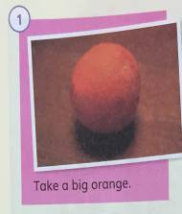
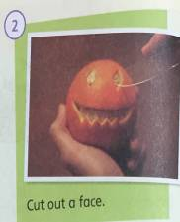
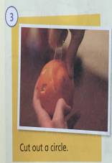
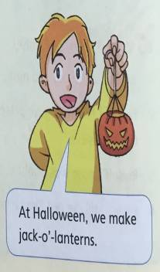
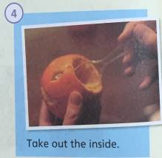
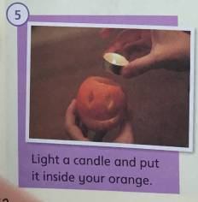
Make and say

Slide 13
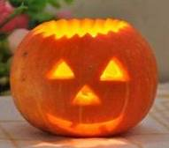
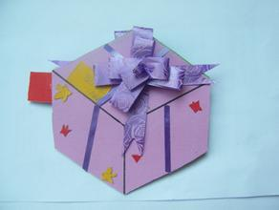
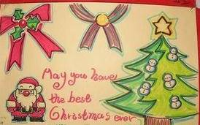
Extensive - activities

Slide 14
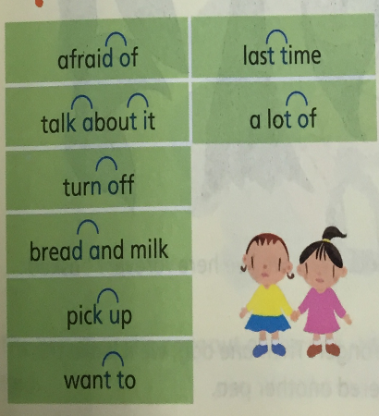
Listen and sounds
英语连读发音规则：
为使说话流畅，词末元音可以和词首元音连读，而不停顿。
相邻的词中，前一个词的末尾是辅音，后一个词的开头是元音。

Slide 15
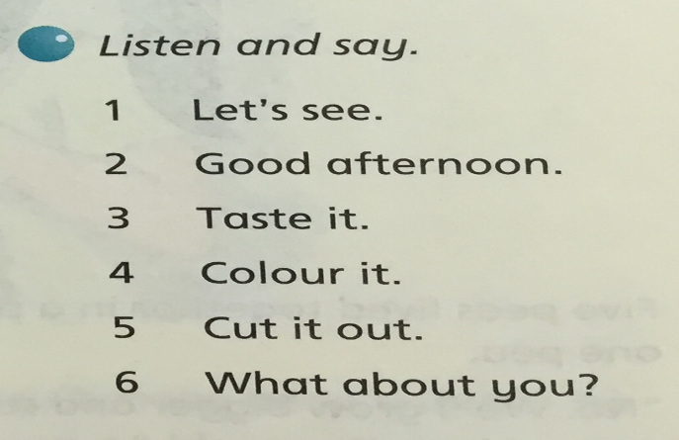
Practice
︵︶

Slide 16
Homework
1.Retell the story.
2.Finish P81 Part 2 – 3.
3.Sing the song “Jingle bells”.

Slide 17
The End

