Slide 1
Unit3 Is It Snowing?
陕旅版
四年级下册
第四课时
WWW.PPT818.COM

Slide 2
>>Review
Look and say
take an umbrella
take a raincoat
put on a coat
put on a raincoat
put on glasses

Slide 3
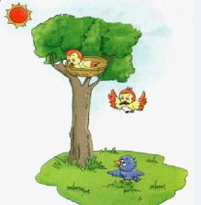
>>Presentation
Ask and answer
Question 1: Are they playing games?
No, they aren’t.
Question 2: Are the two birds busy?
Yes, they are.
Question 3: Does the blue bird have a
house?
No, he doesn’t.

Slide 4
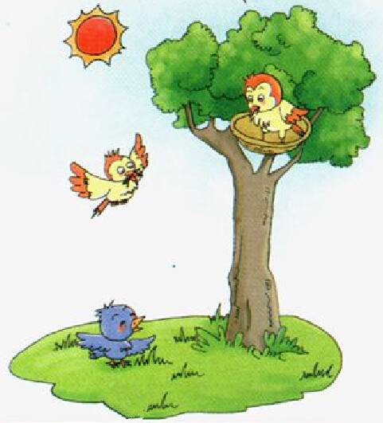
>>Presentation
Read a story
No. We are making our home.
Morning, my friends! Are you playing games?

Slide 5
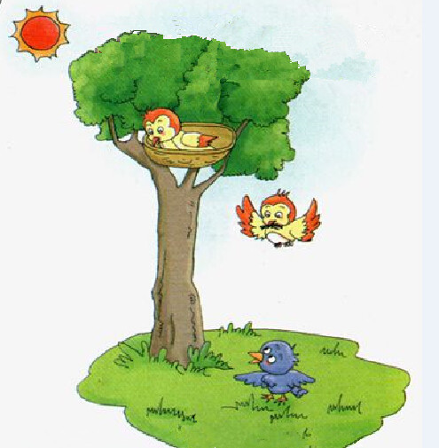
>>Presentation
Read a story
Sorry. We’re busy.
PPT模板：www.1ppt.com/moban/ PPT素材：www.1ppt.com/sucai/
PPT背景：www.1ppt.com/beijing/ PPT图表：www.1ppt.com/tubiao/
PPT下载：www.1ppt.com/xiazai/ PPT教程： www.1ppt.com/powerpoint/
资料下载：www.1ppt.com/ziliao/ 范文下载：www.1ppt.com/fanwen/
试卷下载：www.1ppt.com/shiti/ 教案下载：www.1ppt.com/jiaoan/
PPT论坛：www.1ppt.cn PPT课件：www.1ppt.com/kejian/
语文课件：www.1ppt.com/kejian/yuwen/ 数学课件：www.1ppt.com/kejian/shuxue/
英语课件：www.1ppt.com/kejian/yingyu/ 美术课件：www.1ppt.com/kejian/meishu/
科学课件：www.1ppt.com/kejian/kexue/ 物理课件：www.1ppt.com/kejian/wuli/
化学课件：www.1ppt.com/kejian/huaxue/ 生物课件：www.1ppt.com/kejian/shengwu/
地理课件：www.1ppt.com/kejian/dili/ 历史课件：www.1ppt.com/kejian/lishi/
Look at the beautiful sun.
Come and play with me.

Slide 6
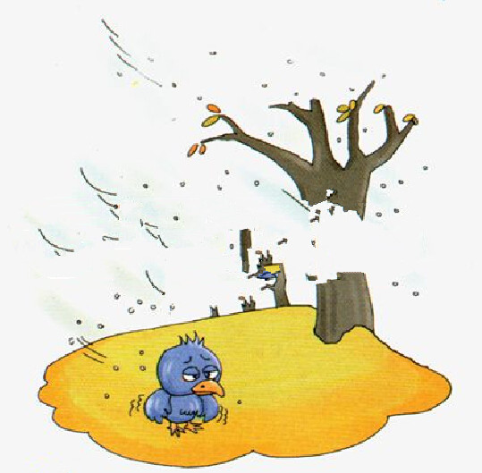
>>Presentation
Read a story
Oh, it’s snowing. How cold it is! I want a house.

Slide 7
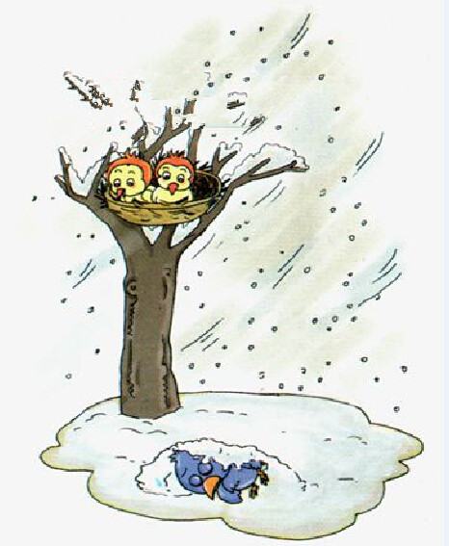
>>Presentation
Read a story
Poor things!

Slide 8
>>Presentation
Read a story
Listen and say
A: Morning, my friends!
Are you playing games?
B: No. We are making our house.
A: Look at the beautiful sun. Come and play with me.
B: Sorry. We are busy.
A: Oh, it's snowing. How cold it is! I want a house.
B: Poor thing!

Slide 9
>>Practice
Read it by yourselves for one minute .
自读课文一分钟。
一分钟倒计时
60
Learning tip :
10
50
当你自己朗读时，遇到不会读或不明白意思的单词或句子，可以把它圈起来，请教同学或老师！
20
40
30
开始

Slide 10
>>Practice
Show time
小组合作，练习对话并表演，其他同学评价。
 | 模仿录音中的语音语调，有感情地朗读。
 | 可以脱离课本，适当改动其中部分，语音地道。
 | 适当添加内容，意思完整，有创新，表演生动。
Good
Great
Excellent

Slide 11
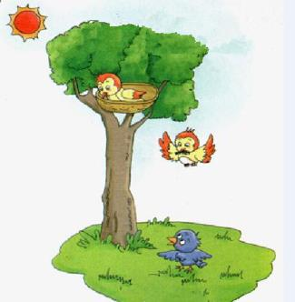
>>Practice
Let’s act
Tips for actors
（演员考核标准）
Tips for actors
Read fluently
流利地朗读
Act fluently
流利地表演
Act it out with emotions
有感情地表演

Slide 12
>>Presentation
Read the words
/æ/
apple
candy
rabbit
face
game
cake
/eɪ/

Slide 13
>>Presentation
Read the words
Try to read more
map
bank
fat
act
lake
page
date
make

Slide 14
>>Practice
把单词带回家
map
rabbit
candy
page
make
cake
act
bank
game
date
/æ/
/eɪ/

Slide 15
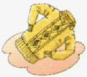
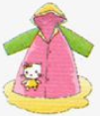
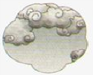
>>Practice
Look and write
Look at the ______ . Please take your ______ .
It’s _______ . Put on your _______ .
It is ______ . I need a ________ .
Look at the ______ in the sky. Please take your ________ .
sun
glasses
snowing
sweater
raining
raincoat
clouds
umbrella

Slide 16
>>Summary
字母A在单词中的常见读音规则：
apple
candy
rabbit
/æ/
face
game
cake
/eɪ/

Slide 17
>>Summary
本课所学的重点句型：
-Are you playing games?
-We are making our school.
Oh, it’s snowing. How cold it is!
I want a house.

Slide 18
>>Homework
1.听课文录音并跟读，按照正确的语音、语调朗读并表演课文对话。 2.用本节课所学的现在进行时句型结构，向自己的家人提问，并操练该句型。
3.预习 Unit4 A Let’s learn。
close

