Slide 1
Unit 2 Lesson 1
2
This is Wang Hong.
WWW.PPT818.COM

Slide 2
重点句型
This is ...
这是……
如：This is Li Ming. 这是李明。
This is a book. 这是一本书。
用于介绍人或物。

Slide 3
This(这) is是用于介绍人或者物的句式：
1. This is Miss li.这是Miss li。
2. This is my teacher.这是我的老师。
3. This is Kevin.这是Kevin。
4. This is Tom.这是我Tom。

Slide 4
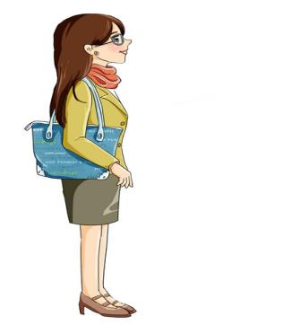
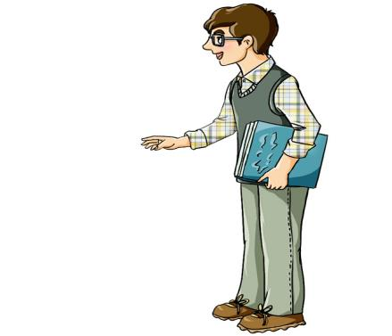
Miss
小姐，老师
Mr
先生
This is Miss. Zhang.
This is Mr. Li.

Slide 5
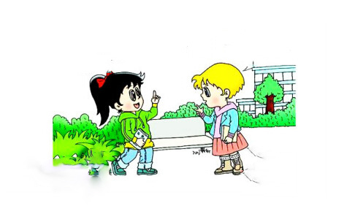
Let’s learn
Good morning, Laura.
Good morning, Jenny.
Nice to meet you.
Nice to meet you, too.

Slide 6
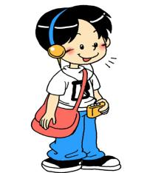
Let’s learn
Good morning, Li Ming.
Good morning, Mr. Li.

Slide 7
This is Amy.
Hello, Amy.
Hello, Li Ming.

Slide 8
This is Nana.
Hi, Nana. I’m Kevin.
Nice to meet you.
Nice to meet you, too.

Slide 9
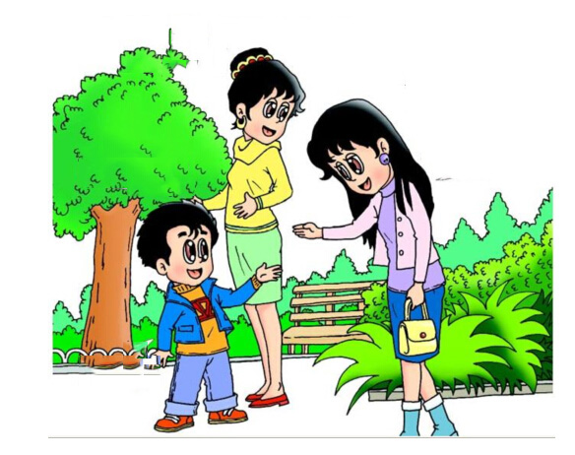
Nice to meet you, too.
Good afternoon,
Kevin.
Good afternoon,
Miss. Liu.
This is my mom.
Nice to meet you.

Slide 10
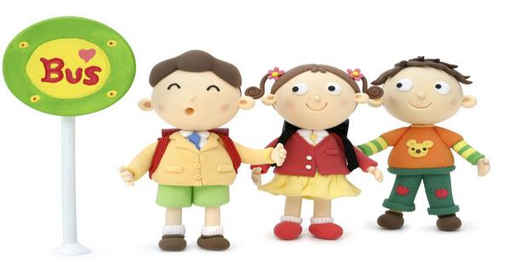
This is Ling.
This is Tom.
This is Jack.

Slide 11
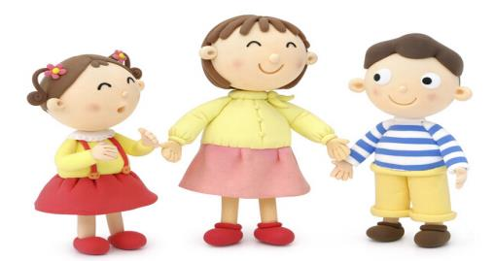
Hello, Ling. Nice
to meet you.
This is Ling.
Nice to meet
you, too.

Slide 12
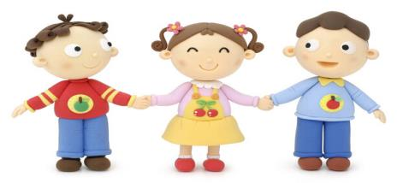
This is Tom.
Nice to meet
you, too.
Nice to meet you, Tom.

Slide 13
Nice to meet you, too.
This is Ling
Hello, Ling. Nice to
meet you.

Slide 14
Homework
1 Copy the dialogue on Page 10.
2 Copy “Let’s talk!” on Page 11.
3 Make a mini dialogue with your classmates or friends.

Slide 15
See you next time!

