Slide 1
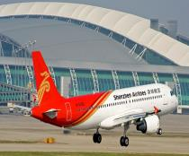
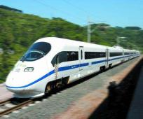
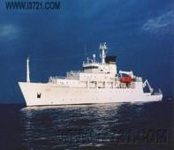
Module 4 Planes, ships and trains
What is the best way to travel?
WWW.PPT818.COM

Slide 2
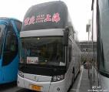
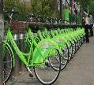
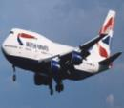
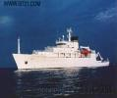
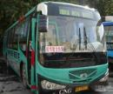
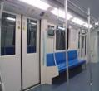
C
C
T
B
P
transportation
s
B
S

Slide 3
Questions
1.How do you come to school?
2.What’s the most expensive way to come to school?
The most expensive way is by…
3.What’s the cheapest way to come to school?
The cheapest way is…
4.What’s the best way to come to school?
The best way is …

Slide 4
Online post
Question: what is the best way to travel from London to Amsterdam
I am planning to travel from London to Amsterdam.
How long does the journey take and what is the best way to travel? Could you please tell me about the trains or ships to get there? The more information, the better. Thanks!

Slide 5
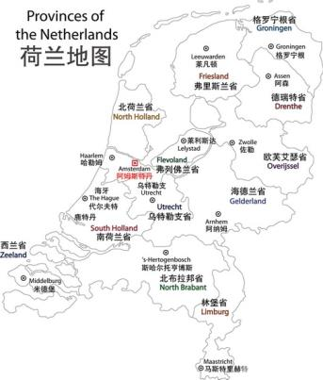
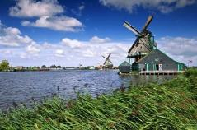
Amsterdam
The capital of Holland
Lie in the northwest of Europe
Be famous for windmill(风车)

Slide 6
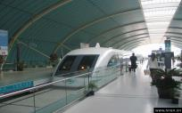
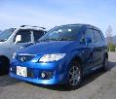
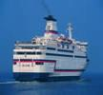
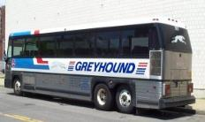
Fast reading
How many ways of traveling in the passage?
There are four ways.
By train, by car and by ship, by coach, by plane.

Slide 7
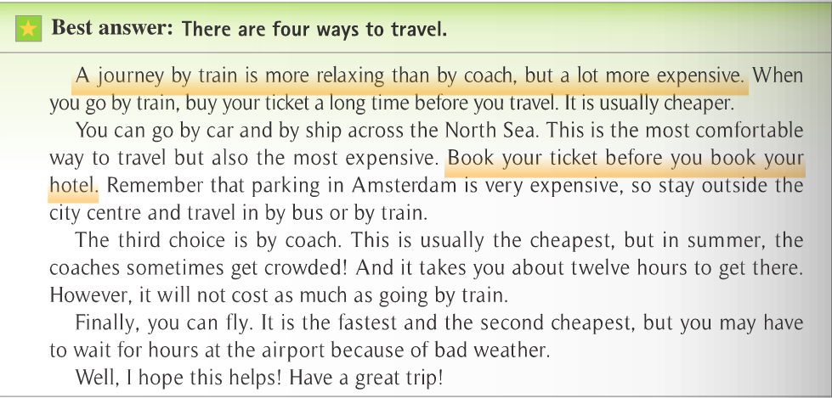
by plane

Slide 8
Reading for details(Para 1)
good point
bad point
suggestion
buy your ticket a long time before you travel
more relaxing
1. A journey by train is than by coach,
But . When you go by train, buy
your ticket a long time before you travel. It is
usually cheaper.
a lot more expensive

Slide 9
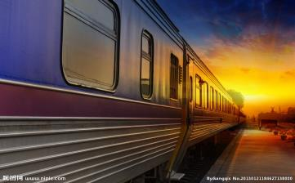
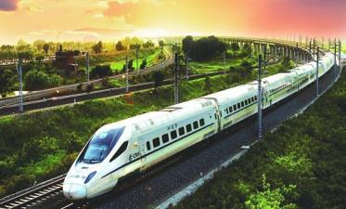
ways of travelling | good points | bad points | suggestions
train | more relaxing | a lot more expensive | buy ticket before travelling

Slide 10
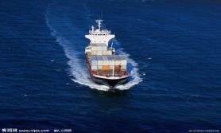
Reading for details(Para 2)
ways of travelling | good points | bad points | suggestions
car&ship
the most comfortable
the most expensive
Book…
Stay outside…

Slide 11
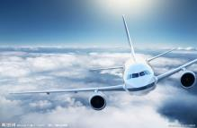
Reading for details(Para 3&4)
ways of travelling | good points | bad points | suggestions
coach
plane
crowded
the cheapest
twelve hours
the fastest
wait for hours
the second
cheapest

Slide 12
Number the 4 ways.
The
cheapest
…
The most expensive
The 2nd
cheapest
The 2nd most expensive
eg. Travelling by car and ship is the most expensive way.

Slide 13
Check your memory
There are four ways to travel from London to Amsterdam. Travelling by train is ___________ than by coach, but a lot ________________.
The most comfortable way to travel is _______________,but also____________________.
The third way is ____ __________. It is usually____________________. However, it will not cost ___________________ going by train. Finally, you can fly. It is the fastest and ________________, but you may have to wait for hours at the airport because of bad weather.
more relaxing
more expensive
by car and by ship
the most expensive
by coach
the cheapest
as much as
the second cheapest
Open your mouth, you are the best !

Slide 14
Discussion:
What is the most important for you to choose the traveling way? (comfortable/relaxing/cheap/interesting/fast…)
What is the best way to travel?
The best way is the most suitable（合适的） to yourself.

Slide 15
My journey: Hefei--Suzhou
By | Fare | Time | comfortable | expensive | interesting | safe
Train | ¥280 | 3
Plane | ¥850 | 1
coach | ¥150 | 5

Slide 16
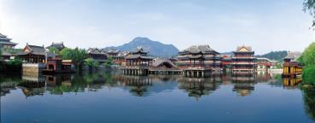
Sample
We are going to …We can go there by….,…or... . Traveling by …is the most…but it’s the most …way to get there. It’s also …than by …or by… Travelling by …is the most … We think being …is the most important for us during the journey. So we choose to get there by…

Slide 17
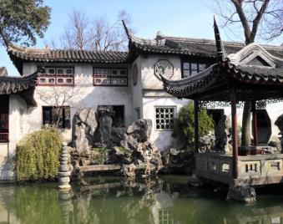
We can go to Suzhou by coach, by plane or by train. Traveling by coach is the cheapest way ,but the most uncomfortable way.
Traveling by plane is the fastest but the most expensive way. It is the most comfortable and safest to travel by train. We think being safe is the most important,so we choose to go there by train.

Slide 18
Choose your proper traveling way, and enjoy your holiday!
Read ten thousand books,
travel ten thousand miles.

Slide 19
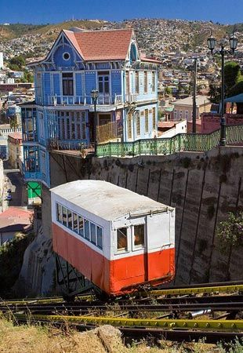
The special transportation
Cable
缆车
From Chile(智利) to Italy, the cable car is a very important means of transportation.

Slide 20
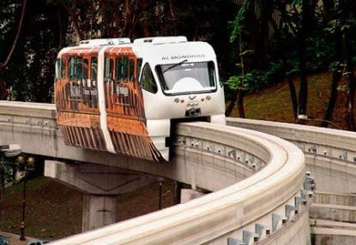
Monorail train
单轨火车
In Malaysia and Japan, it is an effective way to reduce traffic jam.

Slide 21
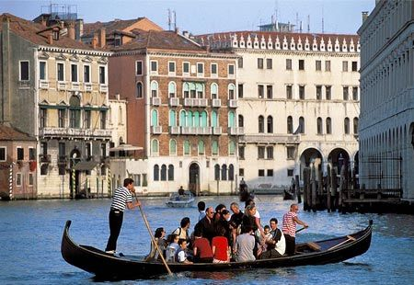
small ferry
People in Venice often travel by small ferry.

Slide 22
Homework
Make a family traveling plan for your next summer holiday and choose proper traveling way.
Notes:
22
中国英语教师网

Slide 23
Bye~
Thank you!

