Slide 1
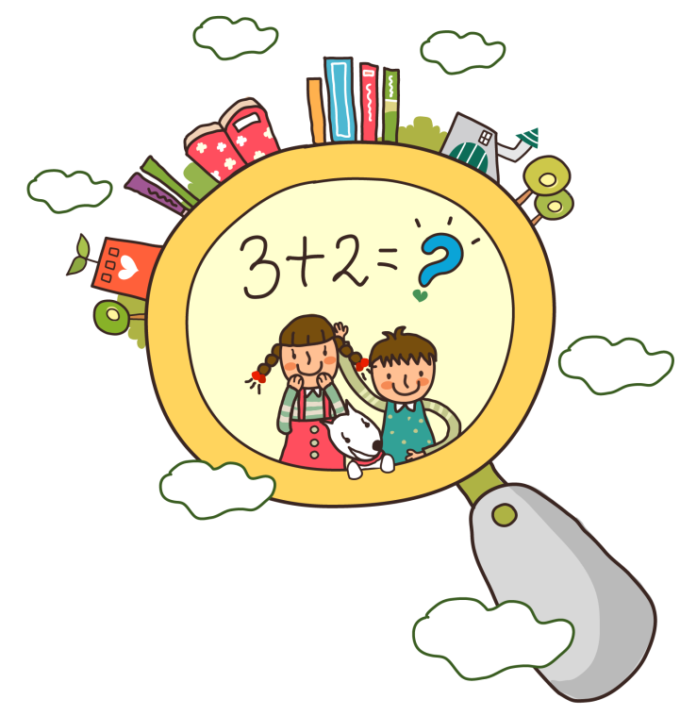
Unit 2
There are forty students in our class
WWW.PPT818.COM

Slide 2
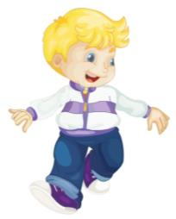
Let’s chant!
How many students are there in Kate’s class?
There are twenty-nine.
How many students are there in your class?
There are forty-six.
How many students are there in Peter’s class?
Can you guess?

Slide 3
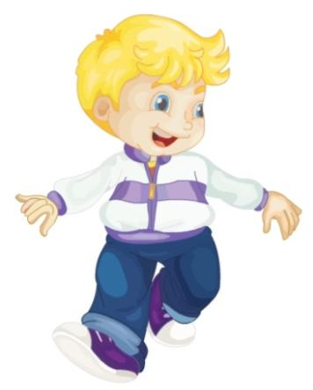
Task 1: Read this passage.
Good morning, boys and girls!
I’m Peter. Let me introduce(介绍)
something(一些事情) about my class.
Miss Green is our new English
teacher. We welcome her to our
class. There are forty students in
our class. There are thirty boys
and only ten girls. I love my teacher
and I love my class, too.

Slide 4
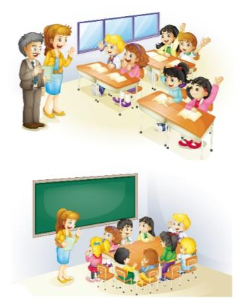
Question 1
How many students are there in Peter’s class?
There are forty.

Slide 5
Good morning, boys and girls!
I’m Peter. Let me introduce(介绍)
something(一些事情) about my class.
Miss Green is our new English
teacher. We welcome her to our
class. There are forty students in
our class. There are thirty boys
and only ten girls. I love my teacher
and I love my class, too.

Slide 6
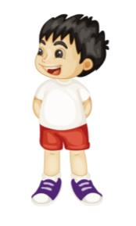
here
Question 2
s
boys
How many ?
There are thirty.

Slide 7
Good morning, boys and girls!
I’m Peter. Let me introduce(介绍)
something(一些事情) about my class.
Miss Green is our new English
teacher. We welcome her to our
class. There are forty students in
our class. There are thirty boys
and only ten girls. I love my teacher
and I love my class, too.

Slide 8
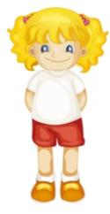
Question 3
girls
How many ?
s
There are only ten.

Slide 9
Good morning , boys and girls!
I’m Peter. Let me introduce(介绍)
something(一些事情) about my class.
Miss Green is our new English
teacher. We welcome her to our
class. There are forty students in
our class. There are thirty boys
and only ten girls. I love my teacher
and I love my class, too.

Slide 10
Question 4
What does “only” mean(意思) in this sentence?
A. 只有，仅仅
B. 唯一的

Slide 11
Question 5
Who is Peter’s new English teacher?
A. Mr. Green
B. Miss. Green

Slide 12
Good morning, boys and girls!
I’m Peter. Let me introduce(介绍)
something(一些事情) about my class.
Miss Green is our new English
teacher. We welcome her to our
class. There are forty students in
our class. There are thirty boys
and only ten girls. I love my teacher
and I love my class, too.

Slide 13
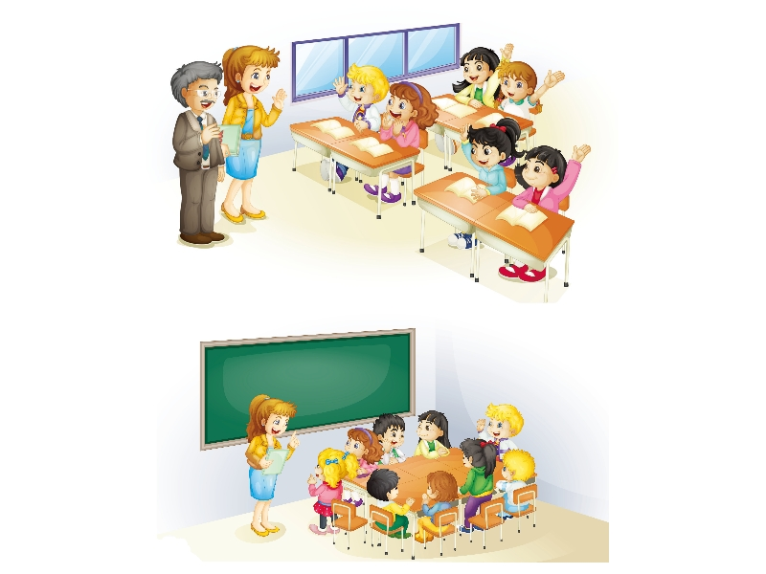
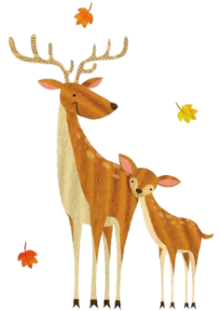
Task 2: Listen and do.

Slide 14
How(如何) do they welcome Miss Green?
Welcome to our class.
What’s Miss Green’s first(第一) question (问题)?
How many students are there in your class?

Slide 15
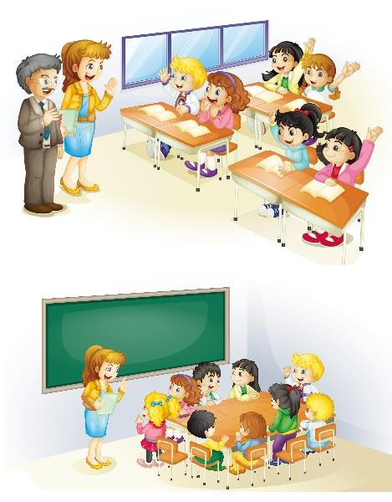
Good morning, boys and
girls. This is Miss Green,
our new English teacher.
Good morning, Miss Green.
Welcome to our class!
Good morning, class!
How many students are
there in your class?
There are forty.
Thirty boys.
And only ten girls.

Slide 16
Task 3: Read and act.
Good morning, boys and
girls. This is Miss Green,
our new English teacher.
Good morning, Miss Green.
Welcome to our class!
Good morning, class!
How many students are
there in your class?
There are forty.
Act the dialogue!
表演对话！
Thirty boys.
And only ten girls.

Slide 17
Good morning, boys and
girls. This is Miss Green,
our new English teacher.
Good morning, Miss Green.
Welcome to our class!
Good morning, class!
How many students are
there in your class?
There are forty.
Thirty boys.
And only ten girls.

Slide 18
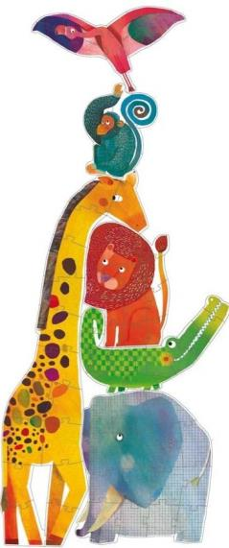
There are ______________ in Peter’s
class. There are _________ and _______.
Miss Green is ______________________.
Peter …
forty students
thirty boys
ten girls
their(他们的) new English teacher

Slide 19
Task 4: Let’s chant.
How many students?
There are forty students.
How many boys?
There are thirty boys.
How many girls?
There are ten girls.

Slide 20
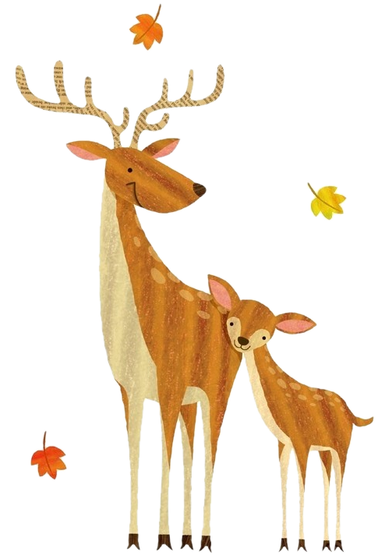
Task 5: Activity.
Make up a new dialogue in groups.
（小组内创编一个新的对话。）
How many …?
There are …

Slide 21
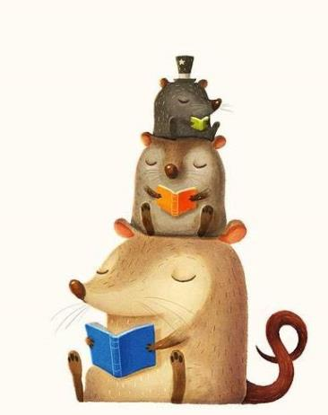
Task 6: Numbers in life.(生活中的数字)
four
There are _______ seasons(季节) in a year.
There are _______months(月份) in a year.
There are _____ months in a season.
There are ______ days in a week(星期).
There are _________ hours(小时) in a day.
There are _______ minutes(分钟) in an hour.
There are _______ days in June(六月).
There are _______ days in July(七月).
There are three _______ and _______ days in 2018.
twelve
three
seven
twenty-four
sixty
thirty
thirty-one
hundred
sixty-five

Slide 22
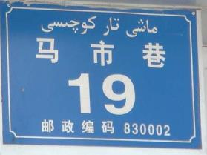
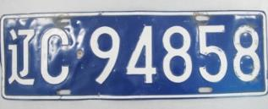
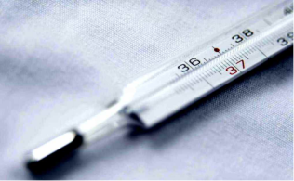
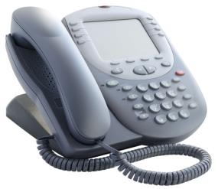
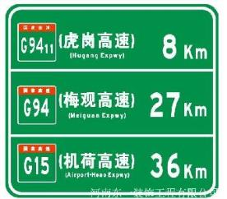
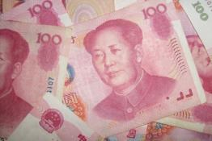
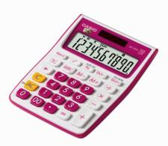
Numbers

Slide 23
Homework:
Must do:
Remember these words and sentences.
Choose to do:
1.Write down a short passage about your class.
2.找到生活中其他关于数字的话题，试着用英文去表达。

