Slide 1
初中英语外研版八年级上
Mdoule6 Animals in danger
Unit 1 It allows people to get closer to them.
WWW.PPT818.COM
Notes:
1

Slide 2
学习目标
1. 掌握词汇：snake, neck, thin, danger, protect, allow, peace等。
2.能够运用所学知识，熟练跟同学谈论动物的生存现状。
3. 通过本单元的学习，让学生意识到保护动物的重要性。

Slide 3
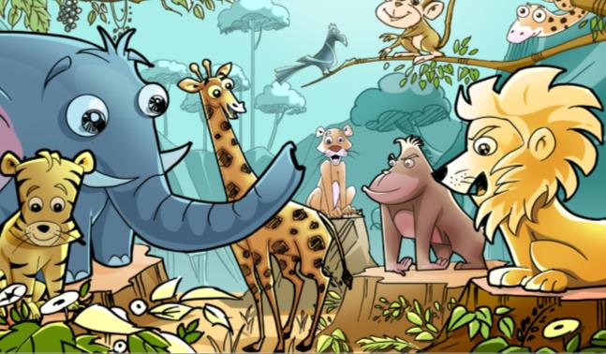
Free talk
How much do you know about animals?
Notes:
3

Slide 4
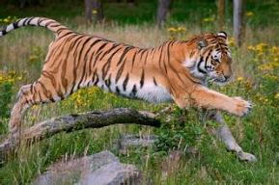
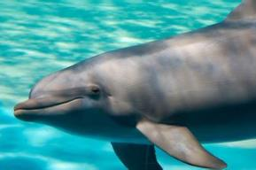
Guessing a game
1. Which animal is the king in the forest?
Tiger.
2. Which animal is the cleverest animal in the sea?
Dolphin.
Notes:
4

Slide 5
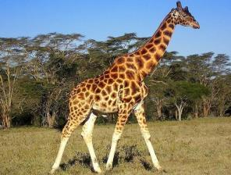
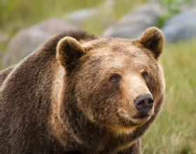
3. Which animal lives in Africa with a very long neck and
long legs?
Giraffe.
4. Which animal is large, strong and heavy with thick fur ?
Bear.
Notes:
5

Slide 6
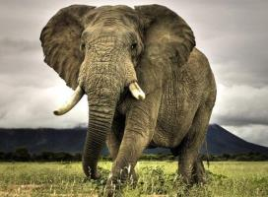
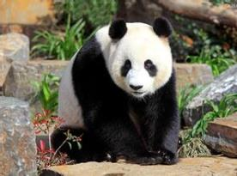
5. Which animal is large with big ears and a very long nose?
Elephant.
6. Which animal looks very cute and lives only in China?
Panda.
Notes:
6

Slide 7
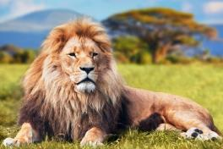
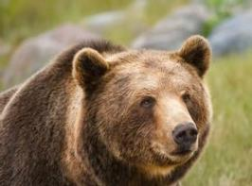
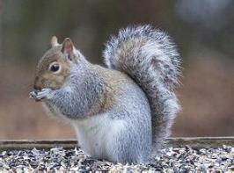
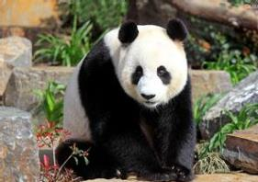
Try to describe
Pandas are very lovely. They’re black and white. They eat bamboo. Most of them live in China.
Notes:
7

Slide 8
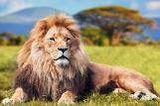
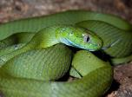
Presentation
1 Look at the pictures and do the quiz.
1. I am tall and I have a long neck.
2. I am the tiger’s cousin.
3. I am long and thin.
4. I am big and I have a very long nose.
5. I am brown and I live in the forest.

Slide 9
2 Listen and answer the questions.
What’s this week’s Animal World about?
2. What animals are in danger?
This week’s Animal World is about snakes.
Animals such as pandas, lions, elephants and bears are in danger.

Slide 10
Tapescripts
Betty: Are you watching Animal World?
Tony: Yes, I’m watching it to find out about different animals. This week it’s about snakes.
Betty: Ugh! Last week they told us why there were so few pandas. They made the programme to show people how the animals live.
Tony: Yes, I saw it. Now I understand why pandas are so special. But we want other animals to be safe too. There aren’t many lions, elephants and bears left in the world.
Betty: It’s good to find out about them.

Slide 11
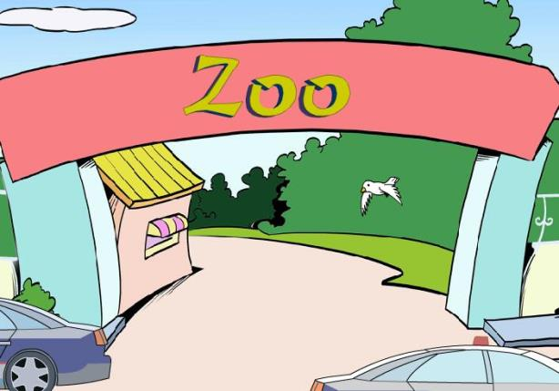
Activity 3
Watch and answer.

Slide 12
Questions
Is Betty more interested in the Wolong Panda Reserve?
Yes, she is.
What does Lingling think of the pandas and other animals
in danger?
She feels sad to think of them in danger.
Why do many animals not have a safe place to live?
Because villages and farms are growing bigger and are taking away their land and forests, and there isn’t enough clean water.

Slide 13
Complete the table
Why many animals are in danger | What we can do to help
Because villages and farms are growing bigger and are taking away their land and forests, and there isn’t enough clean water.
Give money to help protect the animals.
Raise some money at school.

Slide 14
Complete the passage with the words and expression in the box.
allows danger enough in peace protect raise
Many wild animals, such as pandas, are in (1) _______. We need to (2) _______ them! Often there is not (3) ________ land or forests, so the animals do not have a safe place to live.
The Wolong Panda Reserve (4) ______ people to get closer to the pandas. And the pandas live (5) ________ there. You can help (6) ____ money to protect pandas and other wild animals.
danger
protect
enough
allows
in peace
raise

Slide 15
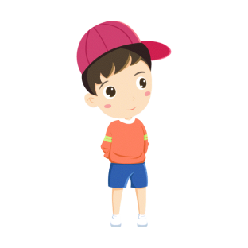
Role play the conversation.
分角色扮演Activity 3部分对话。
小组合作改编对话。

Slide 16
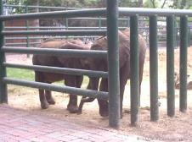
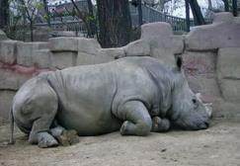
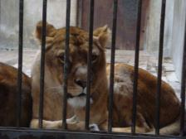
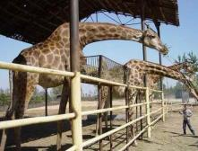
Oral practice
Ask and answer the questions.
1. Why do you visit the zoo?
2. Do you think animals are happy in the zoo? Why?
3. Where do most animals live?
4. What can we do to help the animals?

Slide 17
Talk with your partner about what we can do to
protect animals in danger.
— To protect... we should ...
—We need to ... to protect ...
Make more sentences. Use “To do…we should… ”or “We
need to …to do…”.
E.g.
— To protect the pandas, we should plant more bamboo.
— We need to plant more bamboo to protect the pandas.

Slide 18
Homework
1. 记忆本课时所学的词汇、词组和句型。
2. 熟背Activity 3部分的对话内容。
3. 预习Unit2，查找有关大熊猫的资料。
Notes:
18

