Slide 1
Unit 5 lesson 1
It’s sunny.
WWW.PPT818.COM

Slide 2
重点单词
表示天气的形容词：
“名词+y”转化为形容词：
sun 太阳； sunny 晴朗的
2. rain 雨；下雨 rainy有（多、下）雨的；
3. wind风； windy有（多）风的
4. cloud云； cloudy有（多）云的
5. snow雪；下雪 snowy有（多）雪的

Slide 3
本身就是表示天气的形容词：
1. hot 炎热的
2. warm 温暖的；暖和的
3. cool 凉爽的；酷的
4. cold 寒冷的

Slide 4
重点句型
It is sunny today.
It is windy.
It is cold.
Let’s go to the park.

Slide 5
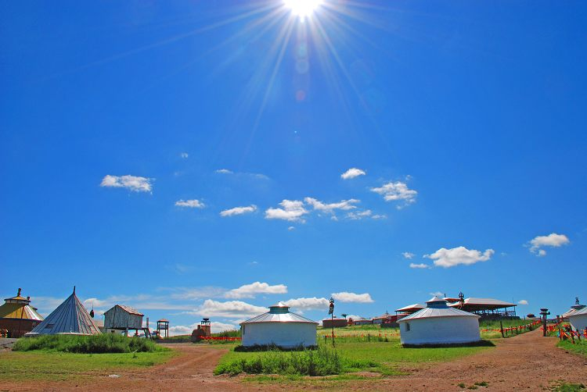
It is sunny today.

Slide 6
It is windy today.

Slide 7
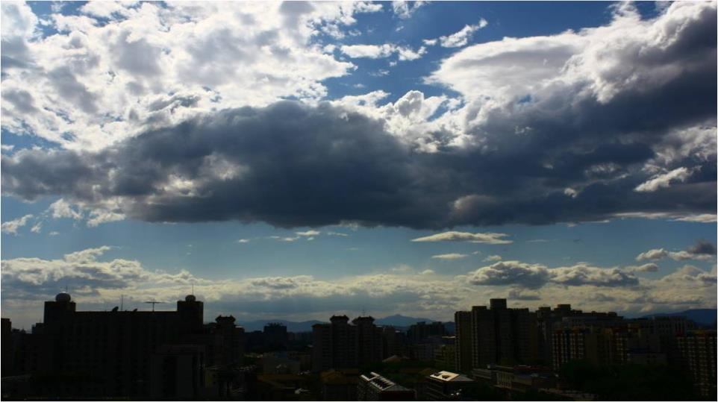
It is cloudy today.

Slide 8
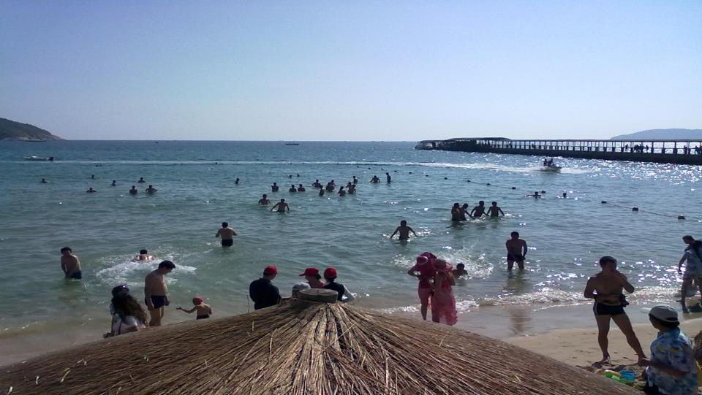
It’s hot.

Slide 9
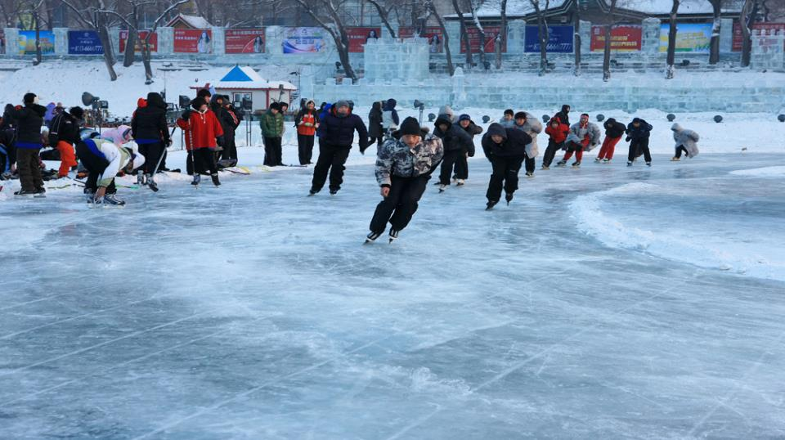
It’s cold.

Slide 10
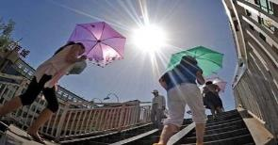
It’s ... today.
It’s hot today.
It’s sunny today.
It’s rainy today.
It’s warm today.

Slide 11
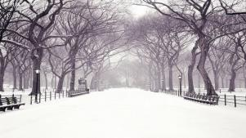
复习巩固
weather 天气
rain 雨
rainy 下雨的
sun 太阳
sunny 晴天的
wind 风
windy 有风的
snow 雪
snowy 下雪的
hot 热的
cold 冷的
cloudy 多云的

Slide 12
把单词与相应的图片连起来
hot
cold
sunny
cool
cloudy
windy
warm

Slide 13
Let’s match!
sunny
cloudy
windy
rainy（下雨的）
snowy（下雪的）

Slide 14
词性变化
It is very ______ today. (sun)
2. It is ______ in Shanghai today. It is ______ in Shanghai today. (rain)
3. It is pretty _______ in Beijing. (cloud)
4. It is ______ there now. It is ______ there now. (snow)

Slide 15
词性变化
sunny
It is very ______ today. (sun)
2. It is ______ in Shanghai today.
(rain)
3. It is pretty _______ in Beijing. (cloud)
4. It is _______ there now. (snow)
rainy
cloudy
snowing

Slide 16
Bye-bye

