Slide 1
人教版八年级上册
Unit3
I am more outgoing than my sister.
Section B（第3课时）
WWW.PPT818.COM

Slide 2
学习目标
1. 熟练使用以下词汇、短语和句型： primary, primary school, information, as…as, than, both, neither
—Who do you think should get the job?
—I think Jenny is more outgoing than Jill. So, I think she should get the job..
—But I think Jill is …
2.能正确运用比较级的句型起草仿写一篇有关友谊话题的短篇文章。

Slide 3
教学互研
新词自查
根据句意及汉语提示完成句子
1. The newspaper always gives us the newest information
(消息).
2. The education in primary school (小学) is very important
for everyone.

Slide 4
情景导入
Enjoy a song
The More We Get Together
The more we get together,
together, together.
The more we get together,
The happier we’ll be.
For your friends are my friends,
And my friends are your friends.
The more we get together,
The happier we’ll be.

Slide 5
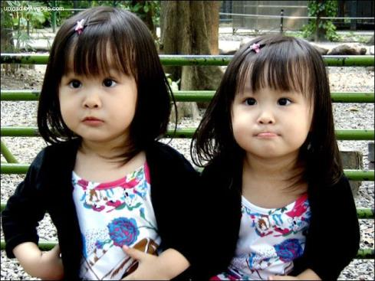
Compare people
Lily
Lucy
They are twins.
Lily is taller than Lucy.
Lucy is shorter than Lily.
5

Slide 6
quieter
more outgoing

Slide 7
Some sayings about friendship
A life without a friend is a life without a sun.
A friend in need is a friend indeed.
Friendship is like money, easier made than kept.
A brother may be not a friend, but a friend will always be a brother.

Slide 8
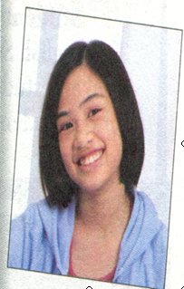
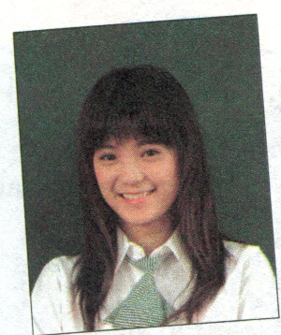
导学达标
3a Wang Lingling and Liu Lili are best friends.
Look at the chart below and compare them.
Wang Lingling
Liu Lili

Slide 9
Wang Lingling | Liu Lili
tall | tall
 | short straight hair
like reading | like sports
popular
outgoing | outgoing
serious
hard-working
long straight hair
popular
funny
smart

Slide 10
Tips
1. 分析词汇，可分为长相，爱好，性格及个人品质。
2. 注意句子结构，介绍发型时，has … hair；介绍爱好时，likes …；其他可用 be + 形容词。
3. 适当运用 and 及 but。

Slide 11
Example
Wang Lingling’ best friend is Liu Lili.
They are both tall, but
________________________________________
________________________________________
________________________________________
________________________________________
________________________________________
________________________________________
________________________________________
Wang Lingling’s straight hair is longer than Liu Lili. Wang Lingling likes reading and Liu Lili likes sports. They are both popular and outgoing. Wang Lingling is more serious, and Liu Lili is funnier. Wang Lingling is more hard-working, and Liu Lili is smarter than Wang Lingling.

Slide 12
3b Make notes about two of your friends. One friend should be similar to you; the other friend should be different.
A friend who is similar to me | A friend who is different from me
Name: | Name:
tall and thin
funny and popular
likes reading
is good at soccer
quiet and serious
speaks loudly
hard-working
smart
has good grades
a good listener

Slide 13
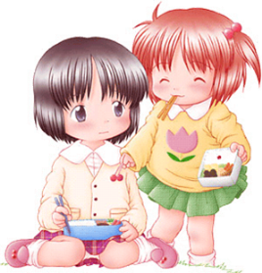
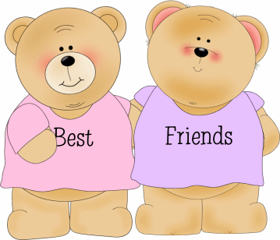
3c Write two paragraphs describing your friends.

Slide 14
Group work
Read the job ad and answer the questions.
1. What do the English Study Center need? 2. Should the student be outgoing?
Then compare two of your classmates. Decide which classmate is better for the job.

Slide 15
Share your writing
Example:
He/ She should be outgoing. He/ She should be good with children. He/ She should be good at English …
Share time

Slide 16
问题探究
make的用法
1.make sb .+v.意为“让（使）某人做某事”。如：
It makes me feel very shy. 这件事让我觉得很害羞。
2.Make sb. +adj. 意为“让（使）某人成为….” 如：
My father wants to make me a doctor.

Slide 17
课堂评价
单项选择
1. The doctor told Tom to eat ___ vegetables and __ meat if he doesn’t want to get fatter and fatter.
A. much; little B. more; fewer
C. many; few D. more ;less
2. We all like Mr. Green. He always makes the math class very_____.
A. interest B. interests C. interesting D. interested
3.—Tom, how are you feeling today?
—Much____. I don’t want to eat anything today.
A. better B. worse C. healthier D. good
D
C
B

Slide 18
4.—It’s said that knowledge is money.
— But I think it is ______money.
A. as important as B. so important as
C. more important than D. the same as
5．－Oh, my god! I’m getting ______.
－You’d better eat ______food. It’s important to keep fit.
A. fat and fat; more
B. fatter and fatter ; fewer
C. more and more fatter ; less
D. fatter and fatter ; less
C
D

Slide 19
Homework
1. Finish the exercises in Self Check.
2. Try to Compare yourself now and two
years ago, and write it down.

