Slide 1
Unit 3 Lesson 15
Jenny's Summer Holiday
WWW.PPT818.COM

Slide 2
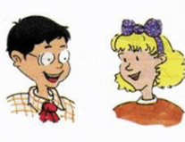
Revision
Which season do you like best, Jenny?
I like summer best.
What's your summer fun?
My family like to go on trips in the summer.

Slide 3
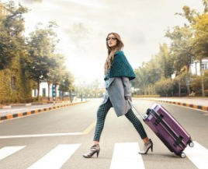
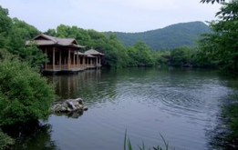
Let’s learn
go on a trip
lake

Slide 4
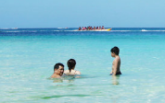
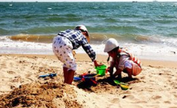
Let’s learn
swim in the sea
play on the beach

Slide 5
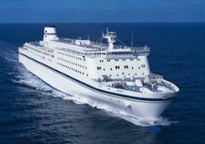
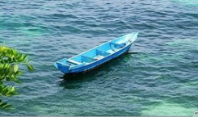
Let’s learn
ship
boat

Slide 6
Circle the key words you learn.
happen beach
swim lake
sea ship

Slide 7
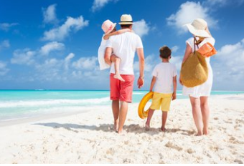
Ask and answer
Read Part 1 and answer the questions.
What do Jenny's family do in the summer?
They like to go on trips.
Does Jenny like playing on the beach?
Yes, she does.

Slide 8
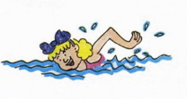
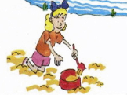
Ask and answer
Read Part 1 and answer the questions.
What did Jenny do last summer?
She went on a trip to a lake. She swam in the lake.
Who did Jenny go with?
She went with her grandparents.
What did Jenny do on the beach?
She played on the beach.

Slide 9
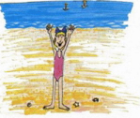
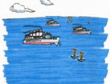
Ask and answer
Read Part 1 and answer the questions.
What will Jenny do this summer?
She will go on a trip to the sea. She will swim in the sea.
What will Jenny watch on the sea?
She will watch ships and boats on the sea.

Slide 10
Let’s learn
in the summer
一般现在时
last summer
一般过去时
this summer
一般将来时
Do you know other time like this?

Slide 11
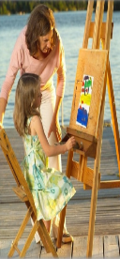
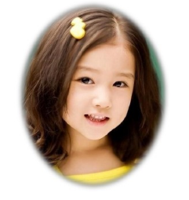
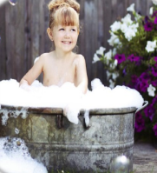
Let’s talk
What do you do on Sundays?
What did you do last Sunday?
What will you do this Sunday?

Slide 12
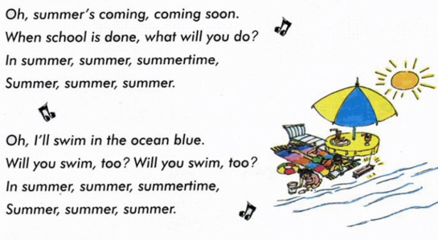
Let’s sing

Slide 13
Summary and Evaluation
What have you learned in this class?
A excellent B good C adequate D need improvement
内容 | 学生自评 | 小组互评
我能认真听老师讲课，听同学发言
遇到我会回答的问题主动举手了
活动中坚持使用英语来交际
我能积极参与小组讨论活动，能与他人合作。

Slide 14
Homework
1. Copy the key words three times.
2. Write a short passage about what you will do
this summer holiday.

