Slide 1
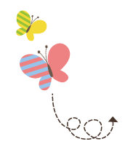
1111111111111111111111111111111111111111111111111111111111111111
Unit 4 Did You Have a Nice Trip ?
五年级下册
Lesson 20 Jenny Goes Home
WWW.PPT818.COM

Slide 2
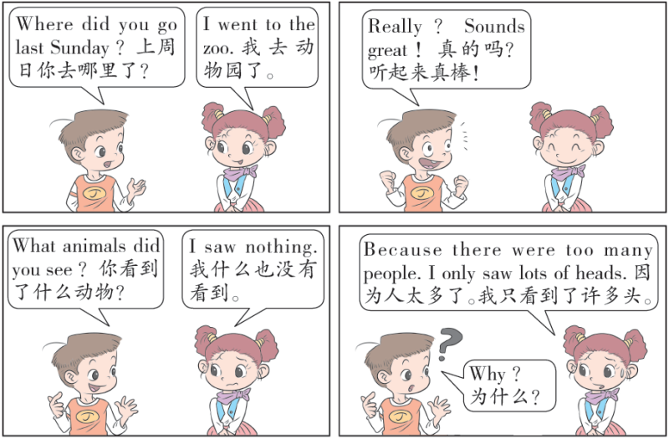

Slide 3
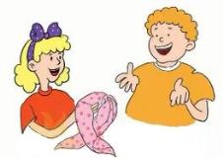
1. Jenny’s gift
“Hi，Mum ！ Did you miss me ？” asks Jenny. “Yes, I did! Did you have fun in Beijing ？”asks Mrs. Smith.
“Yes，I had fun ！” says Jenny.
“What did you do ?” asks Mrs. Smith.
“The first day，we went to Tian’anmen Square.
It’s so big, Mum! The second day, we went to the
Palace Museum. It’s beautiful ！ The third day,
we went to the Great Wall. It’s great ！”
“Did you go shopping ？” asks Mrs. Smith.
“Yes ！” answers Jenny. “The fourth day，we went to Wangfujing. This scarf is for you. Here ！”
“Thank you，Jenny ！”

Slide 4
知识点1
had /hæd/ v. （have 的过去式）吃；有；进行（活动）
发音：
字母a 发的是/æ/。
I had fun in Beijing last week.
上周我在北京玩得很开心。
例句：
词形变化：
have（原形）→ had（过去式）
形近词：
bad 坏的 hand 手

Slide 5
知识点2
went /went/ v. （go 的过去式） 去
发音：
字母e 发的是/e/。
例句：
We went to the Palace Museum last Friday.
上周五我们去了故宫博物院。
词形变化：
went（过去式） → go（原形）
短语：
go shopping 去购物 go out 出去
go straight 直走 go on 继续

Slide 6
用所给单词的正确形式填空。
I _______（go） to visit my grandparents last Sunday.
典例
Did

Slide 7
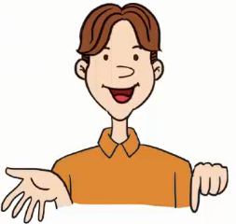
2. Go and went
Let’s find the differences ！
1. I go to the library on Sundays.
I went to the cinema yesterday.
2. I see Danny every day.
I saw Mr. Wood yesterday.
3. I eat an apple every day.
I ate an orange yesterday.

Slide 8
知识点 3
saw /sɔː/ v. （see 的过去式）看见
I saw my teacher in the street yesterday.
昨天我在大街上看见了我的老师。
例句：
see a film 看电影
see a doctor看医生
see 的相关短语：

Slide 9
你见过将动词的原形和其过去式连在一起的吗？see 和saw 连在一起，是个新单词吗？它是什么意思呢？
玩出新单词：
see saw 跷跷板
答案：

Slide 10
知识点 4
ate /et/ v. （eat 的过去式）吃
字母a 发的是/e/。
发音：
I ate bread for breakfast today.
我今天早饭吃的面包。
例句：
加法记忆法：
eat—ate—吃，drink—drank—喝，
play—played—玩

Slide 11
用所给单词的正确形式填空。
The boy ________（eat） three apples yesterday.
典例
ate
点拨：
今天上午我们有四节课。第四节课是我最喜欢的。第一个空要用基数词four，后跟复数名词；第二个空考查序数词的用法。

Slide 12
3. Let’s do it!
1. Read Part 1. Put the sentences in the correct order.
( ) Jenny went shopping on Wangfujing Street.
( ) Jenny went home.
( ) Jenny went to the Palace Museum.
( ) Jenny went to the Great Wall.
( ) Jenny went to Tian’anmen Square.
4
5
2
3
1

Slide 13
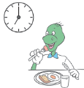
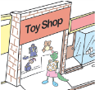
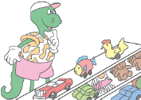
3. Let’s do it!
2. Look and write.
It was Saturday.
Danny______ breakfast at 7：00.
Then Danny ______ to the toy shop.
He wanted to buy a toy car.
There he ______ many toys.
He liked them very much.
go do have play see
had
went
saw

Slide 14
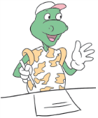
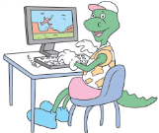
3. Let’s do it!
go do have play see
He went home at 12：00.
He ______ his homework in the afternoon.
In the evening，he ______ on the computer.
did
played

Slide 15
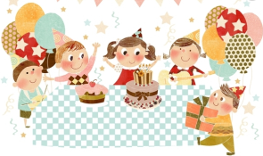
一、按要求完成句子。
I have a birthday party today.（用yesterday 改写句子）
I _______ a birthday party___________ ．
had
yesterday

Slide 16
二、用动词的适当形式填空。
（1）She ______to the store on Sundays.
She ______ to the store yesterday.（go）
（2）We ______ homework every day.
We ______ homework last Monday.（do）
goes
went
do
did

Slide 17
本节课我们学习了以下知识，请同学们一定加强巩固，以便能和同学们进行灵活交流哦！
重点词汇：had, went, saw, ate➢
重点短语：go shopping

Slide 18
1 熟记本节课所学的句型和单词，必须会听、说、读、写。
2 将Jenny’s gift的内容朗读流利。
3 完成配套的课后作业。

