Slide 1
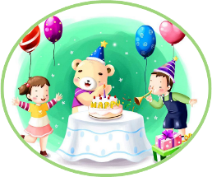
Unit3 Would you like to come to my birthday party?
人教精通版六年级上册
WWW.PPT818.COM

Slide 2
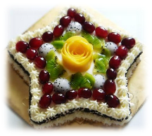
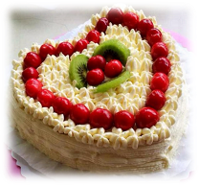
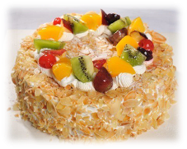
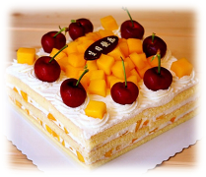
>>Review
Look and say
—What kind of cake would you like?
—I’d like …
star-shaped cake
heart-shaped cake
round cake
square cake

Slide 3
>>Lead-in
Free talk
My friend’s birthday is coming. What present should I buy? Can you help me?

Slide 4
>>Presentation
Just read and talk
Listen and check
What presents does Lisa get?
a new story book
a cake
a teddy bear
some chocolates

Slide 5
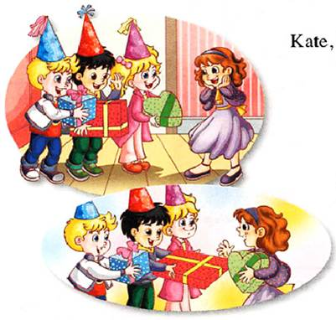
>>Presentation
Just read and talk
Read and answer
How does Lisa’s friends give the presents to her?
Here is a teddy bear for you!
I have a new story book for you!
Here are some chocolates for you!

Slide 6
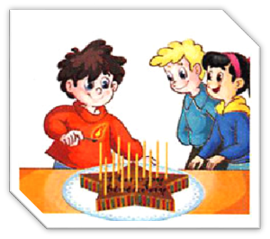
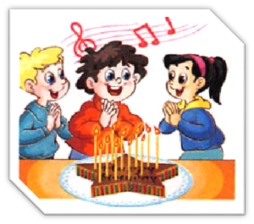
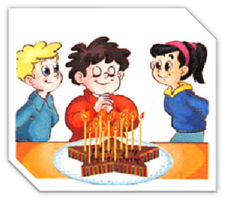
>>Presentation
Just read and talk
Read and answer
What do they do at the party?
light the candles
sing the birthday
song
make a wish

Slide 7
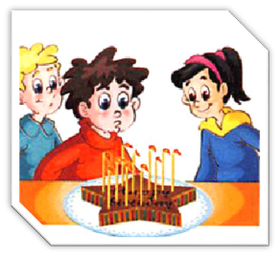
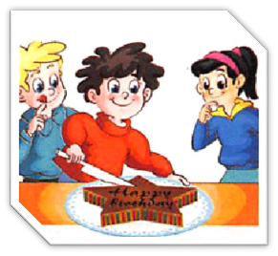
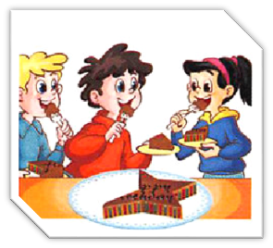
>>Presentation
Just read and talk
Read and answer
blow out the
candles
cut the cake
eat the cake

Slide 8
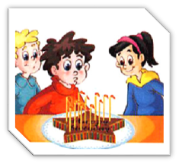
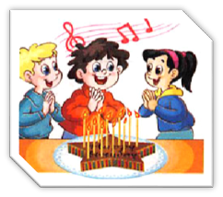
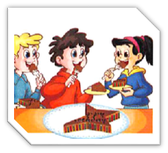
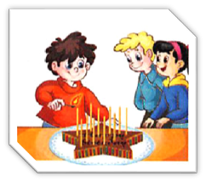
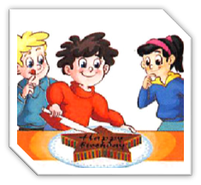
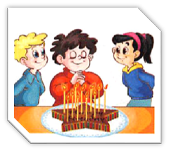
>>Presentation
Just read and talk
Listen and number
4
2
6
1
5
3

Slide 9
>>Presentation
Just read and talk
Listen and imitate
Kate, Gao Wei
& Peter: Happy birthday, Lisa!
Lisa: Thank you! Welcome to my birthday party.
Kate: Here’s a teddy bear for you!
Gao Wei: I have a new storybook for you!
Peter: Look! Here are some chocolates for you!
Lisa: Thank you very much!
Mum: Shall we begin the party?
All: Yeah!

Slide 10
>>Presentation
Just read and talk
Listen and imitate
Mum: Let’s light the candles and sing the birthday
song.
All: OK!
All: Make a wish and blow out the candles, Lisa.
Lisa: All right. Let me make a wish!
All: And now cut the cake, Lisa!
Lisa: OK. Have a piece of cake, Please!
All: Thank you!

Slide 11
>>Practice
Read in groups
以小组为单位，选择一种喜欢的方式读一读课文。
Read together.
(齐读)
Read in pictures.
(分图读)
Choose a picture to read.
(自己选一幅图去读)

Slide 12
>>Practice
Show time
小组合作，练习对话并表演，其他同学评价。
Pronunciation (语音) |  | Fluency (流利) | Cooperation (合作)
OK!
Great!
Super!

Slide 13
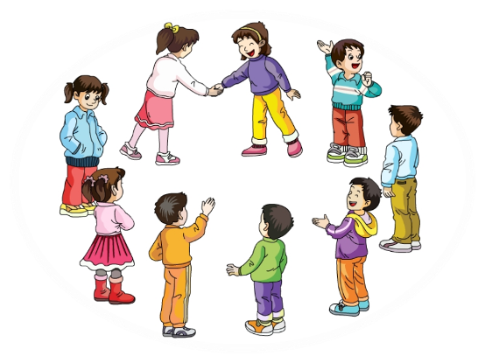
>>Practice
Play a game
击鼓传花
Here are … for you!
…
Here is a … for you!

Slide 14
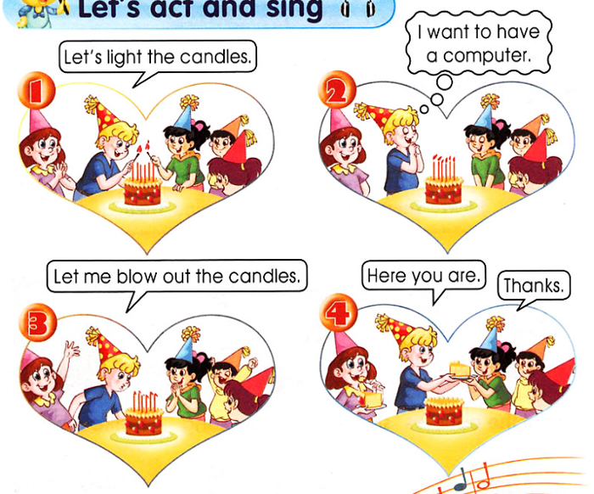
>>Practice
Let’s act

Slide 15
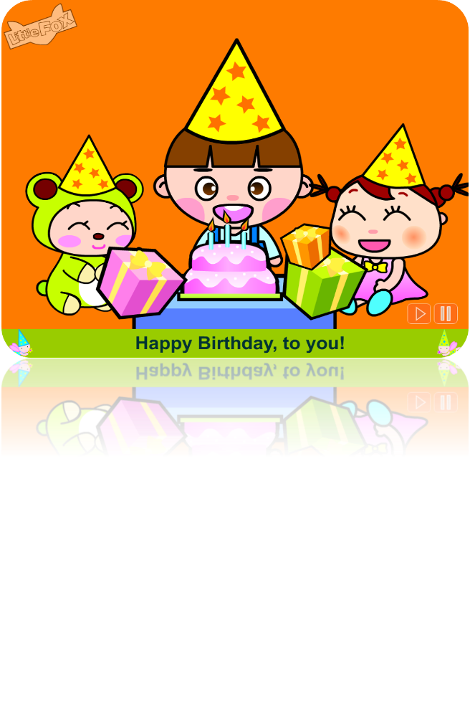
>>Practice
Let’s sing

Slide 16
>>Summary
给别人送礼物时，我们该说些什么？
Here is/are … for you!
如何描述过生日的步骤？
light the candles
sing the birthday song
make a wish
blow out the candles
cut the cake
eat the cake

Slide 17
>>Homework
1.跟读课文录音，按照正确的语音、语调朗读课文对话。 2.根据本课所学内容，调查班级其他同学是如何过生日的，并记录下来。
3.预习 Lesson19。

