Slide 1
Module 10 Spring Festival
Unit 3 Language in use
WWW.PPT818.COM

Slide 2
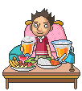
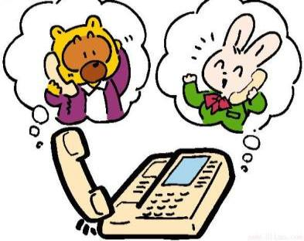
Warming up
Look at the following pictures and say what they are doing.
drinking
calling

Slide 3
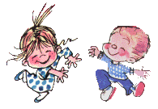
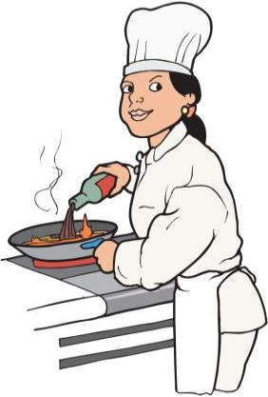
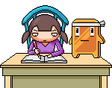
dancing
cooking
writing

Slide 4
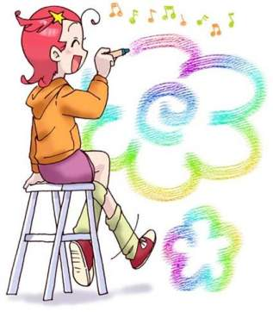
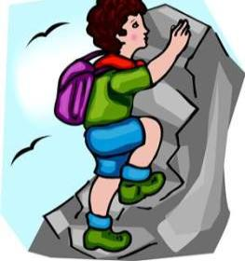
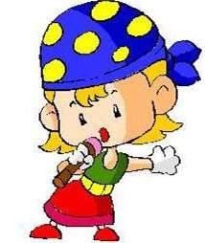
painting
climbing
singing

Slide 5
Write the -ing form of the given words.
write sit begin visit study lie stop see bring talk swim get take have
writing, sitting, beginning visiting studying lying stopping seeing bringing talking swimming getting taking having

Slide 6
Review
Affirmative | Negative | Interrogative
I am going | I am not doing | Am I doing?
You are going | You aren’t doing | Are you doing?
He, she, it is going | He/she/it isn’t doing | Is he/she/it doing?
We are going | We aren’t doing | Are we doing?
You are going | You aren’t doing | Are you doing?
They are going | They aren’t doing | Are they doing?

Slide 7
Language practice
1. Are you getting ready for
Spring Festival?
2. What’s your mother doing?
3. She’s cleaning the house.
4. I’m eating jiaozi.

Slide 8
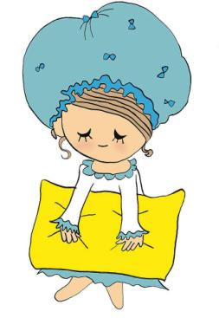
Grammar
一般现在时与现在进行时的对比
什么情况下用
一般现在时呢？

Slide 9
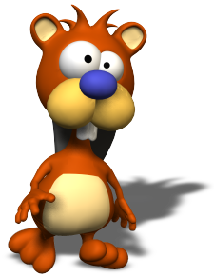
1. 表示现在的状态:
He’s twelve.
She’s at work.
2. 表经常或习惯性的动作:
I get up at 6:30 every day.
He reads English every morning.
3. 表主语具备的性格和能力等:
She likes noodles.
They speak French.
4. 普遍真理、自然规律和客观事实:
Two plus four is six.
The moon goes around the earth.
Birds fly.

Slide 10
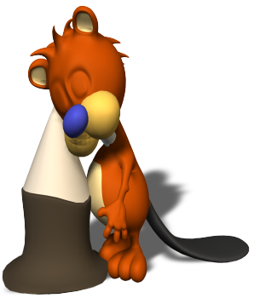
5. 谈论籍贯、国籍等:
Where do you come from?
I come from China.
I come from Guangzhou.
6. 谈论时间表、旅程表等:
What time does the film begin?
The football match starts at 8 o’clock.
Tomorrow is Thursday.
7. 询问或者引用速记、通知或新近接到的
笺内容:
What does that notice say?
What does Ann say in her letter?
She says she’s coming to Beijing next week.
Shakespears says, “Sweet are the uses of adversity.”（莎士比亚说: “苦尽甘来。”）

Slide 11
什么情况下用
现在进行时呢？

Slide 12
1. 表示说话时正在发生或者进行的动作。
2. 表示在现在相对较长一段时间内正在进 行的动作，但是说话那一刻不一定在做。
We are preparing for Spring Festival.
I am writing a letter.
We are enjoying our trip.
⊙难点区别：也许大家认为用一般现在时也可以, 但是要注意的是, 这些动作在说话时候不一定正在进行或发生，但说话的这一刹那包括在一段较长的时间内。
He is building his own house.
David is teaching English and learning Chinese in Beijing.

Slide 13

对比两种时态，我们可以得出以下结论:
【构成不同】
现在进行时由“助动词 be (am, is / are) + V-ing”
She is doing her homework now.
一般现在时(be动词是is, am, are), 行为动词是
V原形+s/es .
Are you a teacher?
你是教师吗？
Yes, I am. / No, I’m not.
是的，我是。/不，我不是。
He plays football every day.

Slide 14
现在进行时与always连用时, 往往含有赞扬厌恶责备等感情色彩。
He is always thinking of himself more
than others.
他总是考虑自己多于别人。
She is always changing her clothes.
她总是变化着她的衣着。

Slide 15
⊙表示的是某种状态的动词, 用一般现在时。一般不说 I am knowing, 而说 I know。
常见的这类动词有: want, like, hate, know, see, hear, believe, understand, seem, think, suppose, remember, need, love, realize, mean, forget, prefer, have, belong
⊙在there和here引起的句子中, 常用一般现在时代替现在进行时。
Here comes the bus.
There goes the bell.

Slide 16
【时间状语不同】
常与一般现在时连用的时间状语有: always, often, usually, sometimes, usually, never, every day/week/month/year, on Sunday(s)/ Monday(s)/in the morning/afternoon/ evening, now, today every day, every week, on Sundays, three times a week…
I write to my uncle every month.
常与现在进行时连用的时间状语有: now, at the moment。另外, 以Look, Listen等开头的祈使句常常是现在进行时态的句子。
Listen! Who is singing over there?

Slide 17
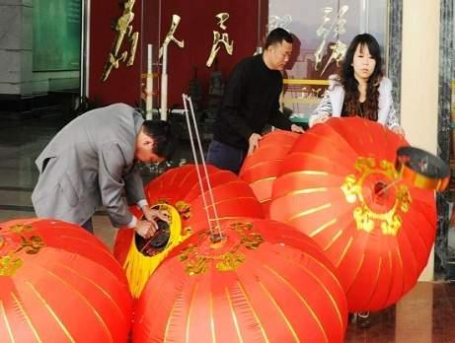
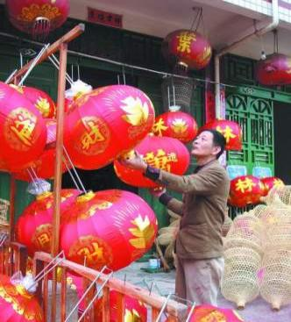
Ask and answer
What are they doing?
They are making big red lanterns.

Slide 18
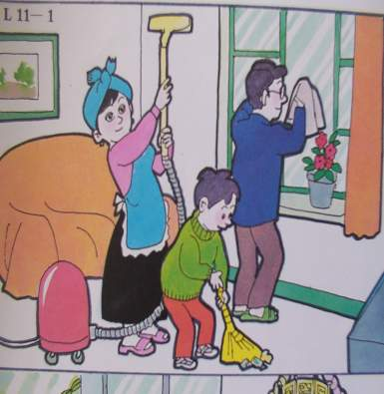
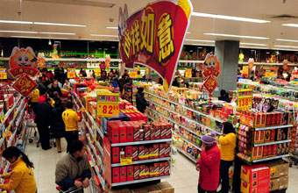
What are they doing?
They’re cleaning the house.
They’re buying things.

Slide 19
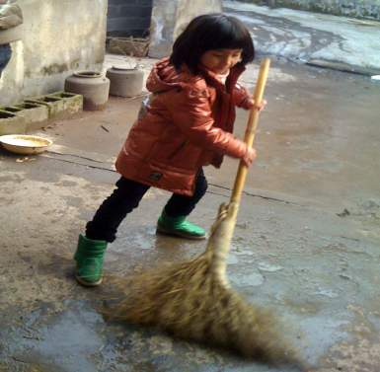
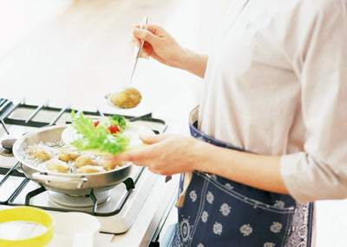
What is he/ she doing?
She is sweeping the floor.
He is cooking the meal in the kitchen.

Slide 20
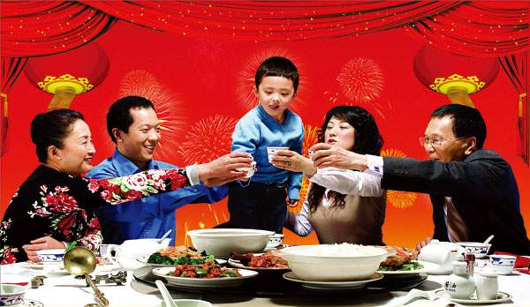
What are they doing?
They are having dinner in a restaurant.

Slide 21
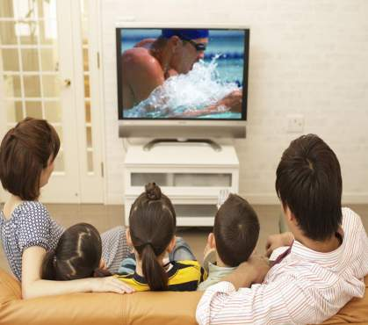
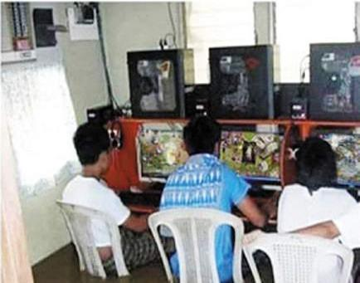
What are they doing?
They are watching TV.
They are playing games.

Slide 22
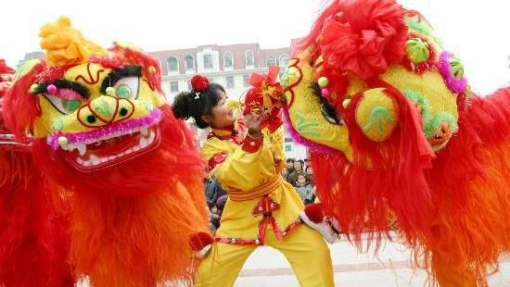
What are they doing?
They’re learning a lion dance.

Slide 23
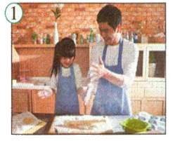
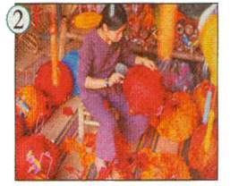
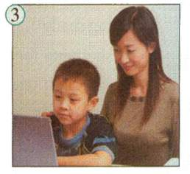
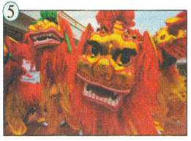
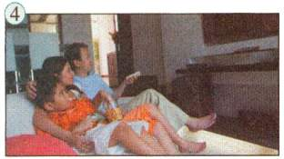
Work in pairs
Students A: Choose a picture.
Say what the people are doing.
Students B: Guess which picture
Students A is describing.
A: They are watching TV.
B: Is it Picture 4?
A: Yes, it is. / No, it isn’t.

Slide 24
Write questions and short answers.
Lingling’s mother / learning a lion dance?
—Is Lingling’s mother learning a lion
dance?
— No, she isn’t.
1. Lingling’s mother / cleaning the house?
Is Lingling’s mother cleaning the house?
Yes, she is.

Slide 25
2. Lingling’s father / making lanterns?
3. Lingling’s aunt / cooking the meal?
—Is Lingling’s father making lanterns?
—No, he isn’t.
—Is Lingling’s aunt cooking the meal?
—No, she isn’t.

Slide 26
4. Lingling’s grandma / sweeping
the floor?
—Is Lingling’s grandma sweeping
the floor?
—No, she isn’t.
5. Daming and Betty / learning a
lion dance?
—Are Daming and Betty learning a
lion dance?
—No, they aren’t.

Slide 27
6. Lingling’s family / getting ready for
Spring Festival?
—Are Lingling’s family getting
ready for Spring Festival?
—Yes, they are.

Slide 28
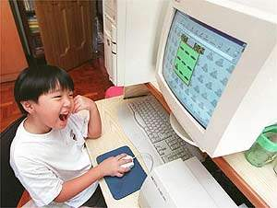
Write questions and answers about the pictures in Activity 1.
— What’s the boy doing?
— He is using a computer.

Slide 29

Complete the passage
At the moment, we (1) ________________ (get ready) for Spring Festival. We (2) _____________ (clean) the house and we (3) _____________ (sweep) the floor. My mother (4) _________ (cook) a meal. My father doesn’t (5) ______ (work) today.
are getting ready
are cleaning
are sweeping
is cooking
work

Slide 30
We always (6) _____ (buy) new clothes for Spring Festival. We always (7) ____ (get) presents from our family and friends. Spring Festival finishes at Lantern Festival, and we often (8) ____ (eat) yuanxiao on that day.
buy
get
eat

Slide 31
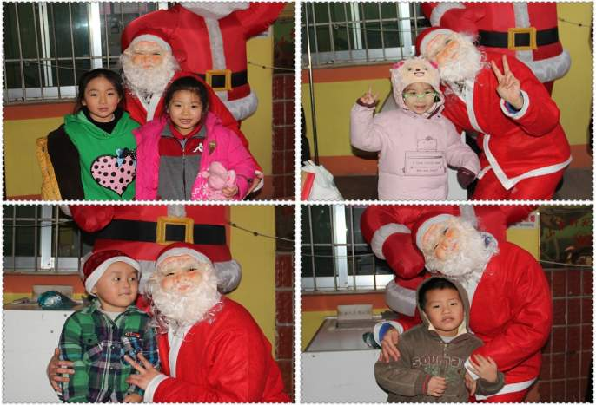
Around the world
Christmas and Father Christmas

Slide 32
Christmas and Father Christmas
Christmas is the most important festival in most Western countries. Children usually like Christmas a lot because of Father Christmas, Santa Claus. He is a fat man with long white beard and he wears a red suit. He visits people on Christmas Eve and Christmas Day, and gives presents to children, so they love him very much.

Slide 33
Module task: Writing a letter about Spring Festival to a foreign student
Ask and answer questions about what you and your family are doing for Spring Festival at the moment.
—What are you and your family doing
for Spring Festival at the moment?
—My mother is cooking.

Slide 34

Writing
Write notes about your Spring Festival. Use the headings to help you.
Getting ready
Food
Presents
Traditions

Slide 35
Getting ready | Food | Presents | Traditions
go shopping for presents | buy lots of food | give new clothes | eat jiaozi
get lots of food ready |  | give hongbao | buy new clothes
 |  |  | have a traditional family dinner

Slide 36
Write a letter to a friend saying:
What you’re doing for Spring Festival
at the moment.
What you usually do.

Slide 37
Use your notes in Activities 6and 7.
Dear …
Here in China it’s Spring Festival and we’re getting ready.
My mother is …
Usually we … and we …
Tell me about a festival in your country.
Best wishes,
______ (your name)

Slide 38
A possible version
Dear Linda,
Here in China it’s Spring Festival and we’re getting ready. My mother is cleaning the house and my father is helping her. Usually we have a big family
dinner and we watch a special TV programme in the evening to celebrate the festival.
Tell me about a festival in your country.
Love from,
Lucy

Slide 39
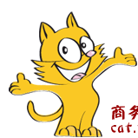
Homework
Try to make a summary on this
module and even this book to find out what you have learned.

