Slide 1
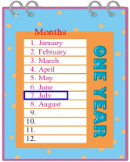
Unit5 July is the seventh month.
人教精通版六年级上册
WWW.PPT818.COM

Slide 2
>>Warm-up
Let’s sing

Slide 3
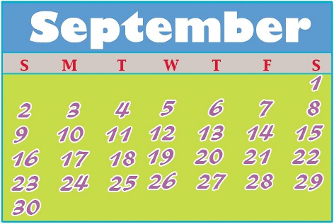
>>Presentation
Let’s learn
September
September is the ____ month of the year.
ninth

Slide 4
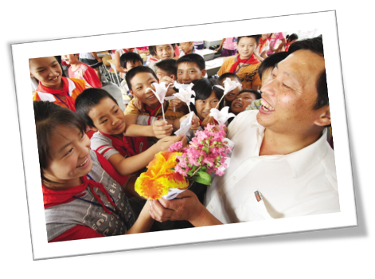
>>Presentation
Let’s learn
What festival is in September?
Teachers’ Day

Slide 5
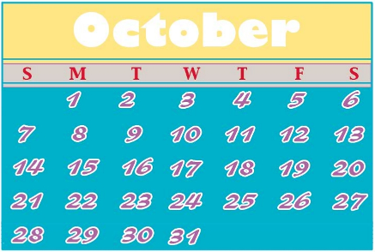
>>Presentation
Let’s learn
What month goes after September?
October
October is the ____ month of the year.
tenth

Slide 6
>>Presentation
Look and say
When is Teachers’ Day?
When is National Day?
It is on September 10th.
It is on October 1st.

Slide 7
>>Presentation
>>Presentation
Listen and say
What do the students do on Teachers’ Day?
The students give their teachers flowers to show their love.

Slide 8
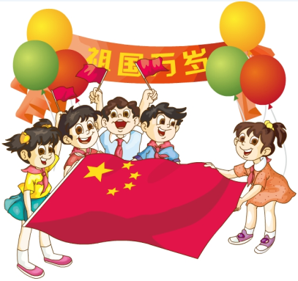
>>Presentation
>>Presentation
Look and say
What are the children doing?
They are celebrating National Day.

Slide 9
>>Presentation
Just read and talk
Listen and imitate
September is the ninth month of the year. Students go back to school.
They celebrate Teachers’ Day on September 10th.
Look, the students are giving their teachers flowers to show their love.
October is the tenth month of the year.
China’s National Day is on October 1st.
Look, the children are celebrating National Day.

Slide 10
>>Practice
Let’s read
Read together.
(齐读)
Read in pictures.
（分图读）
Read in groups.
(分组读）

Slide 11
>>Practice
Let’s chant and sing

Slide 12
>>Practice
1. _________ is the ninth month of the year.
2. The first day of October, is called ___________.
3. Students celebrate _____________ on
September 10th.
4. _______ is the tenth month of the year.
5. The children are _________ National Day.
Look and write
September
National Day
Teachers’ Day
October
celebrating

Slide 13
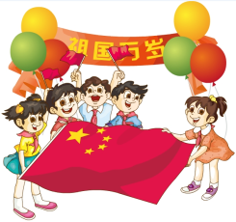
>>Summary
本课学习主要学习的月份和节日有哪些？
September
October
Teachers’ Day
National Day

Slide 14
>>Homework
1.跟读课文动画或录音，按照正确的语音、语调朗读课文。 2.查阅9月、10月还有哪些主要的节日，有哪些庆祝活动，记录下来，并与小组分享。
3.预习 Lesson 28。

