Slide 1
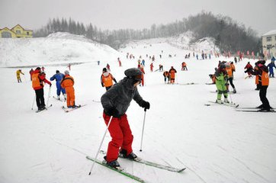
Unit 1 Lesson 2
I didn’t ski.
WWW.PPT818.COM

Slide 2
Fill in the blanks.
1. Li Ming learned _______________.
2. Wang Hong _______ to Hainan.
3. Did Wang Hong _______ in the sea?
Yes, she did. She______ a good time.
4. Peter _______ back to Canada.
He _______ his friends and ______
many pictures.
Beijing Opera
went
swim
had
went
visited
took

Slide 3
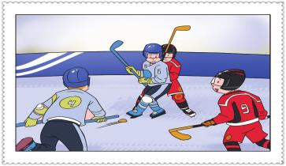
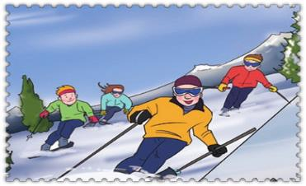
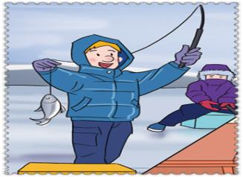
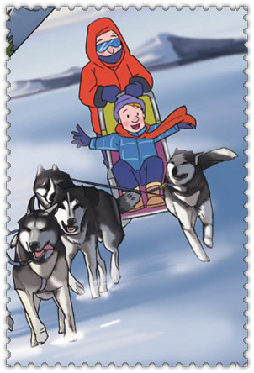
Watch and answer
2
1
So beautiful !
4
3

Slide 4
Watch and answer
2
1
I took them in Ottawa.
(它们） （渥太华）
So beautiful !
4
3

Slide 5
Listen and answer
1
What sport is this?
It’s ice hockey.（冰球）
Where is Peter?
He is behind the tall boy.
It's ice hockey, my favourite sport .
I played it with my friends.

Slide 6
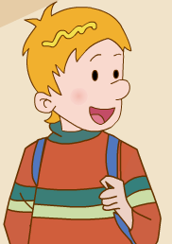
Listen and answer
2
What sport is this?
It’s skiing.（滑雪）
Did Peter ski?
No, he didn’t.
I didn't ski.
I took pictures for them.
（take的过去式）

Slide 7
Listen and answer
3
What sport is this?
It’s dog sledding.
（狗拉雪橇运动）
I went dog sledding
with my dad.

Slide 8
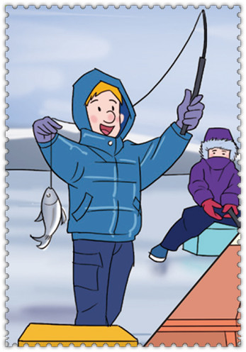
4
Listen and answer
What sport is this?
It’s ice fishing.（冰钓运动）
I also went ice fishing on the lake.
我还去了湖上冰钓

Slide 9
Listen and imitate .

Slide 10
Practise in pairs.
（同桌练读）
Read in roles.
（分角色朗读）

Slide 11
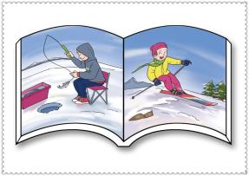
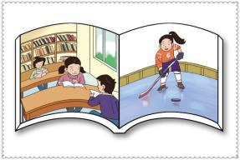
Let’s talk

Slide 12
Let’s talk
A: I went ice fishing.
B: I didn’t go ice fishing.
I went skating.

Slide 13
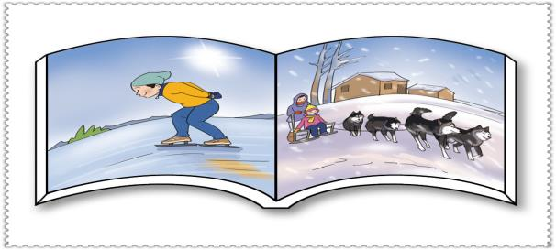
Let’s talk
A: I went to skate .
B: I didn’t ski.
I went dog sledding.

Slide 14
Let’s talk
A: I went to the library.
B: I didn’t go to the library.
I played ice hockey.

Slide 15
In the holidays, …_______.
She / He didn’t __________.
She / He _______________.
go to ski
visit my friends
take the pictures
go skating

