Slide 1
陕旅版英语五年级上册
Unit7 She Looks Tall and Thin
第1课时
WWW.PPT818.COM

Slide 2
教学目标：
1. 能听、说、读、写单词：aunt, uncle, kid, friends, thin, strong, old, young。
2. 能在教师的引导下，完成Part C Let’s say部分的练习。

Slide 3
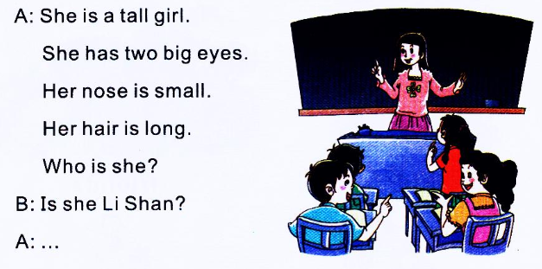
Say and guess
进行本活动前，教师可先引导学生观察自己，复习学过的一些形容词，如tall, short, long hair, short hair, big eyes, small eyes, big nose, small nose等

Slide 4
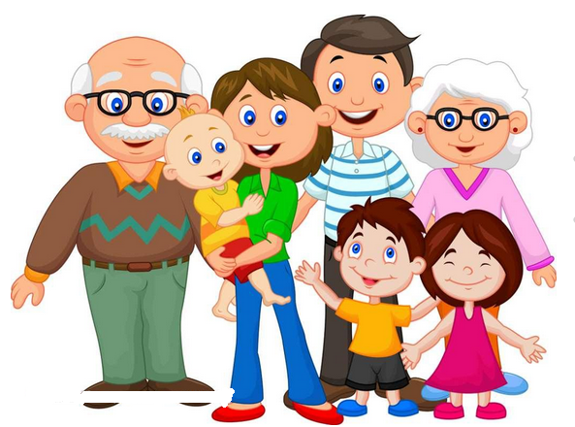
My family photo
教师承接上一环节，展示自己的全家福照片，师生对话，导入新课：
T: Boys and girls, look at my family photo. Who are they? Can you guess? Look at the old man. Who is he?

Slide 5
Let’s learn
教师借助幻灯片展示爷爷和奶奶的照片，向学生描述：
T: Look, this is my grandpa. He is 70 years old. He is old. And my grandma is old, too.

Slide 6
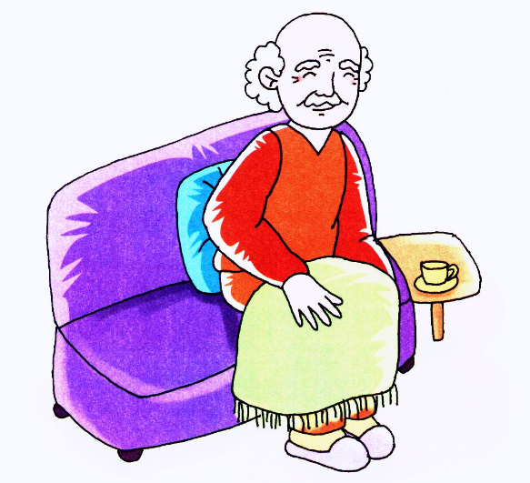
old

Slide 8
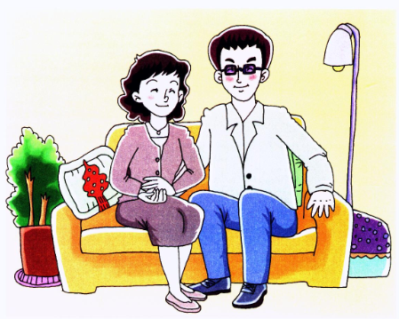
uncle

Slide 9
aunt

Slide 10
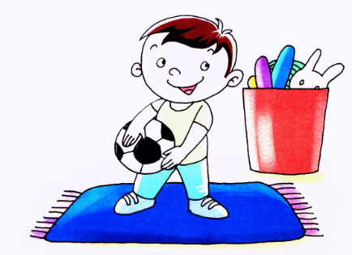
kid

Slide 11
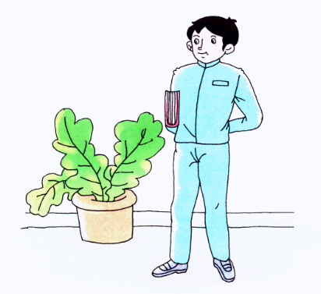
young
My uncle is very young.

Slide 12
They are very young.

Slide 13
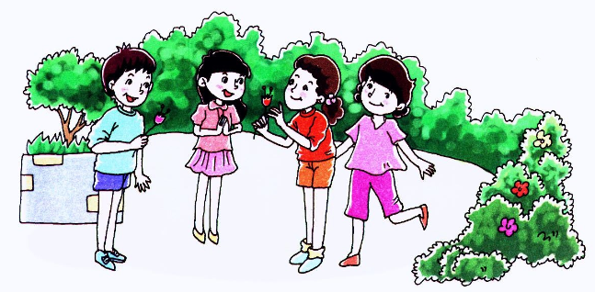
friends

Slide 14
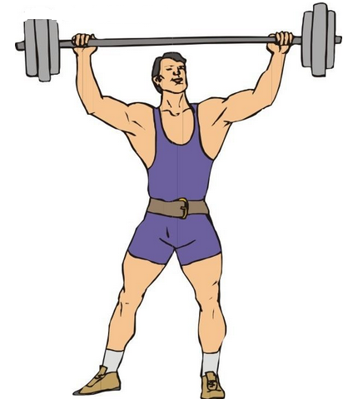
He is strong.

Slide 15
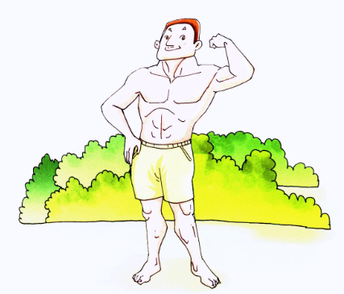
strong

Slide 16
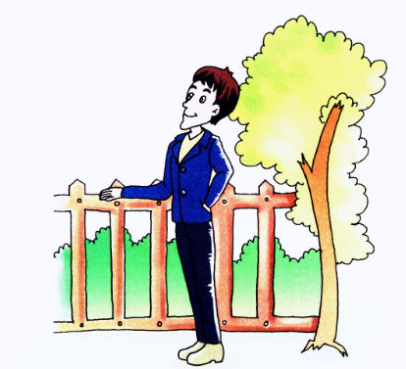
thin

Slide 17
What’s the difference?

Slide 18
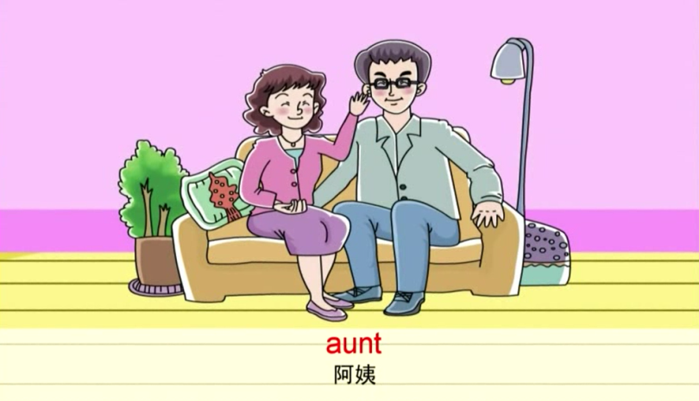
Listen and read aloud

Slide 19
教师把所学的Let’s learn部分的单词打乱字母顺序写在黑板上，随机选几名学生把这些字母重新排序组成单词并写下来。如：utan-aunt, sontrg- strong, tnih - thin等。
Let’s play (1)—比比谁的眼力好

Slide 20
Let’s play (2)—我来分分组
表人物身份的词(名词)：
描述人物特征的词(形容词)：

Slide 21
教师将Let’s learn部分的图片贴在黑板上，然后逐一描述这些图片，让学生根据自己描述的顺序，为这些图片标上序号。
Let’s play (3)—对号入座

Slide 23
小贴士
用于描述人物的词汇：
外貌外形：beautiful short tall
strong handsome lovely
pretty old young
thin
性格特点：clever quiet active
兴趣爱好：
skating playing chess playing the piano
fishing drawing listening to music
running reading singing
playing football/ ping-pong writing

