Slide 1
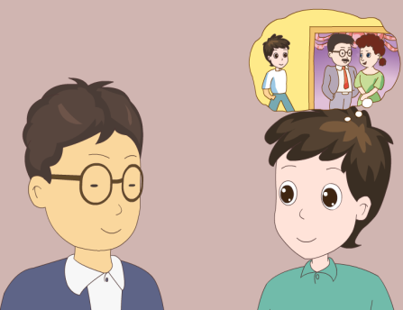
人教版八年级上册
Unit10
If you go to the party, you’ll have a goodtime!
Section B（第3课时）
WWW.PPT818.COM
0

Slide 2
1.能认识词汇：possible, solutions, bring, project。 2.能灵活运用if引导的条件状语从句。 3.能够综合运用所学的知识来描述他人的问题及解决办法的小短文。
学习目标
0

Slide 3
自学互研
新词自查
根据句意及汉语提示完成句子
1. My sister wasn’t happy these days because she got into a
fight with (与······吵架) her classmates.
2. If you are late for the class, you should say sorry to (向···
···道歉) to the teacher.

Slide 4
Problems
情景导入
Hello, everyone. I meet a problem. I don’t have many friends. What do you think I should do? Can you give me some advice?

Slide 5
I am too much fat. I want to be thin. What should I do?

Slide 6
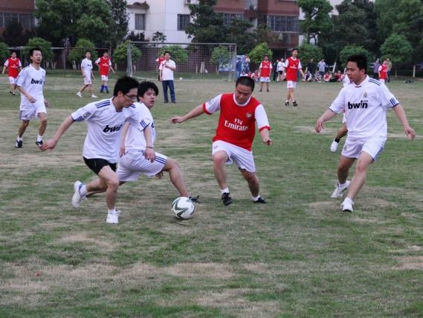
I like playing soccer very much. But my parents let me not play soccer. What should I do?

Slide 7
I have too much homework to do and I don’t have enough time to play and relax. What should I do? Can you give me some advice?

Slide 8
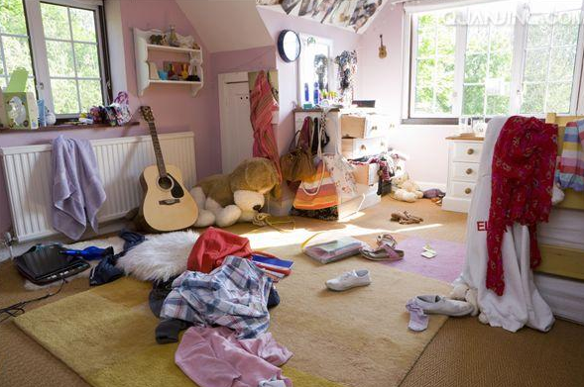
Our house is so dirty. My mom asks me to do the housework at home. But I am too tired every day. What should I do ?

Slide 9
Pair work
Ask your friend about her/his problems and give her/him advice.
A: What problem do you have …
B: …What do you think I should do?/Can you give me some advice?
A: I think you should…

Slide 10
导学达标
3a Talk to someone you know. Find out his / her three biggest worries. Try to think of some solutions to the problems and write them down.
Problems | Possible solutions

Slide 11
3b Write about your friend’s first problem and possible solutions. Then read your writing to the class.
My friends _________has a problem.
He / She ____________________________
____________________________________
I think he / she should __________________
____________________________________
If he /she ____________________________
____________________________________
He / she will __________________________
_____________________________________

Slide 12
3c Now write your advice for your friend’s second and third problem.
My friend also have two other problems. ______________________________________________________________________________________________________________________________________________________________________________________________________________________________________________________________________________

Slide 13
4 Your school is taking part in the project “We Can Help!”. Add more items to the poster. Then talk about what you will do if you take part in the project.
We Can Help!
Old people’s home visit
School clean-up
Children’s hospital visit
____________________________________________________________
A: What will you do if you visit an old people’s home?
B: If I do that, I’ll bring the old people some flowers.

Slide 14
1 Fill in the blanks with the words in the box.
meeting teenagers video experience
1. If my family travels to a new country this summer, I’ll send you a letter about my__________.
2. Will you watch the ______with me if you are free this weekend?
3. If the __________ stay out too late, their parents will worry about them.
4. I’ll go to the________ if it ends by 5:00 p.m.
experience
video
teenagers
meeting

Slide 15
2 Complete the conversation with the words in the box.
A: Hi, Sally. ____ you ____ to the party tomorrow?
B: I _____ to, but I can’t.
A: Oh, But _____ you don’t go to the party, you _____ miss all the fun!
B: I know, but I got into a _____ with my parents.
A: Hmm… then you should just say _____ to your parents.
B: I guess you’re right. I _____ talk to them tonight.
Are
going
if
are
will flight want sorry going
want
if
will
fight
sorry
will

Slide 16
3 Use your imagination! What will you do if …
it rains all weekend?
________________________________________
2. there’s an English test tomorrow?
________________________________________
3. Your cousin decides to come and visit from anther town?
________________________________________

Slide 17
问题探究
1.if 引导的条件状语从句与if 引导的宾语从句的区别。
if引导条件状语从句时，if意为“如果”，主句用一般将来时，从句则用一般现在时；if引导宾语从句时，if意为“是否”，相当于“whether”，时态需根据语境而定。如：I don’t know if it will rain tomorrow.
2. worried的用法
worried adj. 担心的；发愁的 be worried about sb./sth. 为某人/某事担心
拓展：sb. worry about sb./sth.相当于sb. be worried about sb./sth.也可用于sth. worry sb.

Slide 18
3.careless adj. 粗心的；不小心的。
careless的反义词是careful，意为“小心的；细致的；精心的；慎重的”
carelessly adv.粗心地；反义词是carefully，意为“细致地；谨慎地”。
care n.&v.关系；在意；担忧
4.experience n.经验；经历
1）作“经验”讲时，是不可数名词。
2）作“经历”讲时，是可数名词
3）experience v. 经历；体验

Slide 19
课堂评价
用括号内所给词的正确形式填空
1. I’m sure if he _____ (go) to the party, he__________
(have) a great time.
2. If the rain _______(stop) tonight, we will go to the
cinema.
3. I’ll buy a computer if I ______(have) enough money.
4. You ___________ (not get) nervous if you _____
(do) enough exercise.
goes
will have
stops
have
won’t get
do

Slide 20
5. If she ____ (be) kind to me, I _____________
(not argue) with her.
6. I want to know if he ________(come) tomorrow.
If he _______(come), I __________(give) a call to
him.
7. If you ______ (pay) more attention to it, he
_________ (not get) injured.
8. Mr Li will be angry if we _______(break) the rules.
is
won’t argue
will come
comes
will give
pay
won’t get
break

Slide 21
9. If it _____ (be) windy, they ____________(not go)
there by air.
10. Please let us know if he _________ (arrive)
tomorrow.
11. Shall I say “Hi” when the teacher _______(come)
into the room?
12. He’ll get No.1 if he ________ (study ) hard.
13. If you work really hard, you ________ (be) happy
and rich.
is
won’t go
will arrive
comes
studies
will be

Slide 22
Homework
1. Copy the key words and do some exercise.
2. Give advice on how to solve the problems.

