Slide 1
Unit2 It seemed that they were speaking to me in person.
WWW.PPT818.COM

Slide 2
根据汉语意思和提示完成句子
1. 谢谢你带我们参观。
Thank you _____ ________ us around.
2. 感觉好像他们不是在和广大听众说话；而是在亲自和我说话。
___ _______ ____ they were speaking not to lots of listeners but to me in person.
for
showing
It seemed that

Slide 3
3.随着年龄的增长，我们对收音机的兴趣日益增长。
___ I ____ ____, my interest in radio grew.
4.我已经收看这个节目许多年了。。
I ____ ________ the programme for many years.
As grew older
have watched

Slide 4
5
Look at the sentences from the passage.
“How old are you?” The manager looked at me.
“Fifteen,” I said.
“And you want a job in radio? Shouldn’t you be at school?” he asked.
describing an important event in the past

Slide 5
I have always loved the radio. I still remember, when I was four years old, I sat close to the radio in the living room, listening to my favorite programmes and to the voices of my favorite presenters.
giving background information

Slide 6
Now find sentences in the passage in Activity 2 which show:
important events in the past
background information

Slide 7
Important events in the past | Background information
Once a week, I played my favorite music from my father’s computer, talked about life at school, and hoped someone might be listening.
One day I learnt about internet radio.

Slide 8
Important events in the past | Background information
We prepared a programme once a week, doing research on articles about music, sports news, jokes and the weather report ( I did this by looking out of the window).
Soon my friends at school started to listen, and then they wanted to help.

Slide 9
6
Write a passage describing an important event in the past and giving background information.
I first appeared on TV at the age of thirteen. A television presenter stopped me in the street, and started to interview me…

Slide 10
话题分析
本模块以“广播”为话题,具体涉及对电台的简单介绍、收听广播和播音员的职业生活等内容。这一话题能激发学生的学习兴趣。

Slide 11
典型例题
假设你是李雷,请用英语给电台节目Heart-to- Heart Talk 的主持人写一封信,告诉他你最喜欢他主持的这个谈心节目,从该节目中你学到了很多有用的知识,并且长大了也想当一名像他一样的电台节目主持人。但是,你的汉语说得不标准,在别人面前讲话时很紧张,你很苦恼,请他帮助你。
要求:1.包含所有的内容要点,语句通顺,行文连贯;
2.70词左右。

Slide 12
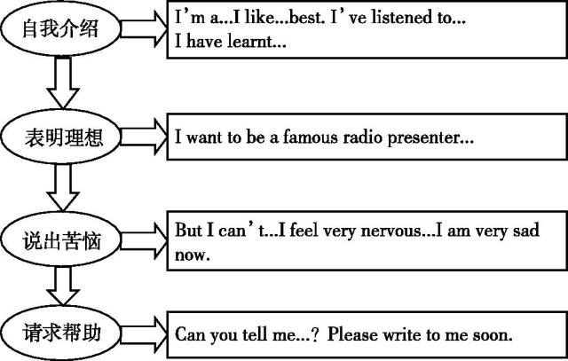
思路点拨

Slide 13
范文示例
Dear presenter, I’m a middle school student now. I like your radio programme Heart-to-Heart Talk best. I’ve listened to it for many years. I have learnt a lot from it. I want to be a famous radio presenter like you when I grow up. But I can’t speak Chinese very well. I feel

Slide 14
very nervous when I speak in front of others. I am very sad now. Can you tell me how to improve my Putonghua? Please write to me soon.
Yours, Li Lei

Slide 15
作文讲评
第一步：让学生先在小组内分享各自的作文，小组成员相互纠错，润色，修改。
第二步：请部分同学朗读自己的作文。
第三步：组内选出一些优秀的作品张贴于墙报上。

