Slide 1
Module 7 Summer in Los Angeles
Unit 3 Language in use
WWW.PPT818.COM

Slide 2
Objectives:
1. To summarise and practise the use of composite sentences with and, but, or
2. To summarise and consolidate new vocabulary

Slide 3
语法讲解建议采用归纳法，如尽可能多的呈现一些相关例句，或可让学生从已学课文中找相应例句，引导学生试着从所观察到的语言现象中总结出语法规律。

Slide 4
Observe
Are you familiar with these sentences? They are all from this module.
让学生大声朗读本模块学习过的并列复合句，然后进行小测试。
1. When are you leaving and how long are you going to stay there?
2. It sounds crazy, but I don’t know what to take.
3. Shorts are good, or you can wear light trousers.
4. I’m leaving at the end of July and I’m going to stay there for four weeks.
5. You can choose to take trips to Hollywood, Disneyland or San Francisco, or you can go shopping.

Slide 5
6. You can stay as a guest with an American family and take part in their daily life.
7. Our teachers are well trained and have a lot of experience.
8. You will have meals with the family and do some activities with them too.
9. You will love coming to Los Angeles to learn about American culture and improve your English at the same time.
10. We provide books, and we set tests every week to check your progress.

Slide 6
1. When are you leaving _____ how long are you going to stay there?
2. It sounds crazy, _____ I don’t know what to take.
3. Shorts are good, _____ you can wear light trousers.
4. I’m leaving at the end of July _____ I’m going to stay there for four weeks.
5. You can choose to take trips to Hollywood, Disneyland or San Francisco, _____ you can go shopping.
and
but
Ready?
go
or
and
or

Slide 7
6. You can stay as a guest with an American family _____ take part in their daily life.
7. Our teachers are well trained _____ have a lot of experience.
8. You will have meals with the family _____ do some activities with them too.
9. You will love coming to Los Angeles to learn about American culture _____ improve your English at the same time.
10. We provide books, _____ we set tests every week to check your progress.
and
and
and
and
and

Slide 8
Grammar
并列复合句

Slide 9
并列复合句是指并列连词and, but, or等把两个或两个以上的简单句连在一起而构成的句子。
1. 基本结构：
I help him and he helps me.
He is very old but he is in good health.
You can stay here, or you can leave.
简单句 + 并列连词 + 简单句。

Slide 10
2. 并列连词前后简单句之间的关系。
(1) 并列关系
They are watching TV, and the others are listening to the radio.
(2) 选择关系
The children can go with us, or they can stay at home.
(3) 转折关系
She was tired, but she did not stop working.

Slide 11
注意：
(1) 并列复合句有时可以不用连词，而用分号隔开（前后句之间的关系须相当紧密）。例如：
We fished all day; we did not catch a single fish.
我们钓了一整天鱼；但一条鱼都没有钓到。
(2) 并列连词后面的简单句如果与前面的简单句有相同的部分，相同的部分可省略。例如：
Snoopy lives in his own world and (Snoopy) finds real life hard to understand.
史努比生活在自己的世界里，觉得现实生活难以理解。

Slide 12
讲解完并列复合句后，做课本60页的1、2大题进行练习。
做完后组内核对答案，老师适当点评。
Join the two parts of the sentences with and, but or or.
1 I would like to go to England…
2 You should wear a raincoat…
3 You can go by plane…
4 I did not bring my sunglasses…
5 I have bought my ticket…
6 You can take two bags…
b)
e)
f)
c)
a)
d)

Slide 13
1 I would like to go to England and practise my English
2 You should wear a raincoat or you can carry an umbrella.
3 You can go by plane or you can take the train.
4 I did not bring my sunglasses but I can buy a new pair.
5 I have bought my ticket and I have got my passport.
6 You can take two bags but they must not weigh too much.

Slide 14
Complete the passage with and, but and or.
There are many English language courses all over the world. You can go to the UK (1) ______ take lessons at a language school. There are usually classes in the morning, (2) ________ in the afternoon you can go sightseeing.
and
and

Slide 15
You can stay in a cheap hotel, (3) ______ you can stay with a family. With a family, you get a lot more speaking and listening practice, (4)
______ you may not be so
close to the school or the
city centre.
or
but

Slide 16
P61
Read the advertisement.
Want to learn about the culture in the UK?
Come and join us!
• Let a British family teach you all about the culture in the UK.
• Students study together in groups.
• After-school activities for students.
• For students from all over the world.
• Cost: £800 for a four-week course.
读这则小广告回答问题，此题相当于一篇阅读理解，先
让学生独自做，然后组内核对答案，老师根据学生掌握
的情况，适当进行指导，总结做题技巧。

Slide 17
P61
Now complete the sentences with the words or expressions in the box.
come cost culture progress studies take part in
1. The ______ of the course is £800.
2. It is a great way to learn about British _______. 3. Students _______ from all over the world.
4. In the course, each group _________ together.
5. All students will be able to _________ different activities.
6. During the course, students will make lots of new friends — and good _______ in English.
cost
culture
come
studies
take part in
progress

Slide 18
P61
Work in pairs. Imagine that you are going to take a summer English course in Australia. Write down questions about the course. Use the words or expression in the box in Activity 4 to help you.
Now ask and answer.
— How long does the course last?
— It lasts for four weeks.
让学生想象要去澳大利亚参加暑期英语课程的培训，
两个同学一组进行简单的问答。然后进行表演，评
出优秀小组。

Slide 19
P62
Complete the conversation with the words and expressions in the box.
chance experience grow up information last
provide take part in
Mrs Smith: Excuse me.
David: Yes, how can I help you?
Mrs Smith: I’d like to get some (1)
__________ about your
summer camp.
David: Yes, of course. Our summer
camp is a great (2) _________ for children.
information
experience
先填空，然后角色扮演，两个同学一组朗读并表演对话。

Slide 20
They learn about themselves, live close to nature and make new friends.
Mrs Smith: It sounds wonderful. And how
long does it (3) _______?
David: Three weeks, starting from the
beginning of July.
Mrs Smith: How many students are there
in each group?
David: Eight. Through the small
group size, we (4) _______
students with the chance to
make new friends.
last
provide

Slide 21
Mrs Smith: That’s great. And do you
plan different activities?
David: Yes, of course. Students can
(5) ___________ different
activities to get close to
nature and try out new ideas.
Mrs Smith: Sounds good.
David: Yes, and it gives your
child the (6) ________ to
live away from home.
Mrs Smith: That’s true. Summer
camping is always good to
help children (7)
___________.
take part in
chance
grow up

Slide 22
P62
Listen and answer the questions.
这篇听力材料比较长，
难度较大，我会让学
生多听一遍，必要时
停顿，以便学生更好
的听出答案。
1 Who has left the message?
2 Where is Wang Feng now?
3 What does he think of his American family?
Wang Feng has left the message.
He’s at home with his American family.
He thinks that they’re really nice.
4 What is his American family going to watch on the beach this afternoon?
They’re going to watch a beach volleyball match.
5 What does his American family think of the French group?
They think that they’re really good.

Slide 23
P62
Listen again and complete the advertisement.
This evening
Concert in the park
Come and listen to some fantastic music by the group, (1) _____________. They are from (2) _______.
Price: (3) _______ — with a (4) __________!
Come and join us!
The Music Planet
France
$5
free drink

Slide 24
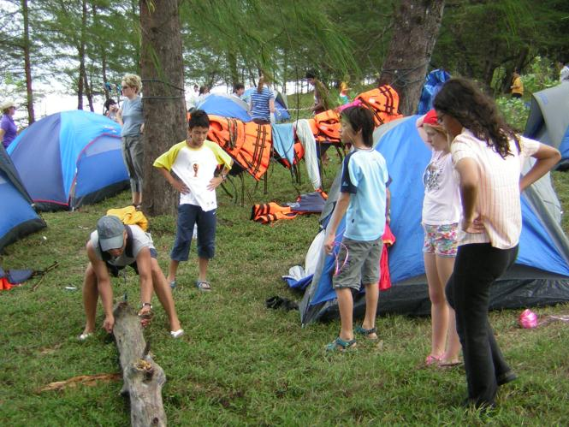
Summer camps
Summer camps for children are very popular in many countries. In Canada and the US, some of the summer camps are in the countryside or on lakes. Children stay there for one to four weeks and sleep in cabins. They do arts and crafts and play sports or music. Sometimes they go for long walks in forests or trips on rivers or lakes. They learn many useful outdoor skills.

Slide 25
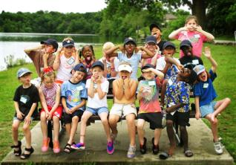
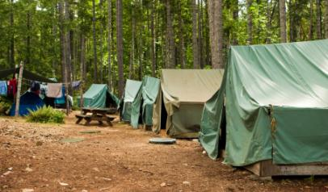
Around the world
Summer camps
Read and discuss.
1. Where are the summer camps?
2. How long do people go there for?
3. What do they do there?

Slide 26
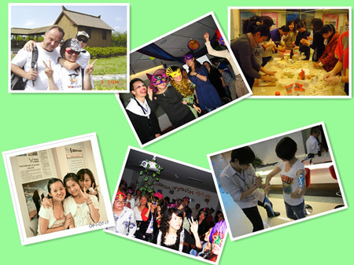
Homework
给你的朋友写一封信，介绍一下你班英语学习的各种课外活动。

