Slide 1
Unit 1 Topic 2
We should learn teamwork.
Section D
WWW.PPT818.COM

Slide 2
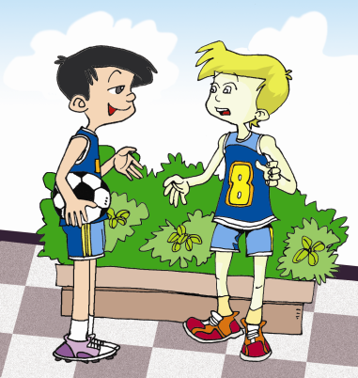
Let's talk
Do you like doing sports?

Slide 3
Let's talk
What kind of sports do you like to play?
Why?

Slide 4
Let's talk
Who is your favorite sport star?

Slide 5
Let's talk
Do you like David Beckham and Bobby Charlton?

Slide 6

Grammar
Subject+ vt. + indirect object + direct object
I kick the ball to you. And you pass me the ball like this.
I’ll kick you the ball again.
You can also pass a teammate the ball.
Bring Peter a present.

Slide 7
Functions
Will you join us? _________________.
Would you mind teaching me? ___________. You can do it!
Would you mind if I try it again? ________________. Please do.
Do you mind not putting your bike here? __________. I’ll put it somewhere else.
Would you mind not throwing bottles around? _______________________. I won’t do it again.
I am sorry for what I said. It’s ____________.
I’d be glad to
Not at all
Certainly not
Sorry
I’m sorry about that
nothing

Slide 8

1a look at the pictures and the title. Guess what
passage is about.
Famous sports in England
sports are important in English life. The people of England are sports lovers. Some of the world’s famous sports began here such as football and cricket.
Football is a fast game played in winter and early spring. Lots of people play football in parks

Slide 9
or playgrounds just for fun. With hundreds years’ history, it is one of the most popular sports in England. The English love football very much and they turned most of their main players into famous persons. David Beckham and Bobby Charlton became heroes for many children. The most interesting part of the English football year is the FA (Football Association) Cup Final each May.

Slide 10
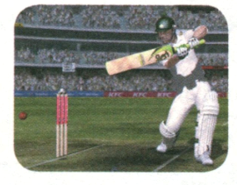
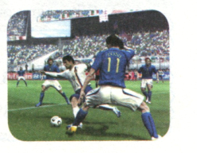
Cricket is a national sport in England. It is a very popular summer sport. It is a game played on grass by two teams of eleven players. Players wear white clothes and score points by hitting the ball with a bat. People can sit around the green, enjoying the sun, having drinks and watching the team games.

Slide 11
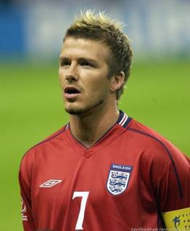
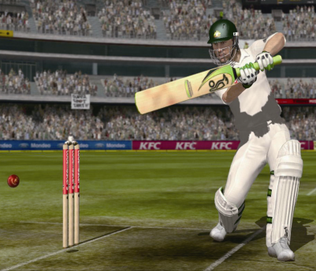
David Beckham
A famous football player in England.
英雄
heroes
板球运动
Bobby Charlton
A famous cricket player in England.

Slide 12
Listen and mark T（True） or F（False）.
1.Most of the English people are sports lovers. ( )
2.Football in England has a history of one hundred
years. ( )
3.The most interesting part of the English football year
is the FA Cup Final each year. ( )
4.Cricket players wear blue clothes and score points by
hitting the ball with a bat. ( )
T
F
T
F

Slide 13
1b Read 1a again and answer the following questions.
1.What’s the meaning of the underlined word “green”?
2.How many sports are mentioned in the passage? And
what are they?
3.What’s the main idea of Paragraph 2 and 3?
It means the grass.
Two. They are football and cricket.
Football and cricket are famous sports in England.

Slide 14
Complete the sentences according to 1a.
Football is ______________ ( 一种快速游戏 ) played in winter and early spring.
______________________________ (有着数百年的历史), football is one of the most popular sports in England.
Some of the world’s famous sports began from England ____________ (例如) football and cricket.
The sports lovers _______ most of their main players _______ (把· · · · · ·变成) famous persons.
Players score points __________________________
(通过用板击球).
such as
a fast game
With hundreds of years’ history
turned
into
by hitting the ball with a bat

Slide 15

2 Suppose you are interviewing David Beckham about “ famous sports in England”. Write a dialog in your exercise book.

Slide 16
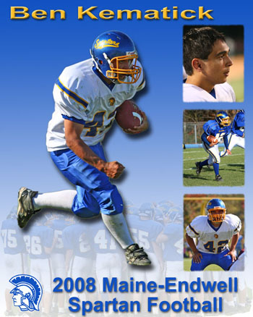
Project
Collect information about your favorite sport.
My favorite sport is … … is my favorite player.

Slide 17
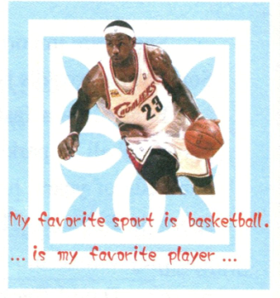
2. Discuss the poster in groups.
1)What do you know about the sport?
2) How often do you play it?
3)What can you get from playing this sport？

Slide 18
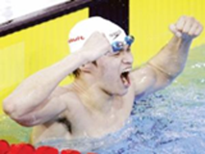
Talking about your favorite sport
3. Choose one student from your group to make a report to the class.
My favorite sport is swimming.
… is my favorite player…

Slide 19
Review the phrases of SA-SD
Translate the phrases into English.
do well in
say sorry to sb.
talk about
shout at sb.
be angry with sb.
have fun
try one’s best
keep sb. doing sth.
擅长于
对某人道歉
谈论
对某人大声斥责
对某人生气
玩得开心
尽最大努力
使某人不停做某事

Slide 20
Exercises
根据括号内要求转换下列句子，每空填一词。
1. Could you help me, please? (转为同义句)
Could you please _______ me _______ favor?
2. They’re sure that they will win next time. (同上)
They’re sure _______ _______ next time.
3. The No 3. bus goes there every day. (就划线部分提问)
_______ bus _______there every day?
do
a
to
win
Which
goes

Slide 21
4. He will be back in two days. (就划线部分提问)
_______ _______ will he be back?
5. My classmates will go to have a picnic this Sunday. (变为否定句)
My classmates ______ ______ to have a picnic this Sunday.
How
soon
won’t
go

Slide 22
A
1. —Would you mind helping me with my English?
— _______ Let’s go and practice.
A. Not at all. B. Don’t mind. C. I’m sorry. D. Sure.
2. Is it important ________ healthy food.
A. eat B. eating C. to eat D. eats
3. He ______ yesterday. I hope he’ll be well soon.
A. fall ill B. falls ill
C. fell ill D. fell illness
4. He always watches TV for a long time after school. His
mother is ____.
A. so happy B. angry with him
C. kind to him D. friendly
C
C
B

Slide 23
C
5. You lied to your mother yesterday. You must say
_____ her.
A. hello to B. sorry for
C. sorry to D. sorry
6. — I’m sorry I broke your pen.
— _____ I have another one.
A. You’re welcome. B. That’s right.
C. It’s nothing. D. Too bad.
7. — _________ do you play sports?
— Once a week.
A. How long B. How often
C. How many D. How much
C
B

Slide 24
8. She prefers ____ basketball.
A. play B. to play C. playing D. plays
9. I see Li Lei ____ English almost every morning.
A. read B. to read C. reading D. reads
10. I hope ____ my letter soon.
A. her to answer B. she answers
C. she will answer D. her answering
B
A
C

Slide 25
C
11. Lucy would like ____ skiing on Sunday.
A. go B. goes C. to go D. going
12. Amy’s planning ____ the skating club.
A. to join B. joining
C. will join D. joins
13. The school sports meet will be ____ December 11.
A. at B. on C. in D. as
A
B

Slide 26
14. Charlie ____ here next month.
A. isn’t working B. doesn’t working
C. isn’t going to working D. won’t work
15. He ____ very busy this week, but he ____ free next week.
A. will be; is B. is; is
C. will be; will be D. is; will be
16. There ____ a dolphin show in the zoo tomorrow evening.
A. was B. is going to have
C. will have D. is going to be
D
D
D

Slide 27
16. – ____ you ____ free tomorrow?
– No. I _____ free the day after tomorrow.
A. Are; going to; will
B. Are; going to be; will be
C. Are; going to; will be
D. Are; going to be; will
17. Ann ____ me a nice present on my next birthday.
A. will gives B. will give
C. gives D. give
B
B

Slide 28
C
18. – Shall I buy a cup of tea for you? – ____.
A. No, you won’t. B. No, you aren’t.
C. No, please don’t. D. No, please.
19. – Where is the morning paper?
– I ____ it for you at once.
A. get B. am getting
C. to get D. will get
20. _____ a concert next Saturday?
A. There will be B. Will there be
C. There can be D. There are
D
B

Slide 29
21. If they come, we ____ a meeting.
A. have B. will have
C. had D. would have
22. He _____ in three days.
A. coming back
B. came back
C. will come back
D. is going to coming back
B
C

Slide 30

Homework
Collect information about your favorite sport.
Make a poster about the sport and bring it to class.
Discuss the poster in groups.
Choose one student from your group to make a report to the class.

