Slide 1
Unit 7 Know Our World
The World Is a Big Place
WWW.PPT818.COM

Slide 2
Learning Targets
Key words & phrases:
planet, billion, total, increase, surface, Indian, Atlantic, Arctic, in total, one third, be covered with…, two thirds
Key sentences:
1. Can you point them out?
2. The earth is a very special planet, and it faces a big problem.

Slide 3
3. In the year 2010, the world’s population was over 7 billion in total.
4. It is increasing very quickly.
5. And by 2050, the world’s population may reach 9 billion.
6. We can’t live in water, and only about one third of our planet is land.

Slide 4
7. Antarctica is covered with snow and ice all year round.
8. The earth is our home now，and it will be our home in the future.
9. It has the highest point on the earth in the Himalayas.
Grammar: passive voice

Slide 5

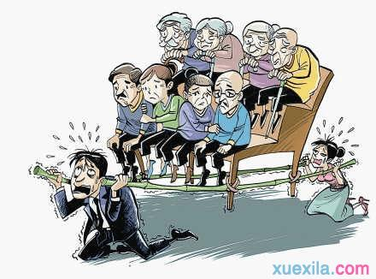
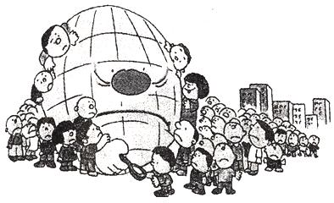
Warming up
What problems the earth faces?
Population problems

Slide 6
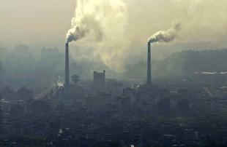
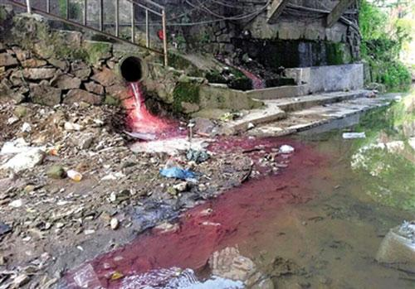
Environmental pollution

Slide 7
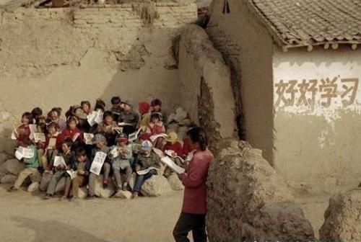
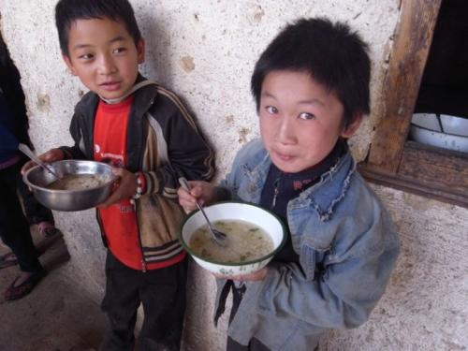
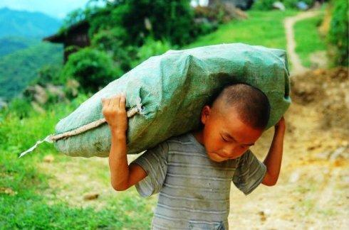
Poverty

Slide 8
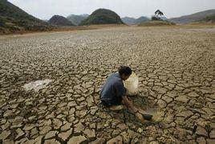
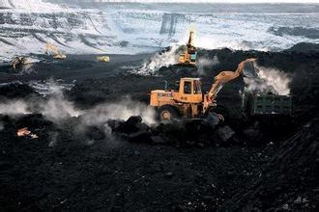
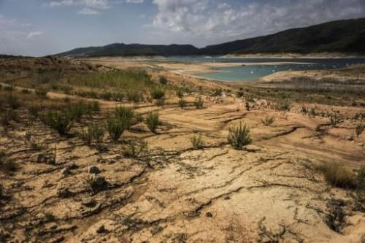
Exhausted resource

Slide 9

Words and expressions
planet
billion
total
increase
surface
Indian
n. 行星
n. 十亿；千兆
n. 总计；总数
adj. 总的；总计的
v. 增加；增大
n. 表面；表层
adj. 印度的 n. 印度人

Slide 10
Atlantic
Arctic
in total
one third
be covered with… two thirds
n. & adj. 太西洋（的）
adj. 北极的
总计，合计，总共
三分之一
被……覆盖
三分之二

Slide 11
THINK ABOUT IT
How many continents are there in the world? What are they?
What do you know about the place where you live?

Slide 12
Presentation
Listen and read
The earth is a very special planet, and it faces a big problem. In the year 2010, the world’s population was over 7 billion in total. It is increasing very quickly. By 2025, the world may have about 8 billion people. And by 2050, the world’s population may reach 9 billion.

Slide 13

There is another problem. People can’t live everywhere on the earth. We can’t live in water, and only about one third of our planet is land. But parts of this land are very dry. These dry places are called deserts. Some areas have very high mountains. Others have a lot of snow and ice. It is not easy to live in those places.

Slide 14

There are seven continents: Asia, Africa, Australia, Antarctica, Europe, North America and South America. Antarctica is covered with snow and ice all year round. Luckily, people can live on the other six continents. On these continents, there are green forests, fresh water and rich lands.

Slide 15
Oceans cover two thirds of the earth’s surface. The earth has only one big ocean, but we use these names for its different parts: the Pacific Ocean, the Indian Ocean, the Atlantic Ocean and the Arctic Ocean. The Pacific Ocean is the largest one.
The earth is our home now, and it will be our home in the future. It must be treated well for our children and for our children’s children, too!

Slide 16
Let’s Do It!
1
Read the lesson and match each paragraph with its main idea.
Paragraph 1 a. Six of the seven continents are
Paragraph 2 b. We should treat the earth well.
Paragraph 3 c. An increasing population is a big
Paragraph 4 d. Two thirds of the earth is covered
Paragraph 5 e. People cannot live everywhere on
c
good for people to live on.
e
a
problem for the earth.
d
with oceans.
b
the earth.

Slide 17
2
Fill in the blanks with the correct forms of the words in the box.
increase dry surface billion total
increasing
1. The number of swimmers here is __________ quickly because it’s very hot these days.
2. The school has a __________ of 900 students.
3. I think it may be the __________ season of the year.
4. The __________ of our body is skin. It protects us.
5. How many __________ of people are there in the world now?
total
driest
surface
billions

Slide 18
Match the seven continents with their correct descriptions.
3
It is the biggest continent. It has the highest point on the earth in the Himalayas.
Europe
Asia
It is the second largest continent. Many elephants, giraffes, zebras and lions live there.
South America
Africa
It is the third largest continent. Canada, Mexico and the U. S. are the three major countries on this continent.
Asia
North America
It is the fourth largest continent. There are 13 countries on this continent.
Africa
South America
Australia
It is the fifth largest continent. The South Pole is on this continent.
Antarctica
Antarctica
It is the sixth largest continent. It is a good place for people to travel to.
North America
Europe
It is the smallest continent. You can find koalas and kangaroos there.
Australia

Slide 19

Language points
1. Can you point them out?
point v．指，指向。
常用短语：point at指着；point out指出，说明。
例：He pointed out the dangers of driving alone.
他指出了单独开车的危险性。
Can you point out the mistakes in this picture？
你能指出这张图片中的错误吗？

Slide 20

2. The earth is a very special planet, and it faces a big problem.
face v. 面临；面对。
它在此作及物动词，后面可接人或表示困难、形势、问题等的抽象名词或动名词作宾语。
例: You should face the challenge bravely.
你应该勇敢地面对挑战。

Slide 21
3. In the year 2010, the world’s population was over 7 billion in total.
(1) billion n．十亿。其复数形式为billions。当其前有具体的数词时，用单数形式，表示确数；当其前没有数词或由some, several, many等词修饰时，用复数形式，且其后要接介词of，表示概数。类似用法的词还有hundred(百), thousand(千), million(百万)等。

Slide 22
例: This company earns two billion dollars a year.
这家公司一年要赚20亿美元。
Billions of stars twinkled in the sky.
无数的星星在天空中闪烁。
(2) in total意为“总计，合计，总共”, 相当于in all。
a total of … 总数为……
例: His sister has three hundred stamps in total.
他的姐姐总共有三百张邮票。
Our class has a total of 60 students.我们班总共有60人。

Slide 23
4. It is increasing very quickly.
increase v．增加；增大。
例：The number of the students in our school is increasing.
我们学校学生的数量正在增长。

Slide 24
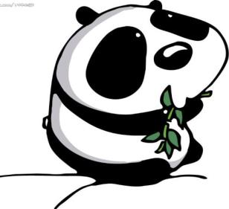
5. And by 2050, the world’s population may reach 9 billion.
by 2025 意为“到2025年为止”。
by在这里意为“到……为止”。
例:Will you finish it by 10:00 p.m.?
晚上十点前你能完成它吗？

Slide 25

6. We can’t live in water, and only about one third of our planet is land.
one third是分数，意思是“三分之一”。
分数表达法：
①分子用基数词，分母用序数词；当分子大于1的时候，分母使用复数形式。
例：one fifth 五分之一；one fourth 四分之一；three eighths 八分之三。

Slide 26
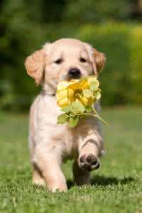
②特殊表达法。
如：a half 二分之一；a quarter 四分之一；three quarters 四分之三。
注意：当分数在句中作主语的时候，若后面的名词是复数，则谓语动词用复数；若后面的名词是单数或不可数名词，则谓语动词用单数。

Slide 27
中考链接
Nowadays，________of the old people in the area ________ used to dancing on the square after supper. (湖北恩施州中考)
A．two third；is B．two thirds；is C．two thirds；are
C
解析 考查分数的用法和主谓一致。
句意：如今这个地区三分之二的老年人已经习惯于晚饭后在广场上跳舞。
分数的表达法为：分子用基数词，分母用序数词；当分子大于1时，分母要用复数，排除A。当分数作主语时，其后的谓语动词与分数后面的名词保持一致。people是复数名词，故用are。
解题方法 语法判定法

Slide 28
7. Antarctica is covered with snow and ice all year round.
(1) be covered with 被……覆盖。
其主动结构为：cover…with…(用……盖住……)
例：Our garden is covered with grass and flowers.
我们的花园被花草覆盖着。
Please cover this desk with cloth.
请用布盖住这张课桌。
(2) all (the) year round 全年，整年。

Slide 29
它相当于all over the year。
例：Drunk driving is a problem all year round.
酒后驾车是个常年存在的问题。
8. The earth is our home now，and it will be our home in the future.
辨析 in the future与in future
① in the future 将来，未来。它所表示的将来是指以后的将来，并不强调从说话的这一刻开始。

Slide 30
② in future 今后。它强调从说话时开始的以后，相当于from now on。
9. It has the highest point on the earth in the Himalayas.
该句运用了形容词的最高级结构。
定义：表示三者或三者以上的人或物进行比较时，用最高级。
形容词的最高级前面要加定冠词the，副词最高级前面的the可以省略。

Slide 31

在含有最高级的句子中，常有一个in/of短语来表示比较范围。
例: I am the tallest in our class.
我是我们班里个子最高的。
My movements are the most graceful of us three.
三个人中我的动作是最优雅的。

Slide 32
Grammar
被动语态
被动语态表示主语是谓语动作的承受
者，一般说来，当强调动作承受者，不必说出执行者或执行者含糊不清时，多用被动语态。

Slide 33
1. These dry places are called deserts.
2. Antarctica is covered with snow and ice all year round.
3. It must be treated well for our children and for our children’s children, too!
4. It’s pronounced like the letter “A”.

Slide 34

被动语态——构成
be + 过去分词（ be随着主语人称和数以及时态的不同而变化）
can / must / may / should … + be + 过去分词（含有情态动词的被动语态）

Slide 35
一般现在时、一般过去时和一般将来时的主动结构和被动结构 (以动词do为例)
时态 | 主动语态 | 被动语态
一般现在时 | do / does | am / is / are + done
一般过去时 | did | was / were + done
一般将来时 | will / be going to + do | will / be going to + be + done

Slide 36

主动语态变为被动语态
一般现在时：
主：We believe him.
被：He is believed by us.
一般过去时：
主：He bought his children some pens.
被：Some pens were bought for his children by him.
一般将来时：
主：Everyone will know the truth soon .
被：The truth will be known by everyone.

Slide 37
学以致用
将下列主动句变为被动句：
1. 人们认为他很有才华。
主动: People regard him as brilliant.
被动:
2.孩子们热烈地欢迎外宾。
主动: The children gave the foreign guests a warm welcome.
被动：
3. 他们将问你许多怪题。
主动: They will ask you a lot of strange questions.
被动:
He is regarded as brilliant by people.
The foreign guests were given a warm welcome by the children.
You will be asked a lot of strange questions by them.

Slide 38

Exercises
一、单项选择
1. We have a lovely room. It’s one of ____ in the hotel.
A. nice B. nicer
C. nicest D. the nicest
____ of the students are from the countryside.
A. Third quarter B. Three quarters
C. Three quarter D. Third quarters

Slide 39
3. —Who has ____ marks in English, Wang Lin, Zhang Fang or Li Hong?
—Li Hong．
A. good B. better C. best D. the best
4. Hong Kong _____ to be a good place for eating today.
A. knows B. knew
C. is known D. was known

Slide 40
5. Nick _______ a job in a bank, but to our surprise, he didn’t take it.
A. offered B. has offered
C. was offered D. offers
6. — Have you heard of Earth Day?
— Yes. The first Earth Day _______ in 1970 to educate us to protect our planet.
A. celebrates B. celebrated
C. is celebrated D. was celebrated

Slide 41
7. More money ________ when we use both sides of paper.
A. will save B. was saved
C. has saved D. will be saved
8. A new club ________ in our school at the beginning of this year and now it has many members.
A. starts B. is started
C. has started D. was started

Slide 42
9. — Our classroom ________ every day.
— So it is. It’s our duty to keep it clean and tidy.
A. cleans B. is cleaning
C. is cleaned D. has been cleaned
10. — Sixteen-year-olds ________ to drive in China.
— But in America, they can.
A. is allowed B. is not allowed
C. are allowed D. are not allowed

Slide 43
二、根据首字母及汉语提示完成句子
The number of tourists has i________ greatly in recent years.
The s______ of the lake is quite still.
The film will be over _____ 9:30.
They claimed to have discovered a new p_____.
_____ _____ _____ (四分之一) the students have left their pictures home.
ncreased
urface
by
lanet
A quarter of

Slide 44
6. The plan would save _________(数十亿) dollars in fuels each year.
7. ________ (总共), 98% of all computer users are now online.
8. The sea covers almost _______ _______ (四分之三) of the earth's surface.
9. The Nile River is the _______ river in Africa.
10. Antarctica is the world’s _____ (最干旱的) continent.
billions of
In total
three fourths
longest
driest

Slide 45
Summary
1. Learn some new words and expressions.
2. Review the present perfect tense
3. Master the passive voice.

Slide 46
Homework
1. Recite the words and phrases in this lesson.
2. Complete the related exercises.
3. Preview next lesson

