Slide 1
Unit 4 Topic 1
Which do you like better, plants or animals?
Section D
WWW.PPT818.COM

Slide 2
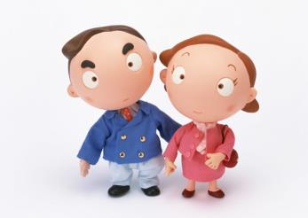
What kind of animal do you like better ?
I like …

Slide 3
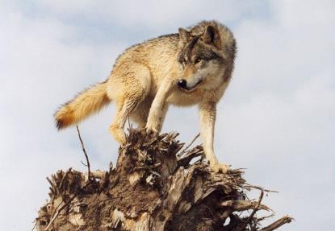
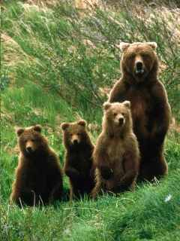
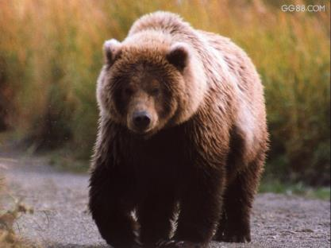
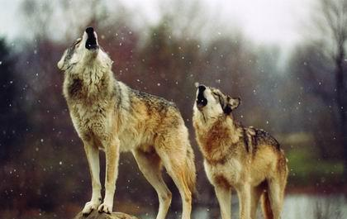
bear n. 熊 v. 承受，负担；忍受；容忍
wolf n. 狼
three wolves

Slide 4
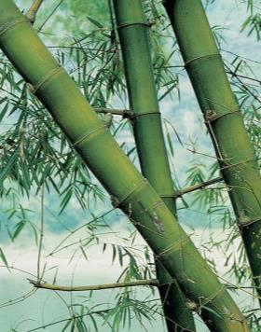
Which animal lives only in China?
Pandas.
What do they feed on?
Bamboo.
They are the ______________ of the animals. (lovely)
the most lovely

Slide 5
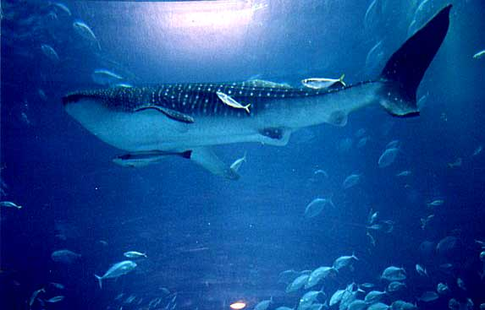
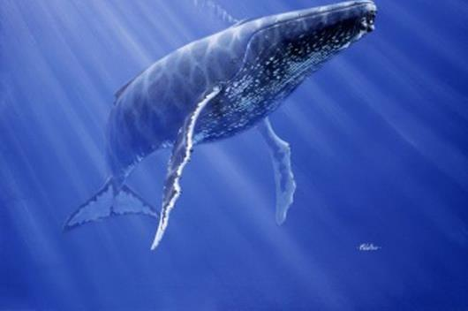
whale
blue whale
Where do they live?
What do they feed on?
the smallest sea animals
ocean n.海洋

Slide 6
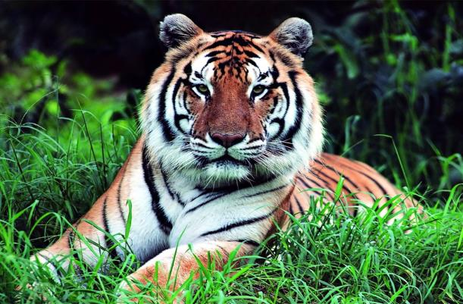
Chinese tiger 中国虎
They feed on small animals.
以……为食

Slide 7
Listen to 1 and complete the table on Page 88.
1
Animal | What they feed on | Where they live | Why they are in danger
 |  |  | They have less and less land to live on.
blue whales
Chinese tigers |  | in the south of China
pandas
bamboo
in Southwest China
smallest
sea animals
Some people kill them and make the ocean water dirtier.
in the ocean
small animals
Some people kill them for their fur and bones.

Slide 8
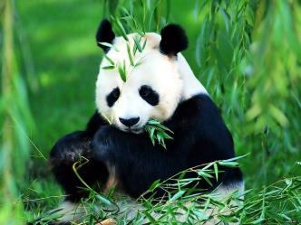
Read Paragraph 1 and fill in the blanks.
Pandas live in the _______ and __________ of Southwest China. They ______ _______ bamboo. But now they have ______ ____ ______ land to live on. So pandas are becoming _______ in number.
forests
mountains
feed on
less and less
fewer

Slide 9
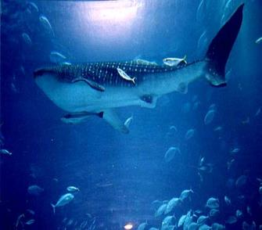
Read Paragraph 2 and fill in the blanks.
The __________ animals in the world are not elephants. They are blue whales. They are the _______ but they feed on the smallest sea animals. Now they are __ _______ because some people make their _______ ______ dirty and others _______ whales for their meat.
heaviest
largest
in danger
ocean home
kill

Slide 10
Read Paragraph 3 and fill in the blanks.
Chinese tigers live in the _______ of China. They are also ______ _______ now. they are the ______ _______ ___ tigers in the world and they eat small animals. Some people kill tigers for their ______ and ________.
south
in danger
oldest
type of
fur
bones

Slide 11
Key points
Pandas live in the forests and
mountains of Southwest China.
= the southwest of China 中国西南部

Slide 12
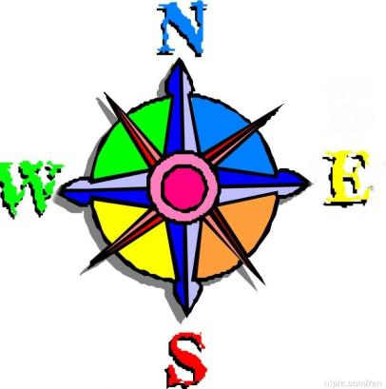
north
northwest
northeast
west
east
southwest
southeast
south

Slide 13
处于危险状态
2. Now they are in danger because some humans kill whales and make the ocean water dirtier.

Slide 14
3 . They are the oldest type of tigers
living in the world.
后置定语
Eg. 你认识正在和我们英语老师谈话的那个男孩吗？
Do you know the boy talking to our English teacher?

Slide 15
Test your memory
Watch the flash and answer the questions as quickly as you can.
Where do blue whales live?
What do they feed on?
Where do Chinese tigers live?
What do they feed on?
They live in the ocean.
They feed on the smallest sea animals.
They live in the south of China.
They feed on small animals.

Slide 16
Find out why they are in danger.
pandas __________________________________
blue whales
____________________________
Chinese tigers ___________________________________
They have less and less land to live on.
Some humans kill them and make the ocean water dirty.
Some people kill them for their fur and bones.

Slide 17
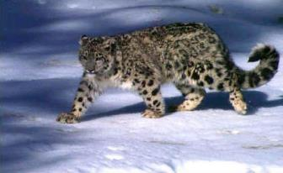
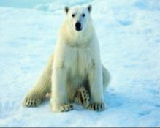
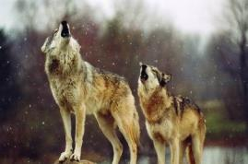
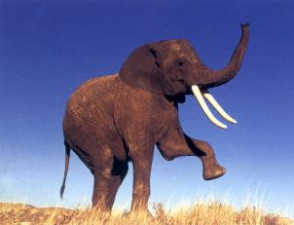
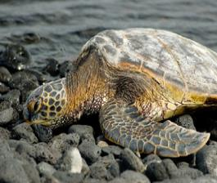
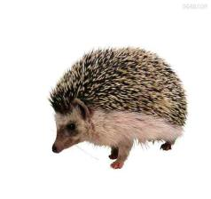
Task
There are many other wild animals in danger, such as bears and wolves. Can you think of some more ?
What should we do to protect them ?

Slide 18
2
Write a passage about an animal. The following questions may help you.
What is the animal?
Where does it live?
What does it feed on?
What are the features of it?
Do you like it? Why?
When you describe something, and compare it with other things, you may use comparative or superlative forms.

Slide 19
Grammar
Comparative and superlative degrees of adjectives (Ⅰ)
The air is _______, the sky is ______ and the rivers are _______ there.
I think the countryside is _____________ the city, too.
I think the sheep are the _______ of all.
The pigs must be the _______ and _______ animals on the farm.
What’s the strongest animals on the farm ?
But now, rainforests are becoming _________________ .
fresher
bluer
clearer
quieter than
nicest
fattest laziest
smaller and smaller

Slide 20
Functions
_______ do you like ________ , plants or animals ? I like animals ________.
________ do you think so ? Because animals are our friends. They ________ us happy.
We ________ the same world _______ them.
People can enjoy the __________ of nature there.
Which
better
better
Why
make
share
with
beauties

Slide 21
Project
Saving the Animals in Danger
Collect information about animals in danger and
complete the table.
Animal | Where they live | What they eat | Why in danger | How to protect

Slide 22
2. Present your information, including the
reasons why the animals are in danger,
to your group.
3. Discuss what you should do to protect
them ?
4. Report the result to the class.

Slide 23
Homework
Write a passage with the title “The
World in My Eyes”.

