Slide 1
Unit 7
It’s raining!
Section B 第2课时
WWW.PPT818.COM

Slide 2
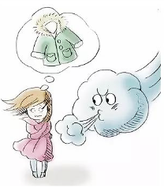
Lead-in
Guessing
How’s the weather?
It’s windy and cold.

Slide 3
How’s the weather?
It’s raining.

Slide 4
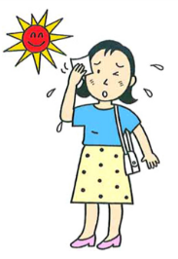
How’s the weather?
It’s sunny and hot.

Slide 5
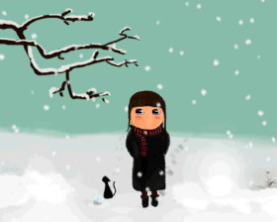
How’s the weather?
It’s snowy and cold.

Slide 6
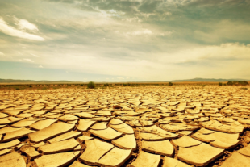
How’s the weather?
It’s dry.

Slide 7
How’s the weather?
It’s sunny and warm.

Slide 8
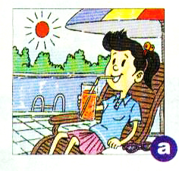
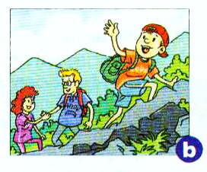
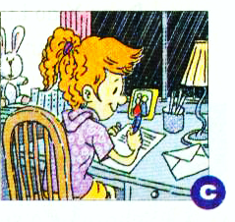
Talk about the pictures below with a partner. How’s the weather? What are the people doing?
2a

Slide 9
How’s the weather?
___________________________
What is she doing?
___________________________
It’s sunny and warm.
She’s drinking by the pool.

Slide 10
How’s the weather?
___________________________
What are they doing?
___________________________
It’s cool and cloudy.
They are climbing the mountains.

Slide 11
How’s the weather?
___________________________
What is she doing?
___________________________
It is raining.
She is writing a letter.

Slide 12
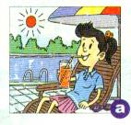
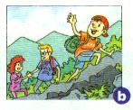
Match each postcard below with the correct picture in 2a.
2b
Dear Jane.
How’s it going? I’m having
a great time …
Su Lin
To
Jane
Dear Jane.
How’s your summer…
I’m having a …
Dave
To
Jane

Slide 13
Read the first postcard in 2b again and answer the questions.
Where is Su Lin now?
______________________
2. What is Su Lin studying there?
_______________________
She’s in Canada.
She’s studying English.

Slide 14
3. Is she visiting some of his old friends there?
_________________________________
4. What’s she doing right now? _________________________________
_________________________________
5. How’s the weather there?
_________________________
Yes, she is.
She’s sitting by the pool and drinking orange juice.
It’s warm and sunny.

Slide 15
Read the second postcard in 2b again and answer the questions.
1. Where is Dave now?
_____________________
2. What are Dave and his family doing there?
_______________________________________
He’s in Europe.
They are having a vacation in the mountains.

Slide 16
3. Are they having a good time?
________________________________
4. How’s the weather there?
________________________________
5. How’s the weather in Jane’s country?
________________________________
Yes, they are.
It’s cool and cloudy.
It’s hot.

Slide 17
Dear Jane,
How's it going? I'm having a great time visiting my aunt in Canada. She's working here and I'm going to summer school. I'm studying English and I'm learning a lot. I'm also visiting some of my old friends. I'm so happy to see them again. It's afternoon right now, and I'm sitting by the pool and drinking orange juice. It's warm and sunny, and it's very relaxing here.
See you soon.
Su Lin

Slide 18
Dear Jane,
How's your summer vacation going? Are you studying hard, or are you having fun? I'm having a great time in Europe! My family and I are on a vacation in the mountains. I want to call you but my phone isn't working, so I'm writing to you. It's hot in your country now, isn't it? The weather here is cool and cloudy, just right for walking.
See you next month.
Dave

Slide 19
Fill in the chart with information from the postcards in 2b.
2c
Name | Where are they? | How’s the weather? | What are they doing?
sitting by the pool and drinking orange juice
warm and sunny
Su Lin
Canada
cool and cloudy
writing letters
Dave
Europe

Slide 20
Language points
1. I'm having a great time visiting my aunt in
Canada. 我正在加拿大看望我的姑妈并且玩得很开心。
have a great/good time (in) doing sth.
表示“愉快地做某事”, 相当于have fun (in) doing sth.
例：我们很高兴地帮助那些老人。
We have a great time (in) helping the old people.

Slide 21
2. I'm studying English and I'm learning a lot.
我正在学习英语，而且我学了很多。
a lot在此作副词短语，在句中作程度状语，表示“很；非常；常常”，用来修饰动词。
例：他感觉好多了。
He is feeling a lot.

Slide 22
【拓展】
a lot of = lots of,可修饰可数或不可数名词，意为“许多，大量的”，相当于many或much。
a lot, a lot of, lots of通常用于肯定句，否定句中一般用many或much。

Slide 23
3. I'm sitting by the pool and drinking orange juice.
我正坐在游泳池边喝着橙汁。
by介词, 此处意为“在……旁边”, 相当于by the side of。
常用短语：by oneself 独自地
by the way顺便说一下，顺便问一下
例：路边有一个食物店。
There is a food shop by the road.

Slide 24
(1)by表示“用某种方法”或“用某种手段”。
例：他以乞讨为生。
He makes a living by begging.
(2)by表示时间，意为“在……之前”。
例：我们能在5点前回家。
We can go home by 5：00.

Slide 25
(3)“by+交通工具名词(by后不加冠词)” ，表示
“乘坐”。
例：我通常骑自行车去上学。
I usually go to school by bike.

Slide 26
4. My family and I are on a vacation in the
mountains. 我和我的家人正在山里度假。
on副词，表示“在进行中”。
其常用短语有：
on sale（特价）出售；
on show正在展览；
on duty正在值班。

Slide 27
5. I want to call you but my phone isn’t working,
so I'm writing to you. 我想给你打电话，但电话坏
了，所以我就给你写明信片了。
call sb.意为“给某人打电话”，call此处作动词，call sb. at…意为“拨打……号码找某人”
例：抱歉这么晚打电话给你。
Sorry to call you so late.

Slide 28
write to sb.意为“给某人写信”，
其反义短语为hear from sb.或get a letter from sb.，意为“收到某人的来信”。
例：他每周都给我写信。
He writes to me every week.

Slide 29
6. It's hot in your country now, isn't it?
你们国家现在很热，对吗？
本句是一个反意疑问句，提出看法，问对方同意与否。
这种问句由两部分组成，前一部分为陈述形式，后一部分为简短问句。如果前一部分为肯定形式，后一部分通常用否定形式。
后一部分的主谓与前一部分的主谓在人称、时态和数上要保持一致。

Slide 30
例：你是一个学生，不是吗？
You are a student, aren't you?
例：你妈妈今天不去上班，是吗？
Your mother doesn't go to work today, does she?

Slide 31
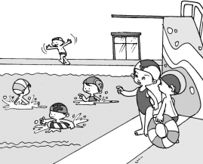
Exercise
1. A: Where are Bob and Tom?
B: They’re ___ the _____.
A: What do they want to do?
B: They want to _____ ___ the lake.
by lake
swim in

Slide 32
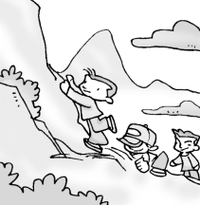
2. A: How’s it going, Jack?
B: Not bad. We’re __________ a
vacation ___ ____ __________.
A: How’s the ________?
B: It’s ______ and ____, just right for walking.
on/having
in the mountains
weather
cloudy cool

