Slide 1
What a day!
Unit2
WWW.PPT818.COM

Slide 2
>>Warm-up
Sing a song
………………....
(单击图片播放动画）

Slide 3
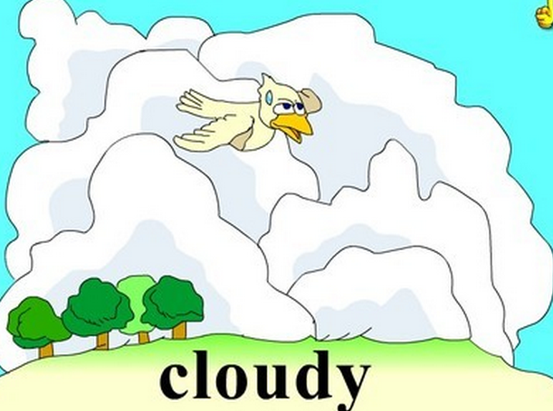
>>Presentation
Look and say
…..…………….....

Slide 4
>>Presentation
Look and say
…..…………….....
rainy

Slide 5
>>Presentation
Look and say
…..…………….....
sunny

Slide 6
>>Presentation
Look and say
…..…………….....

Slide 7
>>Presentation
Look and say
……..………..…....
Where are the children?
They are in the park.
What are they doing in the park?
They’re riding a bike.

Slide 8
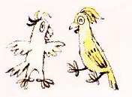
>>Presentation
Look and say
…………..……….
There was a parrot show in the park.

Slide 9
>>Presentation
Look and say
…………..……….
We flew kites high in the sky.

Slide 10
>>Presentation
Let’s learn
……...……….
Sunday, 20th September
……...…………………….
It was sunny in the morning. Su Hai, Mike, Liu Tao and I went to the park by bike.
There was a parrot show in the park.
We saw some interesting parrots.
Then, the weather became windy and cloudy. We flew kites high in the sky.
……...……………………………………………...
……...……………………………………………...
……...………………………………………….......
……………………………………………………..
……...……………………………………………...
……...………………………………………….…..

Slide 11
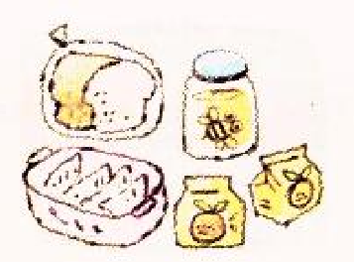
>>Presentation
Let’s learn
………………….
It was time for lunch. We brought
some dumplings, some bread and
honey and some drinks.
We saw some ants on the bread
and honey. There were some bees
too. We could not eat our lunch!
……...……………………………….……...
……...……………………………….……...
……...……………………………….……...
……...……………………………….……...
……...……………………………….……...
……...……………………………….……...

Slide 12
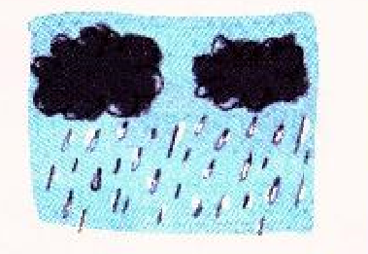
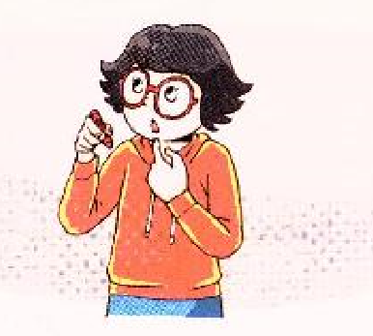
>>Presentation
Let’s learn
………………….
In the afternoon, there were black
clouds in the sky. It rained. We were hungry and wet.
What a day!
……...……………………………….……...
……...……………………………….……...
……...……………………………….……...
……...……………………………….……...

Slide 13
>>Presentation
Let’s learn
………………….
is
was
buy
brought
go
went
are
were
see
saw
become
became
flow
flew
rain
rained
can
could

Slide 14
>>Practice
Read and order
…………………..…….
Key: c a f d e g b
a They saw some interesting parrots in the park.
b They were hungry and wet.
c The children went to the park by bike.
d They flew kites in the park.
e They saw ants and bees on their lunch.
f The weather became windy and cloudy.
答案
g It rained.

Slide 15
>>Practice
True or false
………………….
F
1
It rained all day on 20th September.
2
T
The children saw a parrot show.
T
3
They flew kites in the park.
T
4
They brought lunch to the park.
5
T
They were hungry because they did
not have lunch.
答案

Slide 16
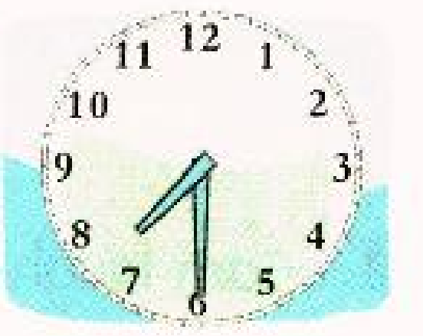
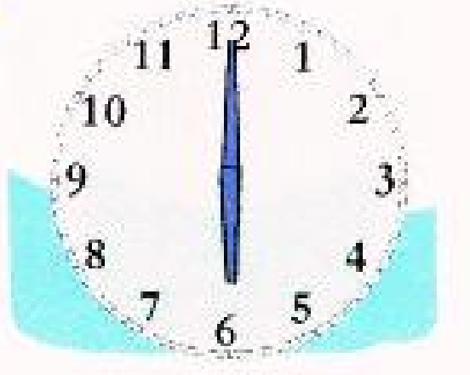
>>Practice
Listen and choose
………………..………….
1
b
It was ____ on Monday morning.
a
b
c
c
2
It got up at _____.
a
b
c
答案

Slide 17
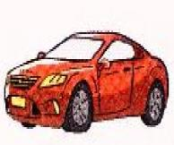
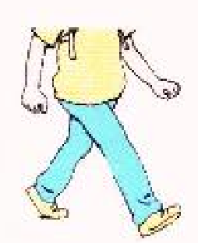
>>Practice
Listen and choose
………………..………….
a
3
It went to school ____.
a
b
c
4
a
It could not find my ____.
a
b
c
答案

Slide 18
>>Practice
Think and write
……….……………...
What did you do with your family or friends last Sunday? Write about it in your diary.
went swimming
watched a film
had a picnic
did the housework

Slide 19
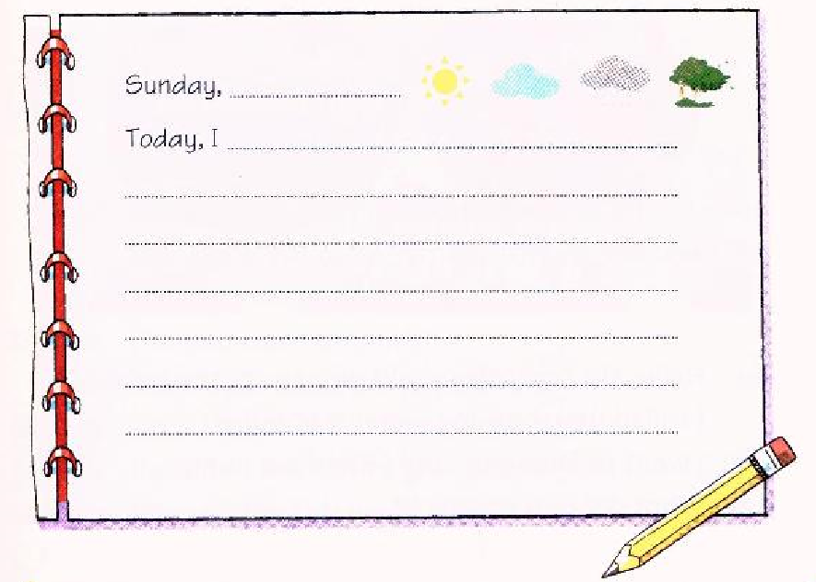
>>Practice
Think and write
……….……………...

Slide 20
>>Summary
sunny
windy
cloudy
rainy
saw
became
flew
brought
were
could
rained
It was ….
We saw ….
There was ….
We brought ….
There were ….

Slide 21
>>Homework
1. 写一篇小日记，记录自己上周末都做了什么活动，并注意一般过去式的运用。
close

