Slide 1
Unit 5
Animals in danger
WWW.PPT818.COM

Slide 2
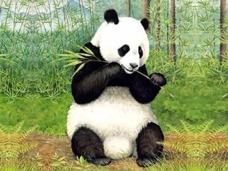
panda
In the past, there were many pandas, but now there are only about one thousand six hundred pandas in the wild.

Slide 3
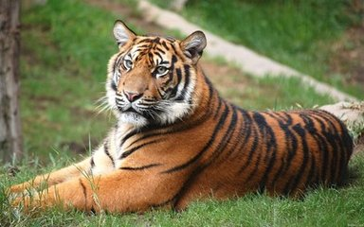
tiger
In the past, there were many south china tigers, but now there are only about thirty in the wild.

Slide 4
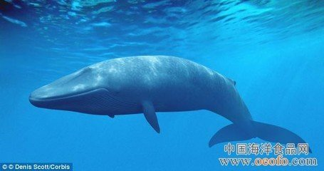
blue whale
In the past, there were many blue whales, but now there are only about ten thousand in the wild.

Slide 5
hundred，thousand
（1）与具体数字连用时，习惯上用单数，而且也不后接介词of。
He was prepared to pay two million. 他愿意支付200万。
More than a hundred people were injured. 有一百多人受了伤。
（2） 表示不确定的泛指数时，则要用复数，而且要后接介词of，然后才能接名词。如：
The sun was shining. Thousands of people were lying on the beach. 阳光灿烂，数以千计的人躺在海滩上。

Slide 6
there is/are 表示客观存在
have/has 表示主观拥有
1.在there be 句型中，主语是单数，be 动词用is . 主语是复数，be 动词用are 。
2.there be 句型的否定句在be 动词后加not , 一般疑问句把be 动词调到句首.
3.针对数量提问的特殊疑问句的基本结构是： How many + 名词复数 + are there + 介词短语？ How much + 不可数名词 + is there + 介词短语？

Slide 7
there
there 是个近视眼，be动词的变化，取决于最近的名词。

Slide 8
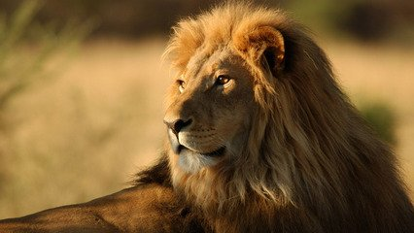
lion

Slide 9
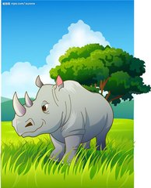
rhino

Slide 10
Joy and Elsa

Slide 11
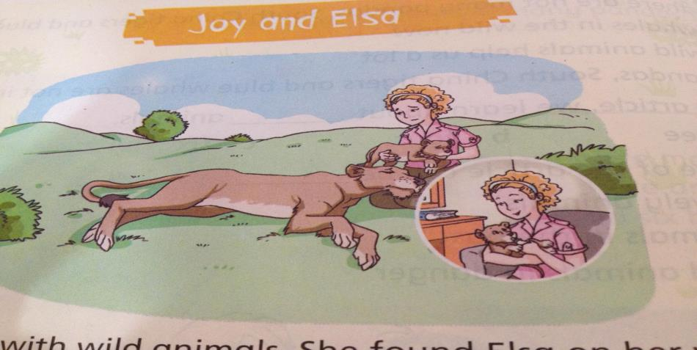
Joy worked with wild animals. She found Elsa on her way home. Elsa's mothr died, so Joy took care of her.

Slide 12
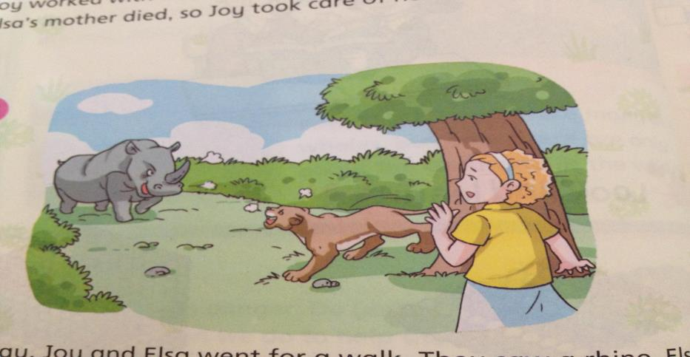
One day,Joy and Elsa went for a walk. They saw a rhino. Elsa drove away the rhino and saved Joy.

Slide 13
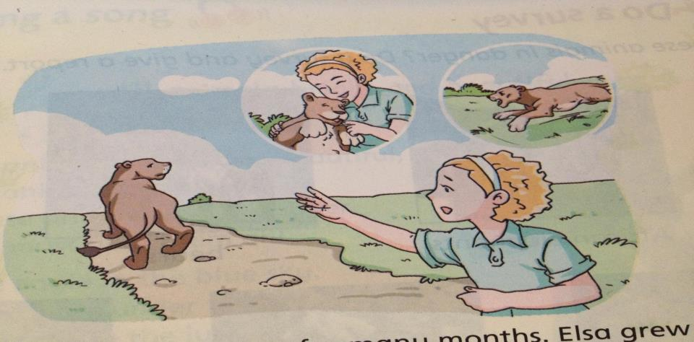
Joy and Elsa lived together foy many months. Elsa grew up and learned a lot. Then Joy sent her back to the wild.

Slide 14
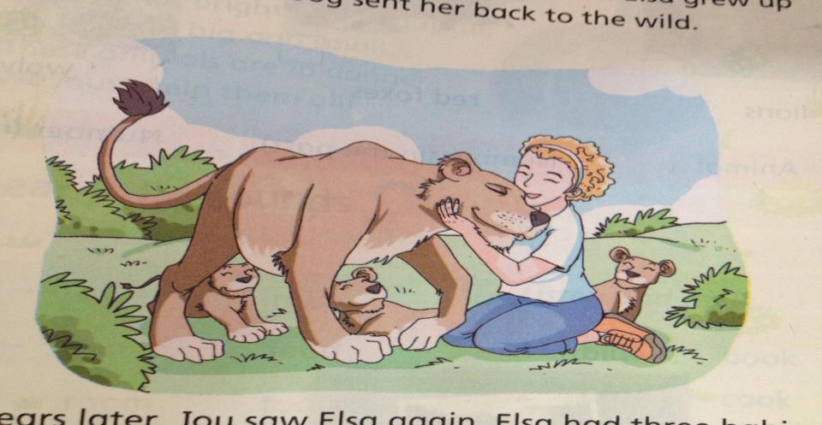
Three years later, Joy saw Elsa again. Elsa had three babies. Joy was very happy to see her.

