Slide 1
Unit 4 Body
I Have two eyes
WWW.PPT818.COM

Slide 2
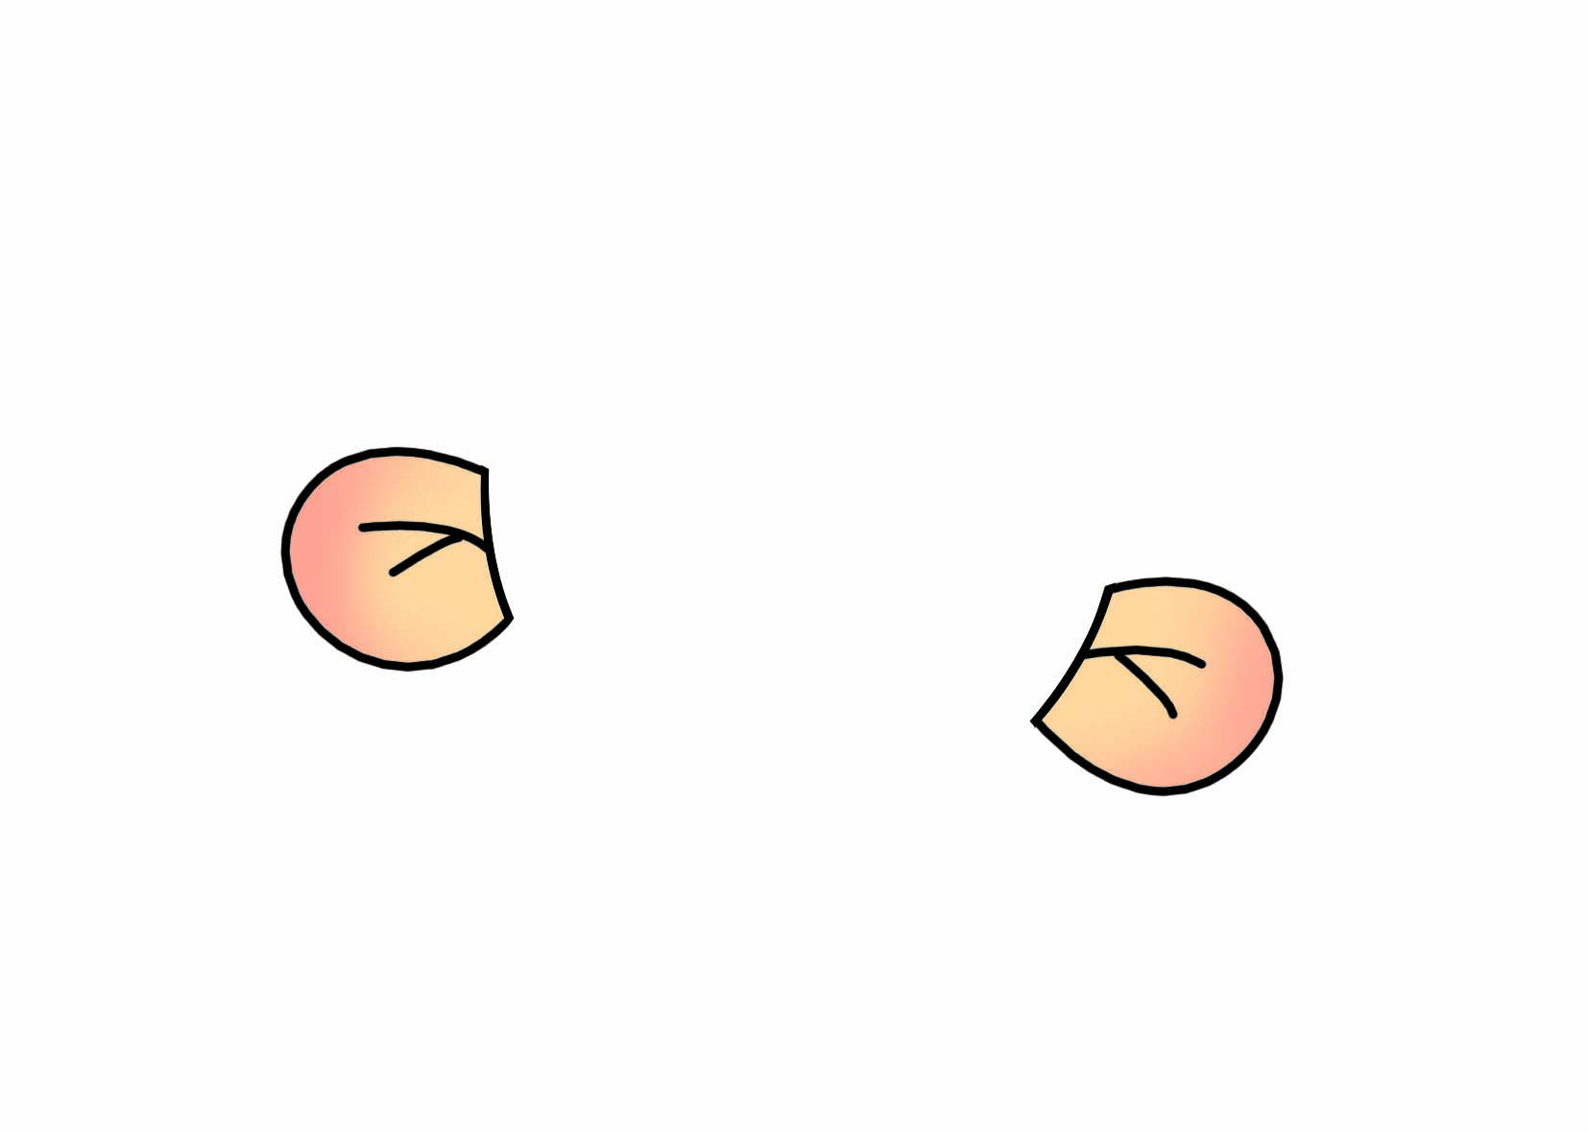
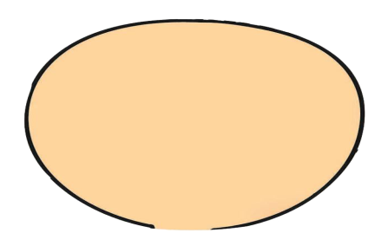
ear
Look! This is my ear.
I have two ears.

Slide 3
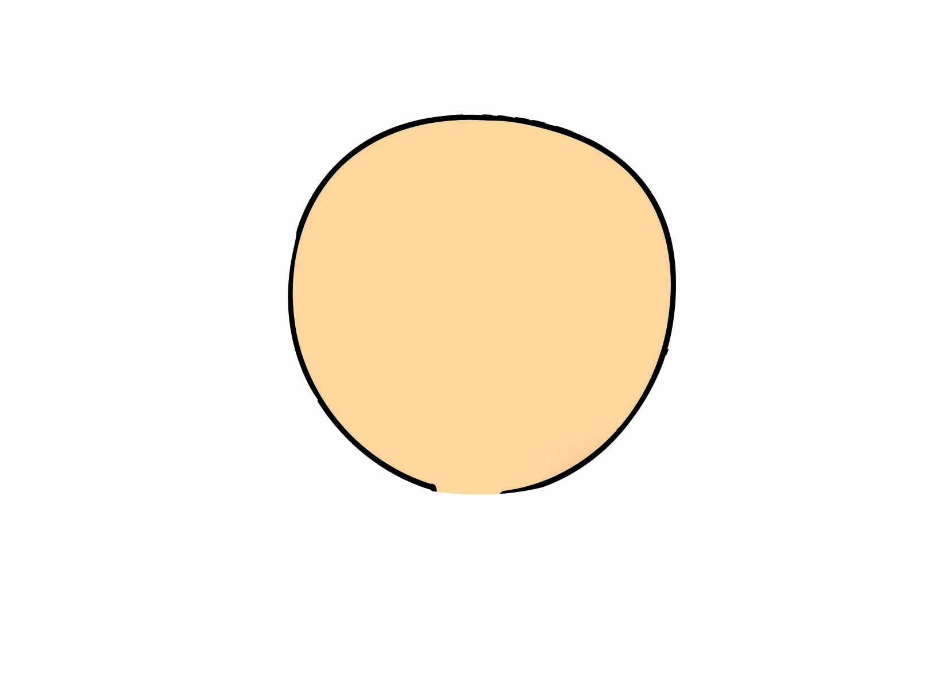
eye
Look! This is my eye.
I have two eyes.

Slide 4
This is my________.
hand
hand

Slide 5
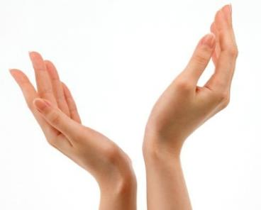
I have two______.
hands
hands

Slide 6
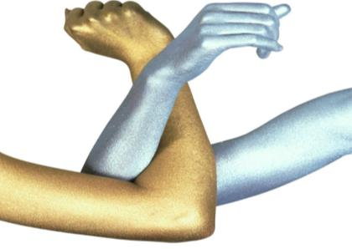
This is my_____. I have two_____.
arm
arms
arms

Slide 7
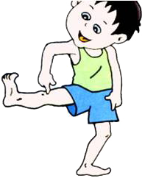
leg
This is my .
leg
legs
I have two .

Slide 8
Let’s talk.
同桌之间用
This is my .
I have two______.
来介绍自己的身体部位。

Slide 9
What’s missing?

Slide 10
What’s missing?

Slide 11
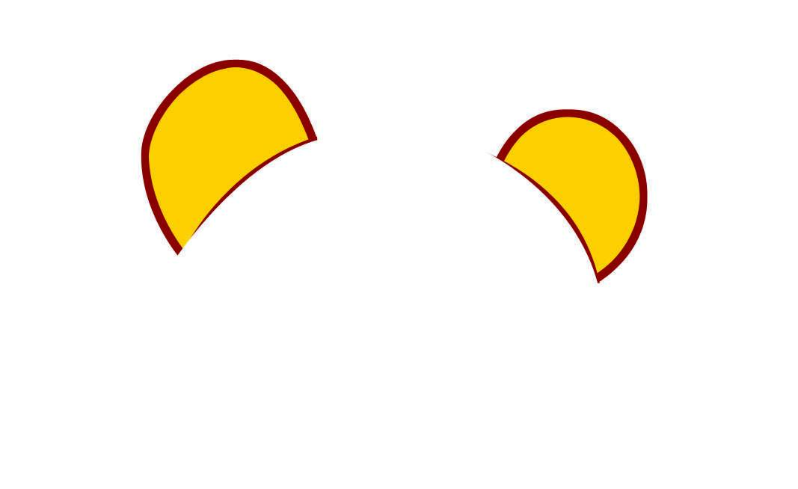
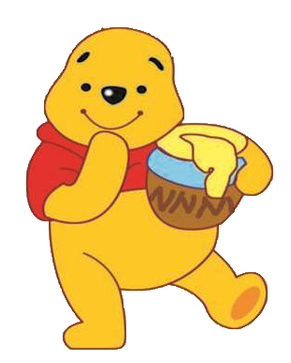
What’s missing?

Slide 12
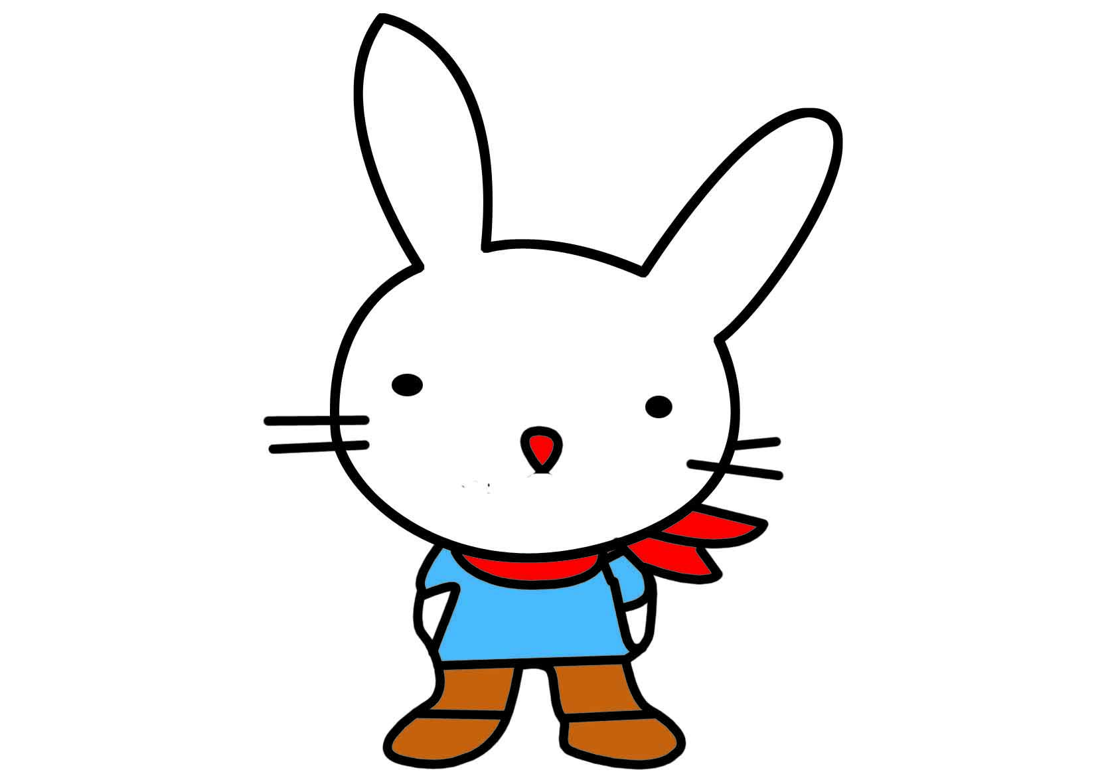
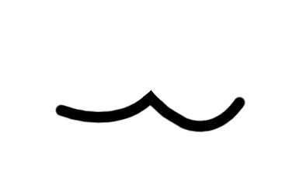
What’s missing?

Slide 13
What’s missing?

Slide 14
Touch and say.
This is my .
I have a/ two .

Slide 15
f
g
e

Slide 16
Homework
爱护五官,讲究卫生。
书本P30听读3遍。
和会说英语的同学练习本课单词及句型。

